Slide 1
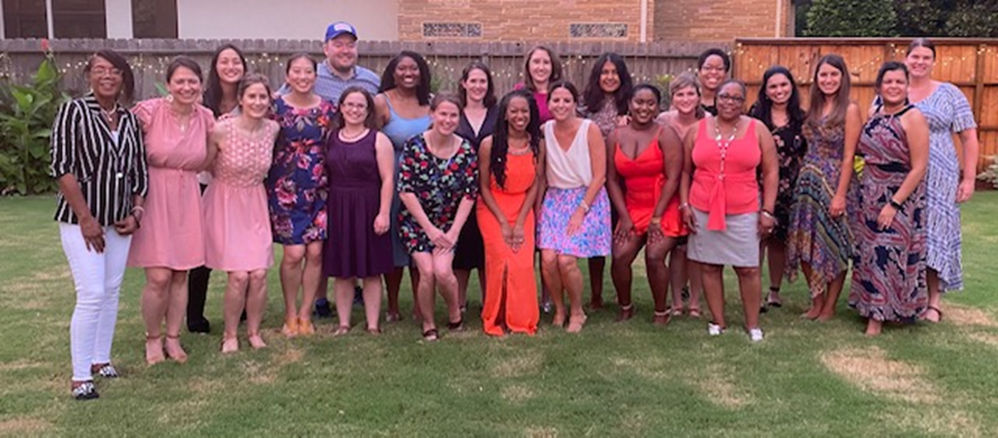


Pediatric Emergency Medicine Fellowship Overview 2022
Kim Little-Wienert, MD, MEd
Marideth Rus, MD, MEd
Elizabeth (Liz) Moran, MD, MEd

Slide 2
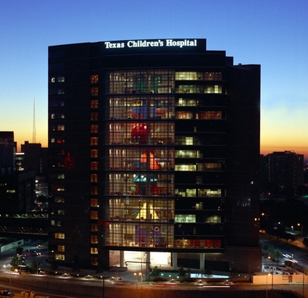
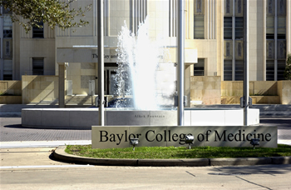
Welcome to Texas!
Notes:
Texas Children's Hospital 491-beds
21,661 admissions 2012
8,504 annual inpatient surgeries
14,840 outpatient surgeries.

Slide 3
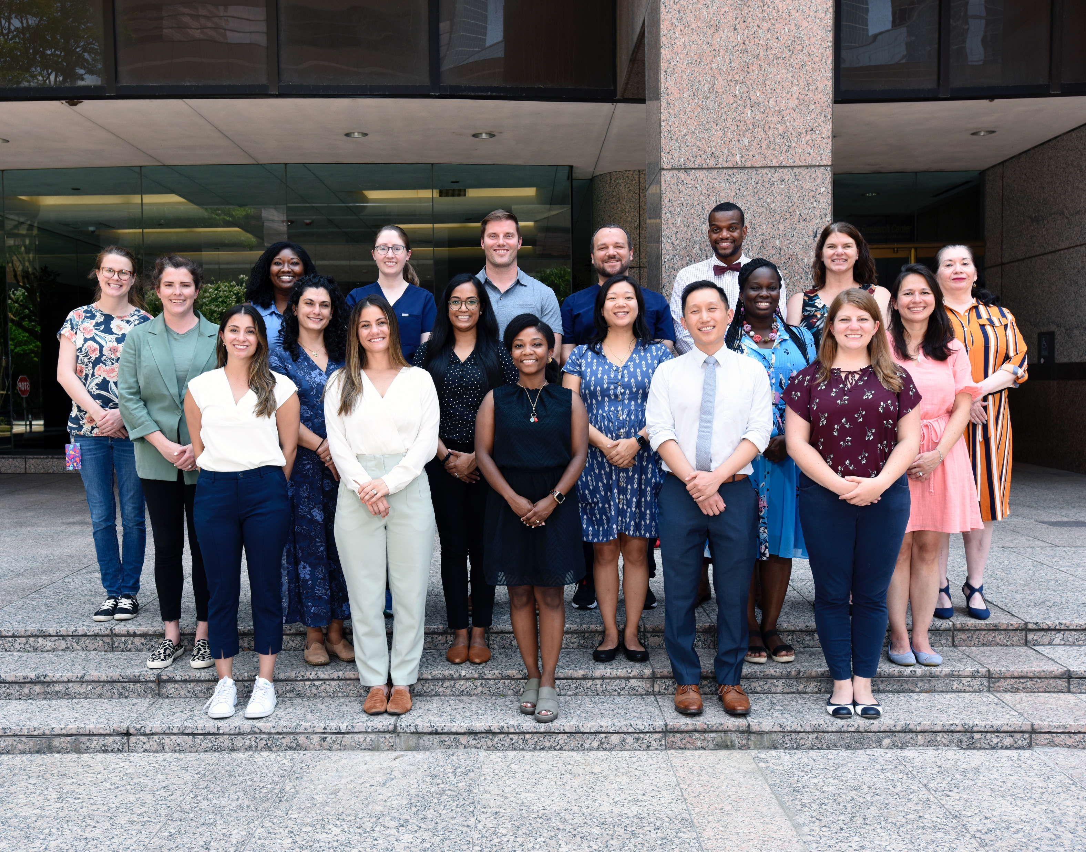
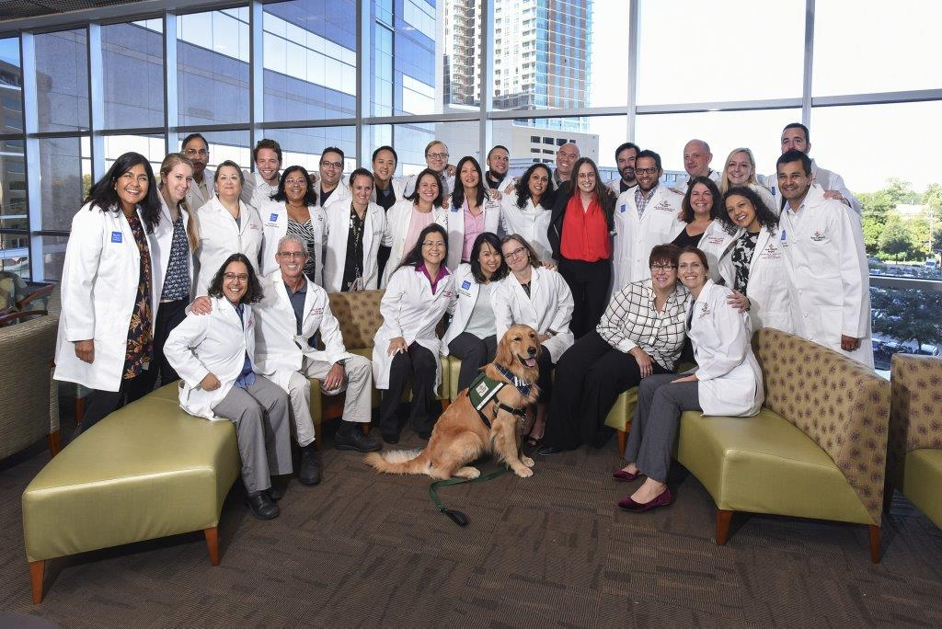
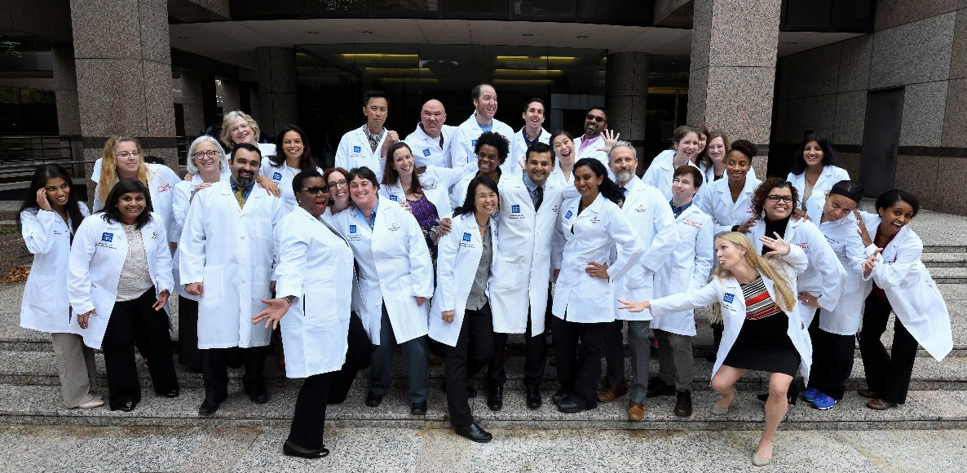
PEM Fellows 2022-2023
2021
Notes:
Texas Children's Hospital 491-beds
21,661 admissions 2012
8,504 annual inpatient surgeries
14,840 outpatient surgeries.

Slide 4
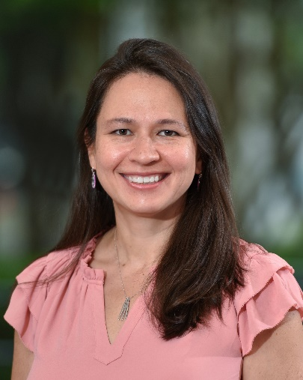
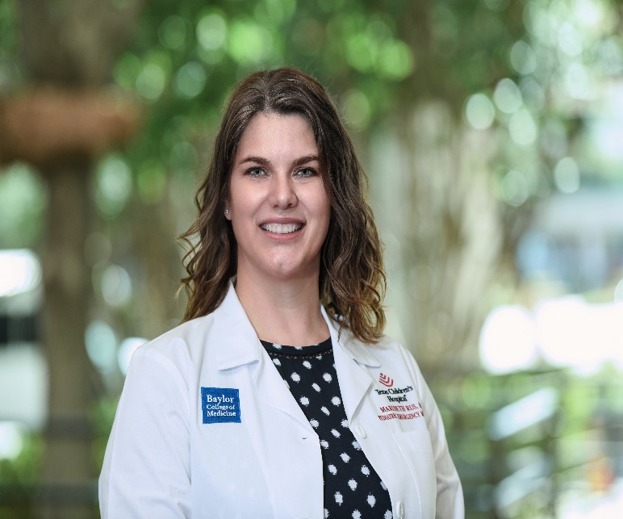
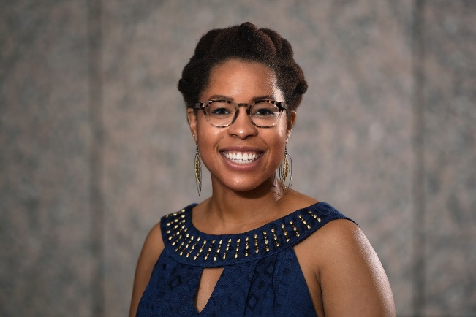
Pediatric Emergency Medicine Fellowship Program
Kim Little-Wienert, MD, MEd
Program Director
Marideth Rus, MD, MEd
PEM- GH Combined Fellowship Director
Associate Program Director
Elizabeth Moran, MD, MEd
Assistant Program Director
Notes:
Different motif, more science
Text
Text
Text

Slide 5
PEM at Baylor and Texas Children’s
Fellowship began in 1992
120 fellowship graduates across the country
Currently 18 fellows
EM and pediatrics trained
2021-Received 174 applications for 6 positions
51 PEM faculty, 6 POCUS faculty, GEMS, APPS

Slide 6
Texas Children’s Hospital
Main Campus
750-bed children's hospital
Legacy Tower
Feigin Center for Pediatric Research
Pavilion for Women
Comprehensive obstetrics/gynecology facility focusing on high-risk births, fetal surgery
West Campus
Community hospital in suburban West Houston
The Woodlands
Community hospital in suburban North Houston
9,053 annual inpatient and 16,216 outpatient surgeries
Critical care and surgical tower constructed in 2018
25,966 admissions in the most recent year

Slide 7
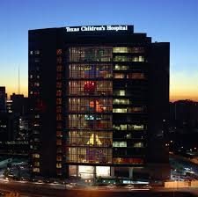
Texas Children’s - Main Campus
Main Fellowship Training Site
Emergency Center
Level 1 pediatric trauma center
50+ beds (North, South)
Legacy Tower
Largest pediatric emergency center in the region
High Acuity Operating Rooms
6 ORs for neurosurgery, orthopedics, plastic, transplant, general surgery
Integrated MRI scanner
Pediatric Intensive Care Units
4 Pediatric ICU floors
Subspecialty PICUs including dedicated neuro-ICU and Surgical ICU
84 large private PICU rooms
Heart Center
8 floors
4 cardiac catheterization labs including integrated MRI scanner
4 cardiovascular ORs
3 cardiovascular ICU floors with 48 private rooms
2 cardiac acute care floors with 42 private patient rooms
Helistop
Enables transport of critically ill patients

Slide 8
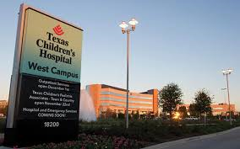
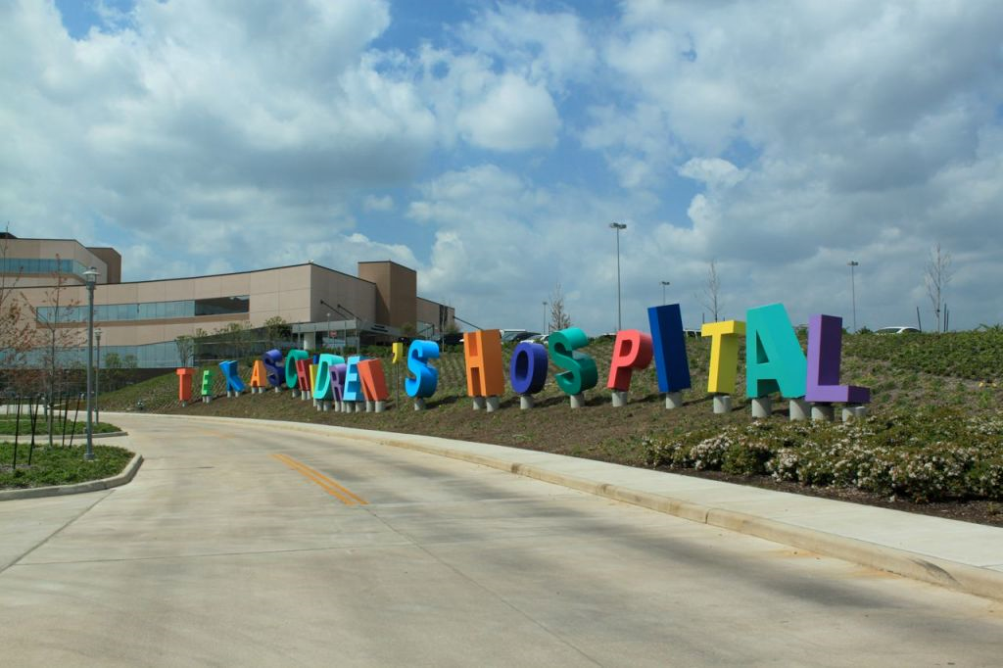
Texas Children’s – West Campus
Community Training Site
Emergency Center
24 beds
Pediatric Intensive Care Unit
22 beds
Inpatient
46 beds

Slide 9
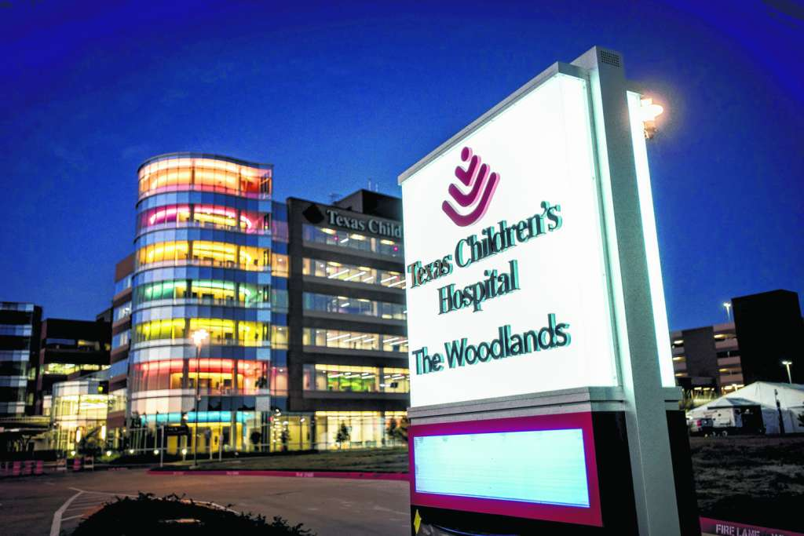
Texas Children’s – Woodlands
Community Site
Emergency Center
20 beds
Pediatric Intensive Care Unit
14 beds
Inpatient
32 beds
NICU Level 3
14
Notes:
ec 20 beds
5th floor-32 acute care beds
4th floor, 14 bed PICU, 14 bed level 3 NICU

Slide 10
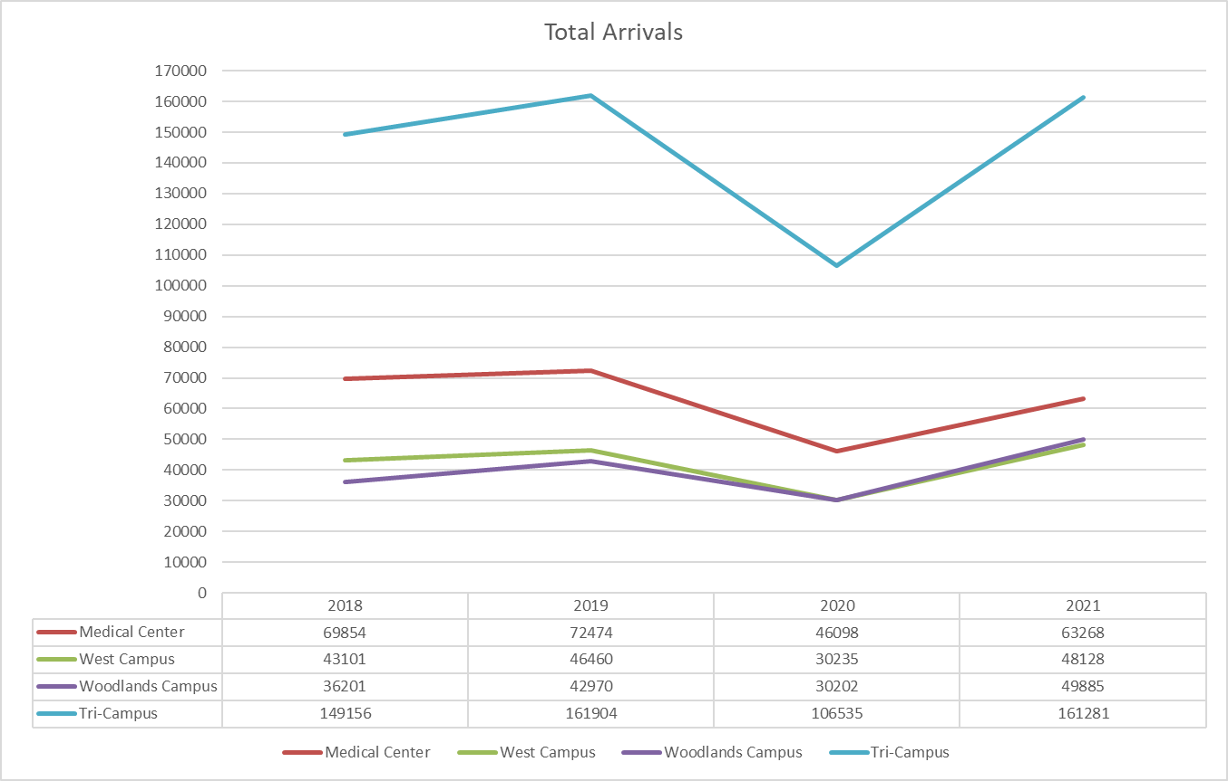
Tri-Campus TCH Arrivals 2018-2021

Slide 11
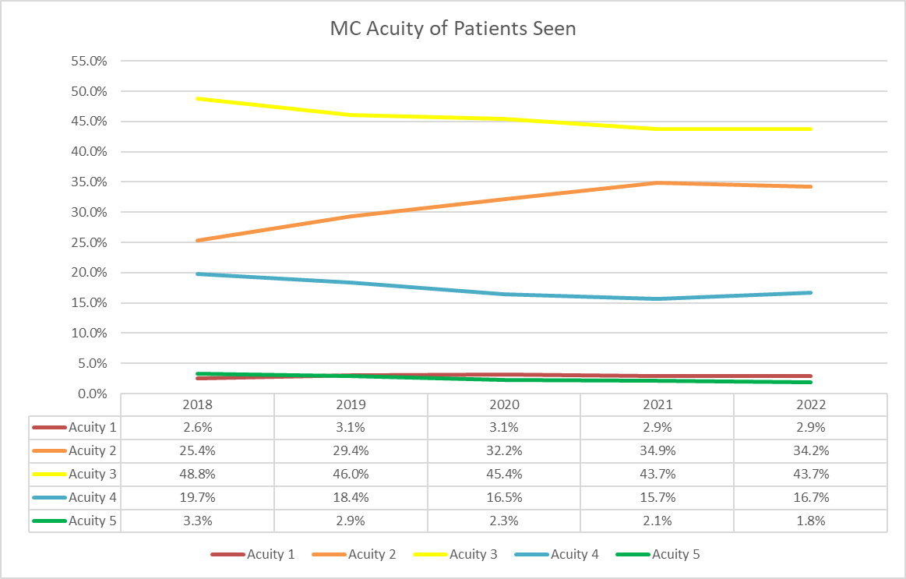
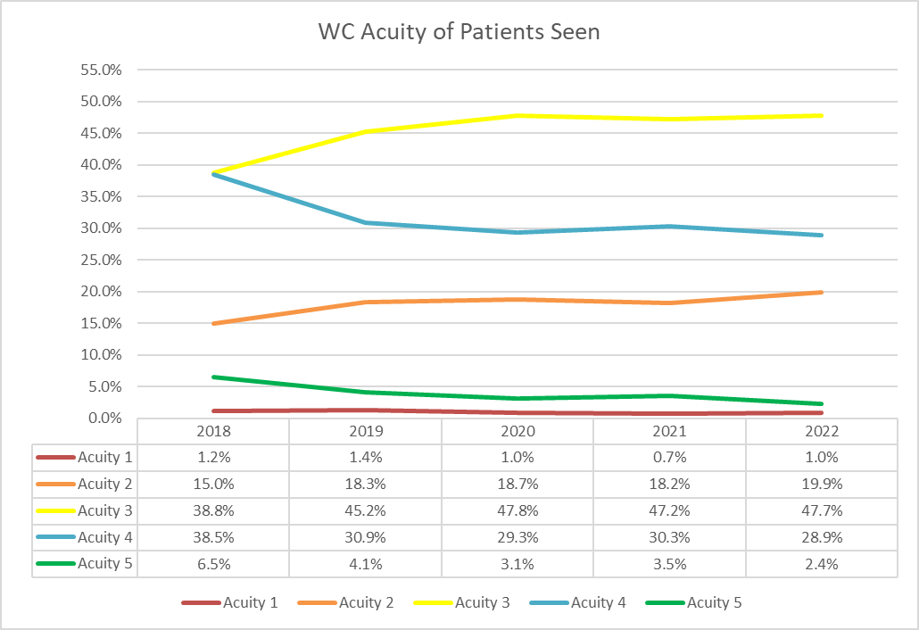
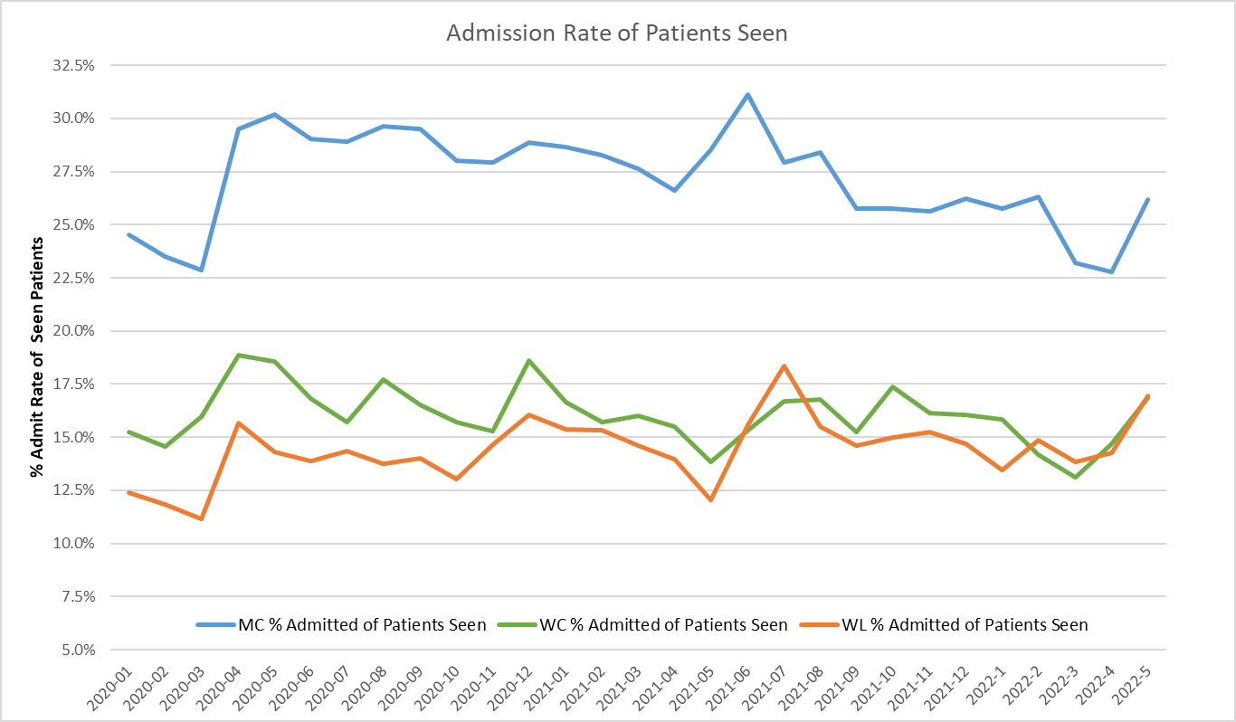
Patient Acuity

Slide 12
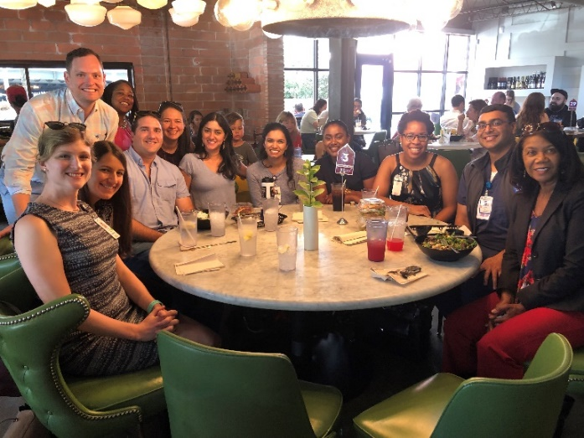
Goals & Objectives
Gain
proficiency in the clinical practice of pediatric emergency medicine (PEM)
Achieve
competency in educating other health care providers and families
Approach
everyday work in a scholarly way
Develop
familiarity with administrative issues
Prepare
for a career in PEM

Slide 13
PEM Fellowship Curriculum
Clinical practice
Teaching and consulting
Administrative training
Quality and performance improvement
Career development
Academics & Scholarship

Slide 14
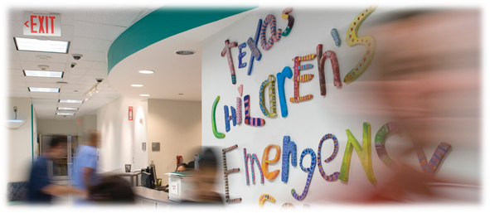
Clinical practice
Provide ED evaluation and management of acutely ill or injured pediatric patients
Perform patient evaluations quickly with stabilization of life threatening processes
Develop competency in technical/procedural and resuscitation skills necessary to practice PEM
Prioritize and simultaneously manage the emergency care of multiple patients
Use evidence based reasoning to guide clinical practice
Academic and community experience

Slide 15
Teaching and consulting
Achieve proficiency in teaching to different types of learners and in a variety of clinical settings
Teach at the bedside
TCH main and WC (resident and med student supervision)
Core medical student teaching shifts (1p-6p Tues)
EC rounds
Lead small and large group discussions
Prepare and present lectures
Become PALS instructors and/or simulation instructors
Notes:
Educational didactic series will include topics such as curriculum development, delivery of information, provision of feedback to learners and assessment of educational outcomes.

Slide 16
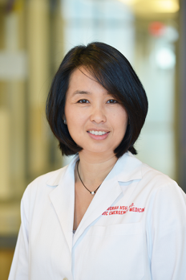
Administrative training
Acquire skills necessary for ED management
Supervise physician trainees
Manage personnel
Serve as team lead during resuscitations
Manage patient throughput
Practice appropriate medical record documentation
Relay information regarding patient care delivered
Document medical decision making processes
Support billing for medical care provided
Gain exposure to financial management in health care
Develop leadership skills
Dr. Deborah Hsu
Section Chief,
Pediatric Emergency Medicine
Notes:
Talk about Dr. Shook, Dr. Sirbaugh

Slide 17
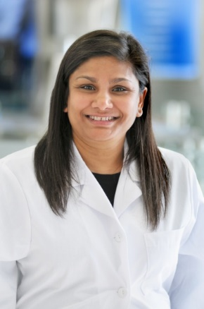
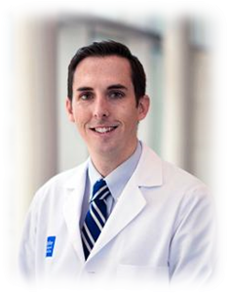
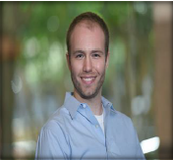
Quality and Performance Improvement
Gain knowledge in quality improvement methods and data gathering
Conduct performance improvement review
Develop EBM guidelines
Identify patient safety or quality issues
Design and conduct a quality project
Dr. Binita Patel,
Medical Director
Chief Quality Officer

Slide 18
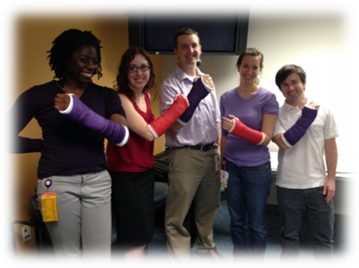
Career development
Create and revise individualized learning plan
Build on your CV
Receive & provide mentorship
Balance clinical and academic duties
Review principles of academic advancement
Create a 5 year plan
Gain awareness of job market demands
Get the job you want; choose the career path that’s right for you
Notes:
Mention career dinners

Slide 19
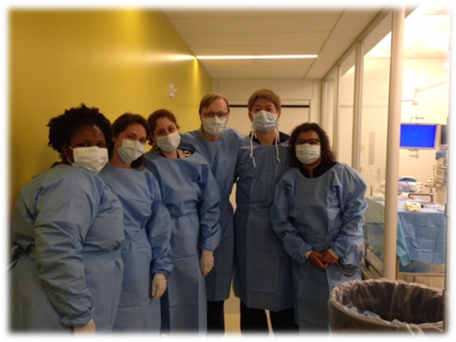
Fellowship Curriculum
Meets all requirements set forth by the American Board of Pediatrics and American Board of Emergency Medicine

Slide 20
First year curriculum –
Peds trained
8.25 months PEM*
2 weeks pediatric anesthesia
1 week pediatric sedation
1 month PICU (Main and West Campus)
1 month adult emergency medicine- Memorial Hermann
1 month ultrasound
*Total ED Time at Texas Children’s Hospital Main and West Campus = 950 Hours (approx 32 clinical hrs/week on PEM rotations)

Slide 21
First year curriculum –
EM trained
7.75 months PEM*
2 weeks pediatric anesthesia
1 week pediatric sedation
2 weeks child development (with child life)
1 month PICU (Main or West Campus)
1 month NICU
1 month pediatric cardiology
*Total ED Time at Texas Children’s Hospital Main and West Campus= 950 Hours (approx 32 clinical hrs/week on PEM rotations)

Slide 22
Second year curriculum –
Peds trained
9 months PEM*
2 weeks orthopedics
2 weeks toxicology
1 month trauma– Memorial Hermann
*Total ED Time at Texas Children’s Hospital Main and West Campus= 1150-1200 Hours (approx 32 clinical hrs/week on PEM rotations)
2 weeks child protection

Slide 23
Second year curriculum –
EM trained
9.5 months PEM*
1 month pediatric infectious disease or neurology
1 month elective
2 weeks child protection
*Total ED Time at Texas Children’s Hospital Main and West Campus= 1150 Hours (approx 32 clinical hrs/week on PEM rotations)

Slide 24
Third year curriculum – peds trained
8.25 months Research (Extra hours experience)*
1 month elective
1 month EMS
1 month adult emergency medicine- Ben Taub General Hospital or Memorial Hermann
1 week radiology
2 weeks anesthesia
Finish in July whatever required clinical hours not completed in years 1 and 2; otherwise no required ED shifts;
Extra hours experience available to maintain clinical skills (approximately 60 clinical hours/month)

Slide 25
Extra hours experience
Clinical opportunity offered only to fellows in their 3rd year of training
Successful completion of all PEM ED clinical requirements
Opt to take this opportunity to maintain clinical skills during a primarily research year of their fellowship
Placed as second attending in TCH North/South and West Campus
Moonlighting rates apply

Slide 26
All Fellows
Complete 2136 clinical hours in the PEM ED setting in first 2 years of fellowship
Weekdays: 6a-2p, 2p-10p, 6p-2a, 10p-6a
Tues medical student teaching shifts: 1p-6p
Weekends and holidays: 6a-4p, 4p-2a, 8p-6a
TCH
West Campus
Weekdays: 3pm-11pm
Weekends and holidays: 3pm-1am
TCH
Main EC
Notes:
Mention that we have some really outstanding PEM docs who work in the community

Slide 27
PEM Rotations
Combined clinical and research time for fellows, based on a 50 hour work week
Pediatric trained fellows
1st year & 2nd year - 65% clinical and 35% research
3rd year - 25% clinical and 75% research if they choose to take the Extra Hours Experience; 100% research if approved not to take the Extra Hours Experience.
Emergency medicine trained fellows
65% clinical and 35% research both years.
Given the time constraints modifications to the requirement of scholarly activity during fellowship are made based on individual fellows’ needs and interests.

Slide 28

PEM-Global Health Combined Fellowship
Fully integrated four year fellowship with 36 months PEM and 12 months GH
Rotation schedule is modified to include 2-4 months per year of global health time
Some rotations will be delayed to the following academic year
Scholarly project focused on global health
Fellows graduate both programs at the end of 4 years

Slide 29
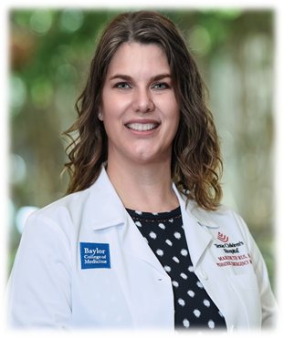
PEM-Global Health Fellowship
Dr. Marideth Rus,
Director, Global Health Fellowship

Slide 30
PEM-Global Health Combined Fellowship

Slide 31
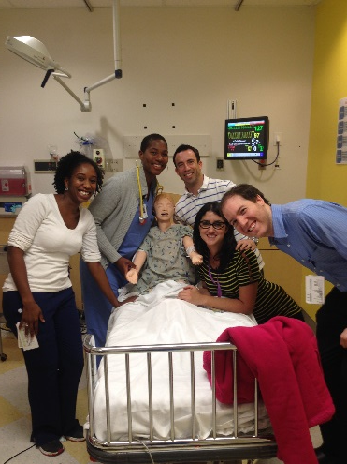
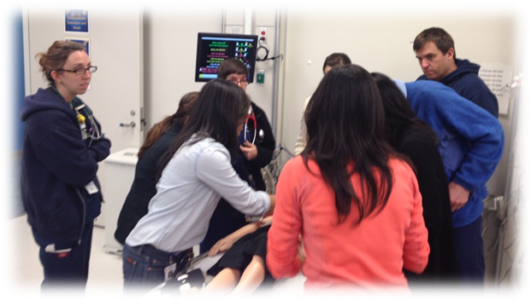
Electives
4 weeks of elective(s) required
Administrative elective
Adolescent medicine/gynecology
Adolescent medicine/sports medicine
Dermatology
Global health- Malawi, Belize
Neurosurgery
Ophthalmology
Otolaryngology
Pediatric Dentistry
Plastic/Hand Surgery
Pediatric Injury
Quality and Safety
Simulation
Create your own elective

Slide 32
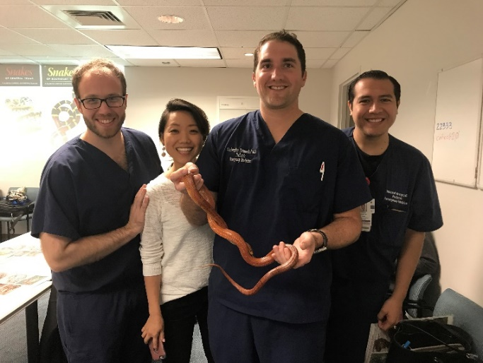
Academics: Conferences and Lectures
PEM conference Thursday 9am-1pm
Conferences which you will present or require your preparation:
Quality and Performance Improvement (M&M)
Board Review
Fellow lectures
Fellow’s follow-up rounds
National conference presentations
Clinical protection Wed overnight and Thurs morning
Radiology Rounds
Notes:
Lectures you prepare and give to residents and the section

Slide 33
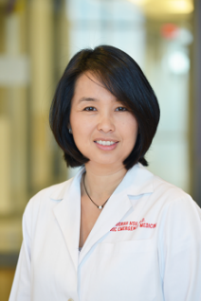
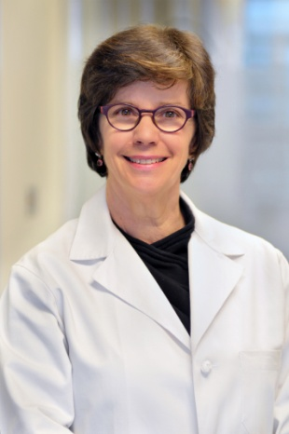
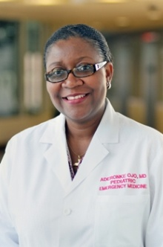
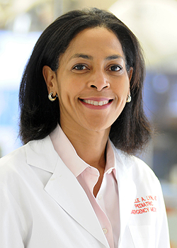
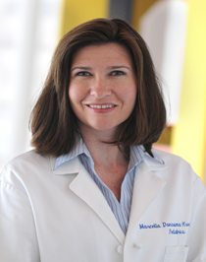
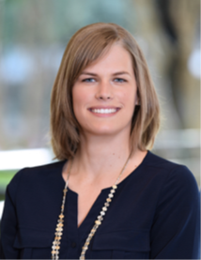
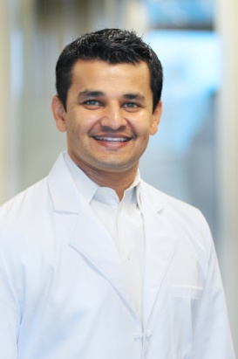
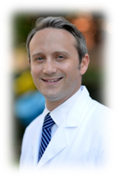
Conferences Series-
24 month Curriculum
July core clinical lectures/workshops
Administrative
Allergy/Immunology
Cardiology
Child Protection
Endocrine
EMS/Disaster medicine
Ethics
Hematology series
Notes:
Didactic lectures prepared by our faculty and outside speakers to augment your education.

Slide 34
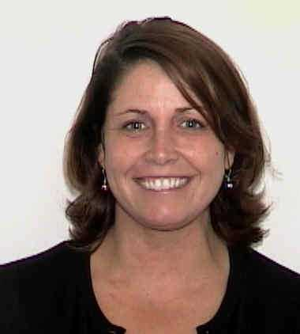
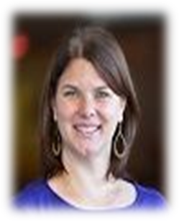
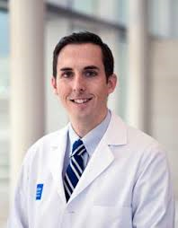

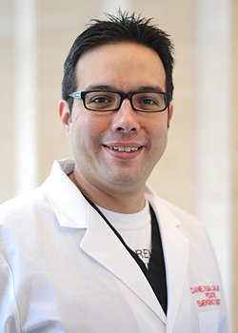
Conferences Series-
24 month Curriculum
Gastroenterology
Global Health
Neurology
Obstetrics and gynecology
Orthopedics
PEM Joint Conferences
  Critical Care Medicine
  Hospital Medicine
  CVICU
Plastic Surgery
Psychiatry
Quality
Radiology
Renal
Sports medicine
Surgical
Trauma
Toxicology

Slide 35
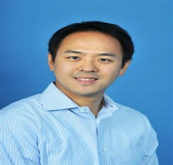
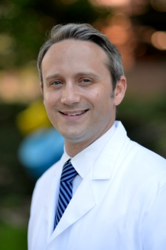
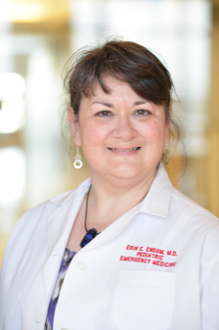
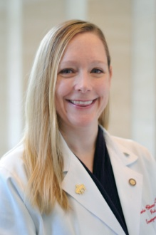
PEM Domains of Interests
Information technology
Disaster preparedness
Observation medicine
Sedation and pain management
Notes:
Endom and kaziny, little

Slide 36
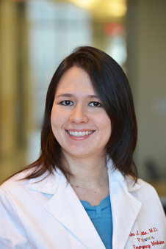
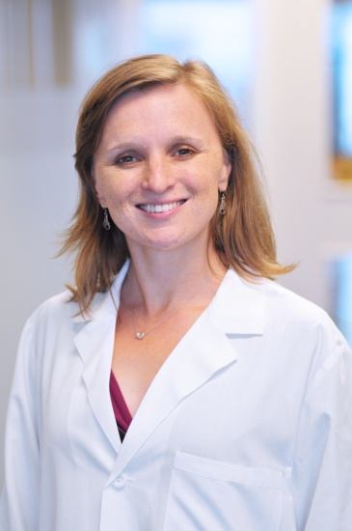
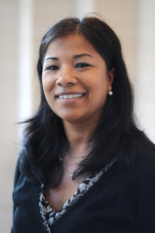
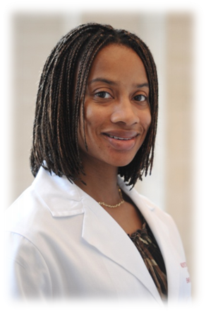
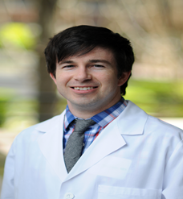




Education
Simulation Director
Peds Residency PD
PEM Chief
Notes:
Endom and kaziny, little

Slide 37








PEM Domains of Interests
Airway
Customer Service and Communication
Advocacy
EMS
Notes:
Endom and kaziny, little

Slide 38



PEM Domains of Interest
Asthma
Diversity
Bronchiolitis
Ultrasound (Team Grayscale)
Handoffs, Technology

Slide 39




Global Health
Belize
Uganda
Colombia
Malawi
Botswana
Puerto Rico
El Salvador
Guatemala
Notes:
Botswana cumulative 9 months, Malawi 4.5 months, Uganda 2 months, Belize 6 weeks, Colombia 2 weeks and Puerto Rico 2 weeks, ongoing projects in Rwanda, Guatemala and El Salvador and of course many GH activities here in Houston

Slide 40



PEM Point-of Care Ultrasound
One month Ultrasound rotation during first year
PEM
Adult EM
Radiology
Cardiology
Ultrasound during your core PEM shifts and adult EM shifts
Ultrasound research
Ultrasound fellowship
Dr. Kiyetta Alade,
Director PEM POCUS
Dr. Stephanie Leung
POCUS Fellowship Director
Notes:
Mention Steph Leung as well

Slide 41
POCUS Training
POCUS training required for PEM fellow graduation
  1) 150 scans by fellowship completion
  2) 10 proctored scans with ultrasound faculty
POCUS training completion by March of 2nd year allows for ultrasound privileges as 3rd year “pretendings”
Notes:
If you do not complete the 150 total scans as a fellow and apply for credentials, you will have to go through a number of proctored exams for each type, in order to be credentialed.

Slide 42






PEM simulation
Involving all fellows:
Good to know about:
PEM fellows simulation days
RCDP for first years
EC in-situ simulation
  Full teams, 4/month, unannounced
Procedural teaching
  Central lines
  Chest tubes
SCOPE
  July
Resident and nursing resuscitation/ PALS training
  Thursdays after conferences
Trauma simulations for first years
Medical students
  During core rotation, sim for procedural training
Pre hospital training
  Pediatric resuscitation for HFD providers, twice monthly for 2 years, trained over 1200 providers
Global Health
  Pre-departure training for residents
  and BIPAI physicians

Slide 43






















PEM outreach and service

Slide 44







PEM Research
Notes:
Add rohit and danny

Slide 45
Scholarship
Critically assess scientific merit of research protocols & publications
Gain knowledge in basic clinical epidemiologic principles & biostatistics
Explore non-traditional avenues for demonstrating scholarship
Design & conduct a hypothesis driven scholarly project
Analyze & interpret data
Acquire knowledge in grant funding mechanisms
Attain and hone writing skills

Slide 46









N National presentations

Slide 47




AAP 2018
Fellows National Conference 2018
Advocacy on Capitol Hill
EMS for children
2018 Harvard Humanitarian Response Intensive Course
2017 American Academy of Pediatrics
First place PediSonoFest Competition

Slide 48





Micheal Arroyo:
Best original research award and platform presentation at the Injury Free Coalition for Kids Conference, December, 2019, Ft. Lauderdale, Florida
Asha Morrow
2019 Best and Outstanding Center of Excellence Clinical Fellow Scholar Award
Texas Pediatric Society E-Poster Contest Winners
Bryan Greenfield and Abhay Kulkarni
FIRST PLACE for your poster in the Evidence Based Medicine/QI category:
#60minutes: Improving Timeliness of Antibiotic Delivery to Patients with Febrile Neutropenia
Justin Moher
Best Trainee Abstract SOICH AAP, 2019

Slide 49

How Are Academic Skills Developed in PEM Fellowship?
(SOC)

Slide 50

Topics in Research Series: 2022-2023 Schedule
Notes:
Text
Text
Text
Text

Slide 51
Advisory Committee on
Excellence in Research (ACER)
Small group setting where faculty focus on thorough development of research projects
Faculty with expertise in quantitative and qualitative research, education, quality improvement, and global health
Receive written and verbal feedback on:
Study question
Study design
Analysis plan
1st year fellows required to attend 4 sessions

Slide 52
Journal Club & Literature Review
Journal Club
Review recent paper from past 2 years
Purpose: To learn critical appraisal skills
Literature Review
To review classic PEM articles
To review recent ‘hot off the press’ articles that have been published within the past 6 months
Notes:
Text
Text
Text
Text

Slide 53
Faculty & Research Mentor Roles
Attend journal club, fellow lecture, follow-up rounds and QPI presentation for mentee
Give quarterly feedback to mentee on clinical/academic performance
Research Mentor
Participate in ACER sessions with fellow
Review the fellow’s proposal prior to submission to ACER
Review the fellow’s IRB prior to submission
Review abstracts and manuscripts prior to submission
Both
Review posters and slides prior to presentations
Attend 2 SOC meetings per year
Mentor

Slide 54
Other Scholarly Activities
Case submissions (PEMPix, EmergiQuiz, Case Reports)
Participation in National PEM Fellows’ Conference
Feedback on presentations for conferences
Career workshop in July
Final year career planning at orientation
BCM Fellows’ Day abstract presentations

Slide 55



Other Activities (Optional)
Career dinners
Advanced degrees (MPH, MBA, MEd, Master’s Clinical Research)
Writing book chapters or review articles
Teaching residents, medical students, paramedics
Evidence-Based Medicine course
Serving on section or hospital-wide committees

Slide 56



PEM RESEARCH STRUCTURE
Research Chief
Directors of Research Education
Research Coordinators
Research Assistants
Academic Associates
PEM Section Support Staff
Epidemiologist and database manager
Biostatistician
Accountant

Slide 57

PECARN
National PEM research network, 18 sites
TCH is a member site
Enables multicenter studies:
Decision rules for CTs after head injuries
Meningitis prediction rules
Multiple publications
DKA
www.pecarn.org

Slide 58
Research: ongoing studies
PECARN
  C-spine prediction (Rubalcava)
  Arginine for sickle cell VOC (Chumpitazi – resubmission pending)
  Identification of pulmonary emboli (Chumpitazi – submission pending)
  Febrile baby study
  Screening for sexually transmitted infections in the ED
  Non-operative management of appendicitis (planning grant)
  Infections in solid organ transplant recipients (Cruz = study PI, nodal study)
  Interobserver agreement in historical and examination variables for headaches (Cruz = site PI)
PEM CRC
  Submersion (Shenoi = study PI)
  IBIs in acute otitis media (Cruz = senior PI)
  HUS (Cruz = site PI)
  HSV (Cruz = Study PI)
  Omphalitis/mastitis (Cruz = site PI)
  Short gut and CLABSI (Cruz = Co-I)
  Survey competition (quarterly)
PERN
  Medical errors (Lewis)
  Influenza (Meskill)
Industry
  New drug for sickle cell VOC (Chumpitazi)
  Smart cough (Sampayo)
  Bluetooth monitoring of vital signs
  New diagnostic platforms for rapid strep
  Salivary biomarkers for traumatic brain injury

Slide 59
Current Single-Center Studies
(just a sampling)
Quality improvement projects: intubation, pain control in sickle cell patients, resuscitation/communication, appendicitis
Educational projects: ultrasound, simulation, rubrics, bad news delivery, e-learning
Global health: triage, resuscitation, simulation
Trauma: trampoline injuries, cognitive impact of mild traumatic brain injury, abuse in the NICU

Slide 60
Examples of Fellows’ Studies 2016-current
Administration: Optimizing billing for procedural sedation in the ED
Asthma: Standing Delegation Orders and Triage Steroids, Evaluating the inter-rater reliability and validity of the CRS in asthma patients,
Bronchiolitis: High Flow Nasal Cannula and Intubation risk
Quality Improvement: Barriers to Flu vaccination Best practice advisory, MIXED METHODS, Sedation
Disparities: RETROSPECTIVE Pediatric submersions and safety violations in city swimming pools, Demographic Discordances Between Patient Reported and Electronic Medical Records
EMS: Prehospital administration of steroids, Mixed-methods study on adherence to pediatric seizure protocols QUALITATIVE, Weight Tools
POCUS: POCUS inferior vena cava (IVC) measurements to assess the severity of the patient’s dehydration;“Development and Implementation of a Novel Point-of-Care Ultrasound Training for Pediatric Providers in Malawi” COVID and POCUS
Global Health: Pediatric tropical infectious diseases in emergency medicine utilizing the MODIFIED DELPHI METHOD, Healthcare Provider Attitudes Toward the Emergency Triage System in Belize
EDUCATION, SIMULATION- RCDP, Debriefing Tools, PEM Fellow Procedures; Essential components for debriefing pediatric residents returning from global health experiences
Infectious Disease: Neonatal FEVER, RRTs

Slide 61
Evaluations in PEM Fellowship
360 evaluations-peer, self, outside rotations, procedural, PEM
Progress monitored monthly, quarterly, and semi-annually
Evaluated on all core competencies for PEM

Slide 62
Moonlighting
1st years can start moonlighting after 2 quarterly evaluations cycles complete and competency ascertained
TX license, DEA and DPS numbers
Hospital credentialing papers and GME moonlighting approval must be obtained
Prior to completion of 2136 required clinical hours: moonlight only at non training sites
After completion of 2136 hours, moonlight anywhere

Slide 63


2022-23 PEM Chief Fellows
Katie Guess MD
Adrienne Smallwood MD
PEMFellowChiefs@BCM.edu

Slide 64

CONTACT US
Pediatric Emergency Medicine
Fellowship Program
Texas Children's Hospital
6621 Fannin Street,
Ste. A2210
Houston, TX 77030
Kim Little-Wienert, MD, MEd
Program Director
kjlittle@texaschildrens.org
Marideth Rus, MD, MEd
PEM- GH Combined Fellowship Director
Associate Program Director
mcrus@texaschildrens.org
Elizabeth Moran, MD, MEd
Assistant Program Director
Em10@bcm.edu
Lisa Kuchik
lkuchik@bcm.eddu
832-824-6309
Felecia Smith
fasmith@texaschildrens.org
832-824-5399
Notes:
Different motif, more science
Text
Text
Text

Slide 65




@bcm_pemfellows

