Slide 1
Case of the month Feb. 2025
Dilshad Dhaliwal, MD-PGY3 resident
Celia Marginean, MD-Program Director

Slide 5
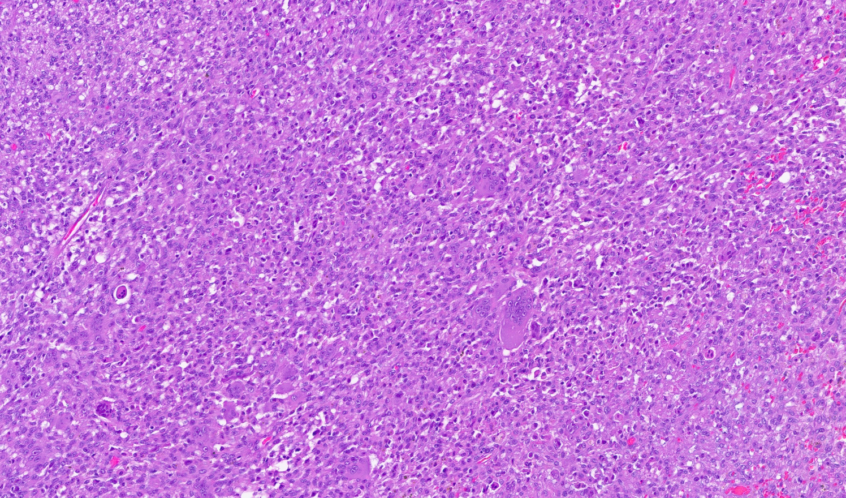
The tumor is composed of sheets of spindle cells, admixed with epithelioid cells and numerous multinucleated osteoclast like giant cells.

Slide 6
Vimentin

Slide 7
CK7

Slide 8
CD68

