Slide 1
Case of the month March 2025
Jacky Akhter, MD, GI Fellow (PGY-6)
Kalyani Patel, MD, Associate Professor,
Site Director for GI/Hepatobiliary Pathology Fellowship, Texas Children's Hospital

Slide 2
Q1: 10-day old female presented with abdominal distention, bilious emesis with concern for bowel obstruction, and lack of stools for six days, previously normal, ultrasound negative for pyloric stenosis, underwent rectal suction biopsy. Which of the following is an adequate biopsy specimen for the diagnosis of this condition?
A) 2 cm above the anal verge, showing transitional mucosa, and all biopsy specimen showing at least 50% submucosal tissue, 20 sections are given for microscopic review
B) 2, 3, and 4 cm above the anal verge, all biopsy exhaustively sectioned, most biopsy sections include at least 50% submucosal tissue, showing colonic mucosa
C) 2, 3, 4 cm above the anal verge, maximum up to 40 sections cut per biopsy specimen, showing minimal sub-mucosal tissue with overlying colonic epithelium
D) 5 cm proximal to the transition zone, with presence of ganglion cells and does not show submucosal nerve hypertrophy or myenteric hypoganglionosis

Slide 3
Q2: Which of the following features define the transition zone?
A) Partial circumferential aganglionosis
B) Myenteric hypoganglionosis
C) Submucosal nerve hypertrophy
D) A, B, and C (all 3 necessary)
E) A, B, or C (any one of these features)

Slide 4
Explanations:
Q1:
Answer: B) 2, 3, and 4 cm about the anal verge, all biopsy exhaustively sectioned, most biopsy sections include at least 50% submucosal tissue, showing colonic mucosa
Explanation:
In suspected HD, the biopsy must be adequate to diagnose or rule out HD. An adequate biopsy must have tissue from multiple areas (conventionally taken 2, 3, and 4 cm above the anal verge), and each biopsy must show at least 50% submucosa in most of the sections. Biopsies from 2.0 cm can sometimes show transitional mucosa, however, colonic mucosa is typically considered reassuring for adequacy. Finally, adequate sections must be examined to confidently rule out HD, ranging from 40 to >100.
Q2:
Answer: E) A, B, or C, if any of these features are present, this is considered diagnostic of transition zone
Explanation:
The transition zone (TZ) is the intestinal segment immediately proximal to the aganglionic bowel, leading to more proximal euganglionic tissue. The presence of any of these features is diagnostic of TZ. Intraoperative recognition of TZ at the proximal margin of the pull-through specimen is necessary to ensure that the anastomosis does not contain aganglionic or TZ tissue.

Slide 5
Rectal suction biopsy:
Colonic mucosa with abundant submucosal tissue

Slide 6
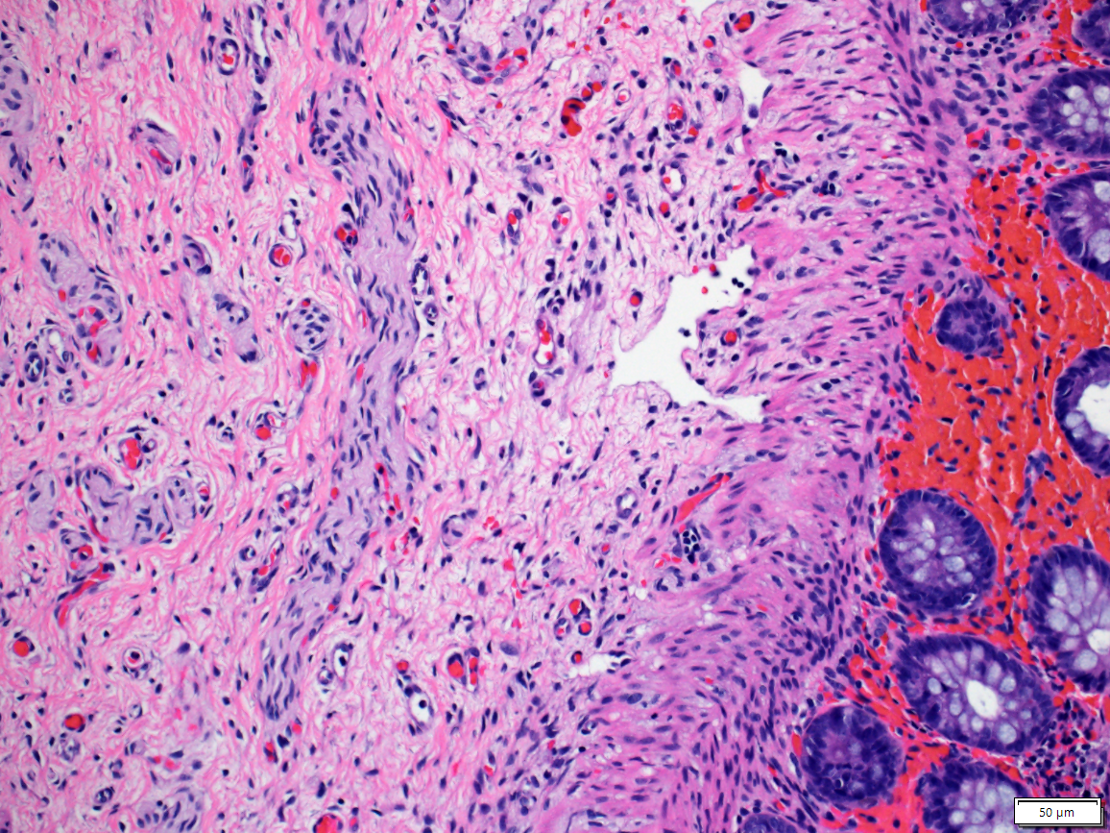
Rectal suction biopsy at 2.0 cm (H&E, 200x)
Nerve thickness: 42.8 um

Slide 7
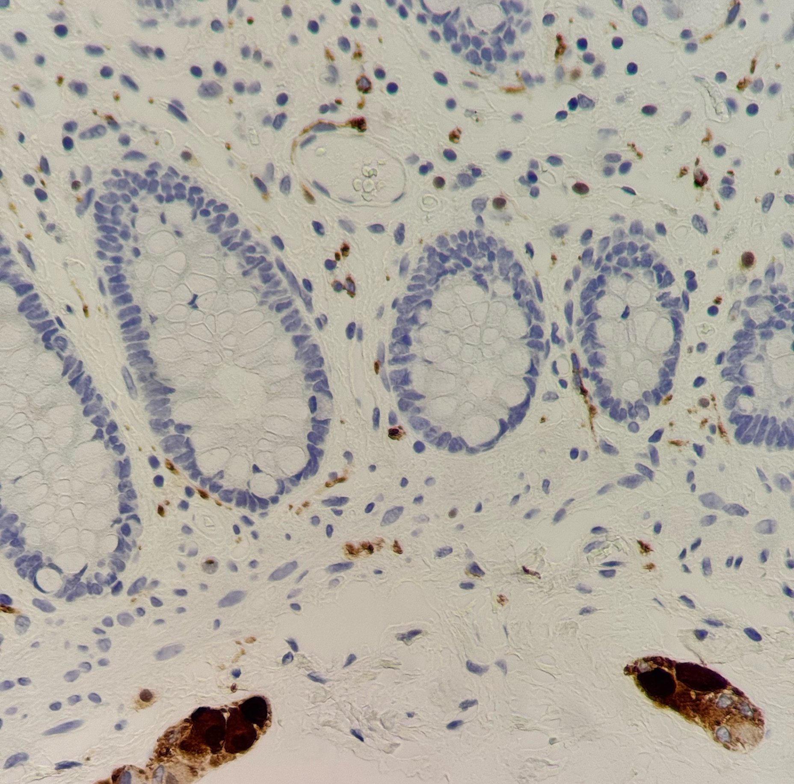
Calretinin:
Normal (expected) stain- submucosal ganglion cells (red arrow) and mucosal neurites in lamina propria (blue arrow)

Slide 8
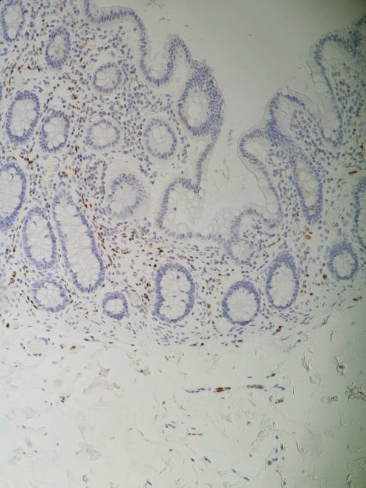
Calretinin: mucosal neurites present within lamina propria; no ganglion cells identified within the submucosal tissue (representative of transition zone)

Slide 9
Abnormal Calretinin immunostain with complete absence of submucosal Ganglion cells and mucosal neurites.

Slide 10
Hirschsprung-associated enterocolitis (HAEC)
Intraepithelial neutrophils within the colonic crypts (acute colitis)

Slide 11
Etiology/Pathogenesis
Hirschsprung disease (HD) is defined as incomplete colonization of the gut by neural progenitor cells which leads to complex multigenetic disease characterized by absence of intrinsic ganglion cells (aganglionosis) in the submucosal (Meissner) and myenteric (Auerbach) plexuses in the rectum, and extending variable lengths proximally
Complex multigenetic disease, can be associated with congenital abnormalities: Trisomy 21 (most common), cardiac defects, CNS anomalies, MEN2a, GI/GU/limb defects

Slide 12
Definition/presentation
Remove this slide – let us focus on "diagnosis" only.
Aganglionic segment: starts at internal anal sphincter (IAS), extends proximally, leading to distal narrow aperistaltic and proximal dilated GI segments
Short-segment classic HD (75-80%): Rectosigmoid colon
Long-segment HD (10-15%): Proximal to splenic flexure
Total colonic aganglionosis/HD (5-10%): Entire colon
Zonal ("segmental") and "skip segment" variants (rare)
Clinical presentation:
Neonates:
delayed passage of meconium (>48 hours), feeding intolerance, abdominal distention, bilious emesis (concern for intestinal obstruction)
Can rarely have bowel perforation of cecum, ascending colon, appendix
Longer segment of aganglionosis: commonly present as neonates with symptoms of intestinal obstruction
Infants/children:
long standing mild to severe constipation, refractory to oral laxatives, a/w vomiting, abdominal distention, growth failure
Complications: acute intestinal obstruction, recurrent fecal impactions, and acute life-threatening or chronic enterocolitis
Hirschsprung-associated enterocolitis (HAEC): explosive (usually bloody) diarrhea, fever, abdominal distention
Milder forms may be treated with antibiotics; however, severe forms require surgical interventions

Slide 13
Diagnostic procedures
Screening tests
Contrast enema (CE)
Water-soluble contrast is instilled into the colon using a catheter that is placed inside the anus followed by live fluoroscopic imaging
Suggestive of HD: presence of a radiographical transition zone with proximal dilated bowel, microcolon, retention of contrast on post-evacuation film, irregular colonic contractions, mucosal irregularity, and abnormal rectosigmoid ratio (n=>1; HD= <1)
Less accurate in patients <30 days old, recommend rectal suction biopsy even if normal CE if there is high index of suspicion for HD
Anorectal manometry (ARM)
Motility test used to evaluate the voluntary and involuntary properties of the anorectum
Measures intraanal pressures=manometric assessment of the anorectal function
Measures resting pressures, RAIR (rectoanal inhibitory reflux), rectal sensation, ability to squeeze and simulate defecation
Concern for HD:
Rectal suction biopsy (RSB)
Initial/primary modality for obtaining tissue to R/O HD in infants <6 months of age
If results equivocal--> full thickness biopsy (FTB)

Slide 14
Adequacy and Diagnostic Features of HD
Unequivocal identification of a ganglion cell
Appropriate location (mucosa): surface of the biopsy should be lined entirely by colonic mucosa
Sections from TZ or squamous mucosa can be physiologically aganglionic, hence these biopsies are inadequate unless a ganglion cell is identified (excluding HSCR)
Most places take biopsies at 2, 3, and 4 cm above the anal verge
Adequate submucosa: suction biopsy should be at least 2-3 mm in greatest dimension and have 50% or more of submucosa
50-75 H&E-stained sections at 4 to 5 um thickness (TCH: 40 sections (5 slides with 8 sections on each slide); some institutions will exhaust the block as their protocol
No ganglion cells; overt submucosal nerve hypertrophy (>40um), then diagnosis can be established without further ancillary testing
Submucosal nerve hypertrophy may be absent in patients with total colonic aganglionosis
Ancillary tests:
Acetylcholinesterase (AChE) histochemistry
Cholin transporter (ChT) histochemistry
Calretinin IHC

Slide 15
Pediatr Dev Pathol. 2020 Jan-Feb;23(1):8-22.
AChE:
Highlights abnormally coarse and dense cholinergic mucosal innervation
Performed on frozen sections, typically on unfixed tissue, not compatible for FFPE tissue
Calretinin:
Highlights enteric neurons and cell bodies/neurites
Normal: calretinin (+) nerves in muscularis mucosae and lamina propria
Aganglionic rectal tissue: complete absence of
calretinin (+) mucosal nerves
Cholin transporter:
Expressed in the abnormal cholinergic nerves found in aganglionic rectal mucosa
Can be performed on FFPE tissue sections
Highlights larger/more numerous nerves in the mucosa of aganlionic bowel, helpful in patients with very short segment HD (vssHD), where calretinin may be misleading

Slide 16
Pathology report
At minimal should include:
Location and type of biopsy
Presence/absence of ganglion cells
Presence/absence of submucosal nerve hypertrophy
Results of ancillary testing (AChE, ChT, and/or calretinin)

Slide 17
Surgery
Remove this slide.
1-stage (primary pull-through) vs 2-stage (initial fecal diversion, with pull-through procedure performed later) surgical intervention based on clinical stability (enterocolitis), bowel dilation, location of TZ
Resect greater than or equal to 5 cm proximal to where ganglion cells were identified
Frozen section: makes sure margin does not include TZ so euganglionic proximal margin is used for anastomosis
Enterocolitis:
Can be life-threatening; presence of acute enterocolitis on biopsy requires a call to the clinician
Can be managed with rectal irrigations, antibiotics, and supportive care
Fecal diversion with ostomy in severe cases
If bowel is dilated, need to do fecal diversion to allow decompression of GI tract and ensure proximal and distal ends of the anastomosis fit together

Slide 18
Intraoperative pathology
Seromucosal biopsy:
3-10mm in thickness of Seromucosal biopsy, include both layers of muscularis propria, and ensure proper orientation, get sections perpendicular to serosal surface
Start with 2 slides each with 2-3 sections, 4-5 um in thickness, stain with H&E or Romanowsky stain (Diff Quik ).
Cut more if no ganglion cells are identified (usually up to 10 sections)
Proximal margin of the pull-through specimen (the "donut"):
Take full-circumferential 5 mm thick transverse section from the proximal margin
Orient tissue well, and cut tissue deeply if necessary to obtain full-thickness representation of the entire circumference of proximal margin (see picture)
Exam for unequivocal ganglion cells and features of transition zone (TZ)
TZ defined by partial circumferential aganglionosis, myenteric hypoganglionosis, and submucosal nerve hypertrophy— any one of these features are considered diagnostic of TZ, and are an indication to position enterostomy/anastomosis in a more proximal position

Slide 19
Smith C, Ambartsumyan L, Kapur RP. Surgery, Surgical Pathology, and Postoperative Management of Patients With Hirschsprung Disease. Pediatr Dev Pathol. 2020 Jan-Feb;23(1):23-39. doi: 10.1177/1093526619889436. Epub 2019 Nov 20. PMID: 31747833.

Slide 20
References:
Ambartsumyan L, Smith C, Kapur RP. Diagnosis of Hirschsprung Disease. Pediatr Dev Pathol. 2020 Jan-Feb;23(1):8-22. doi: 10.1177/1093526619892351. Epub 2019 Dec 2. PMID: 31791203.
Gershon EM, Rodriguez L, Arbizu RA. Hirschsprung's disease associated enterocolitis: A comprehensive review. World J Clin Pediatr. 2023 Jun 9;12(3):68-76. doi: 10.5409/wjcp.v12.i3.68. PMID: 37342453; PMCID: PMC10278080.
Kapur RP, Ambartsumyan L, Smith C. Are We Underdiagnosing Hirschsprung Disease? Pediatr Dev Pathol. 2020 Jan-Feb;23(1):60-71. doi: 10.1177/1093526619889434. Epub 2019 Nov 20. PMID: 31747832.
Kapur RP, Smith C, Ambartsumyan L. Postoperative Pullthrough Obstruction in Hirschsprung Disease: Etiologies and Diagnosis. Pediatr Dev Pathol. 2020 Jan-Feb;23(1):40-59. doi: 10.1177/1093526619890735. Epub 2019 Nov 21. PMID: 31752599.
Karim A, Tang CS, Tam PK. The Emerging Genetic Landscape of Hirschsprung Disease and Its Potential Clinical Applications. Front Pediatr. 2021 Aug 5;9:638093. doi: 10.3389/fped.2021.638093. PMID: 34422713; PMCID: PMC8374333.
Smith C, Ambartsumyan L, Kapur RP. Surgery, Surgical Pathology, and Postoperative Management of Patients With Hirschsprung Disease. Pediatr Dev Pathol. 2020 Jan-Feb;23(1):23-39. doi: 10.1177/1093526619889436. Epub 2019 Nov 20. PMID: 31747833.
Veras LV, Arnold M, Avansino JR, Bove K, Cowles RA, Durham MM, Goldstein AM, Krishnan C, Langer JC, Levitt M, Monforte-Munoz H, Rabah R, Reyes-Mugica M, Rollins MD 2nd, Kapur RP, Gosain A; American Pediatric Surgical Association Hirschsprung Disease Interest Group. Guidelines for synoptic reporting of surgery and pathology in Hirschsprung disease. J Pediatr Surg. 2019 Oct;54(10):2017-2023. doi: 10.1016/j.jpedsurg.2019.03.010. Epub 2019 Mar 21. PMID: 30935730; PMCID: PMC6754813.
Yoshimaru K, Yanagi Y, Obata S, Takahashi Y, Irie K, Omori A, Matsuura T, Taguchi T. Acetylcholinesterase staining for the pathological diagnosis of Hirschsprung's disease. Surg Today. 2021 Feb;51(2):181-186. doi: 10.1007/s00595-020-02055-x. Epub 2020 Jun 23. PMID: 32577882.

