Slide 1
Case of the month
April 2025
Sonal Italiya, MD, (Pathology Resident,PGY-2)
Yuriko Fujita, M.D., Ph. D. (Surgical Pathology Fellow)
Shilpa Jain , M.D. (Associate professor, Director of GI Pathology at Baylor St. Lukes Hospital)

Slide 2
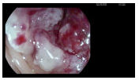
Clinical Presentation
A 77-year-old female presented with nausea, vomiting, and abdominal pain.
She recently underwent an ERCP, which revealed a severe fibrotic stricture with nodularity in the upper third of the main duct, and a stent was placed. However, her symptoms did not resolve.
A subsequent abdominal CT scan showed signs of colitis, including distention and mural thickening of the descending colon, as well as irregularity of the sigmoid colon. She was treated empirically with Fidaxomicin for 10 days.
A sigmoidoscopy later revealed a frond-like/villous partially obstructing large mass in the recto-sigmoid colon (see image), and a biopsy of the mass was performed.

Slide 3
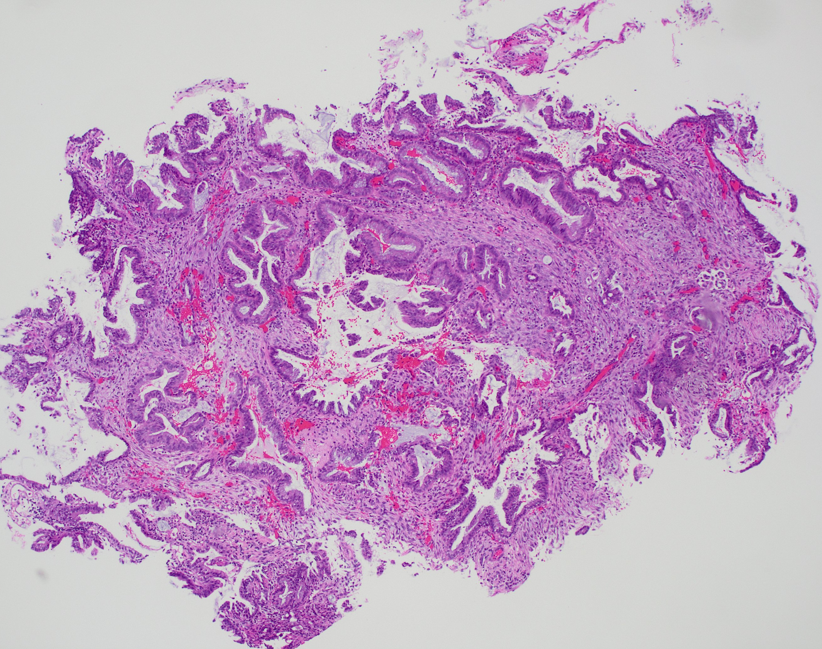
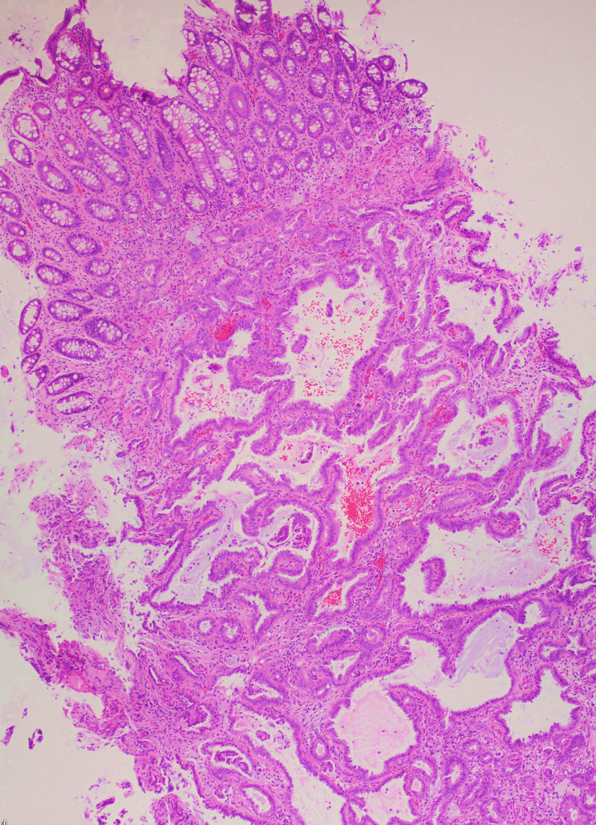
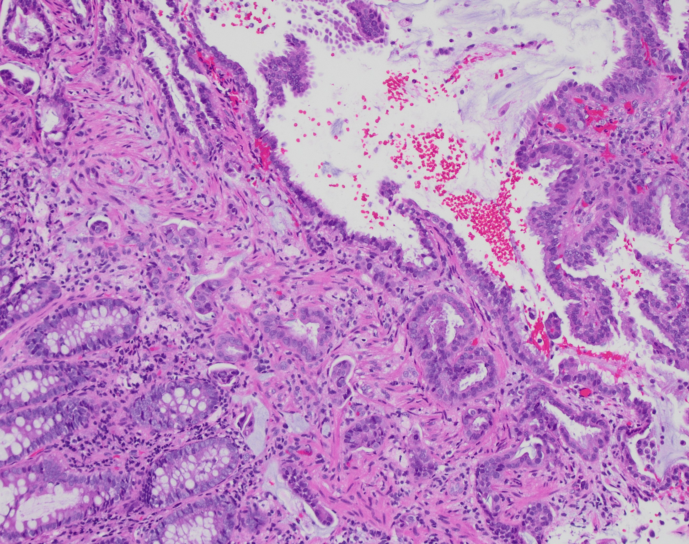
The biopsy shows a moderately differentiated adenocarcinoma involving predominantly the submucosa (indicated by the arrow) without any surface dysplasia (H&E,10x).
The tumor involves the surface, but no precursor lesions such as tubular adenoma are noted (H&E,4x).
There is extensive lymphovascular invasion present in the lamina propria and superficial submucosa (H&E,40x).
B​
A
C

Slide 4
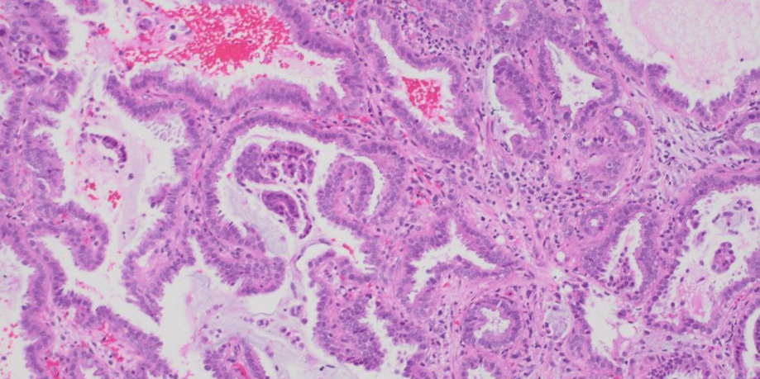
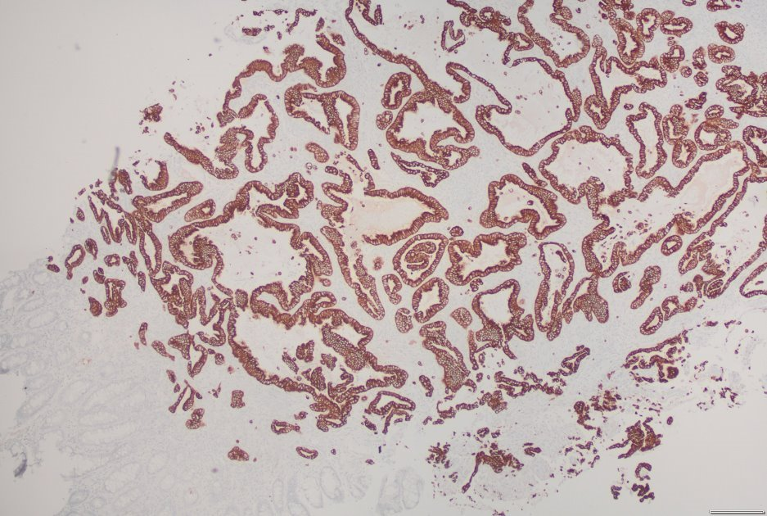
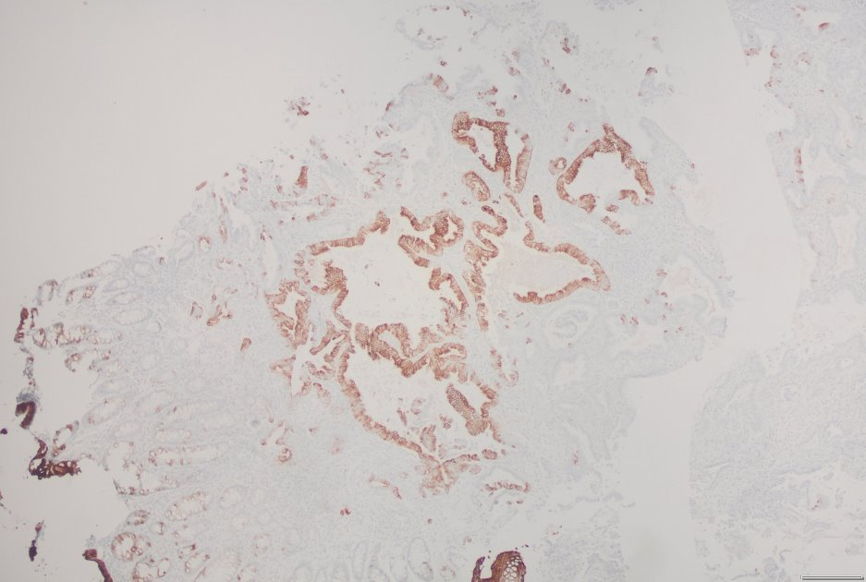
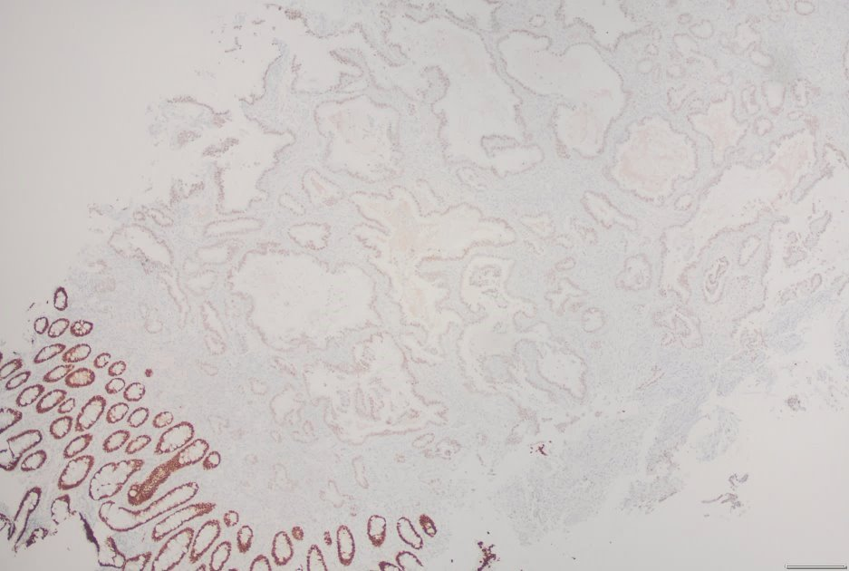
H&E,10x
CK-7​,4x
CK-20,4x
CDX2,4x
The high-power shows infiltrating glands lined by cuboidal cells with low N:C ratio, basally located round nucleus with mild pleomorphism(arrow). The cells are diffusely positive for CK7, patchy positive for CK20 and weakly nuclear positive for CDX2.

Slide 5
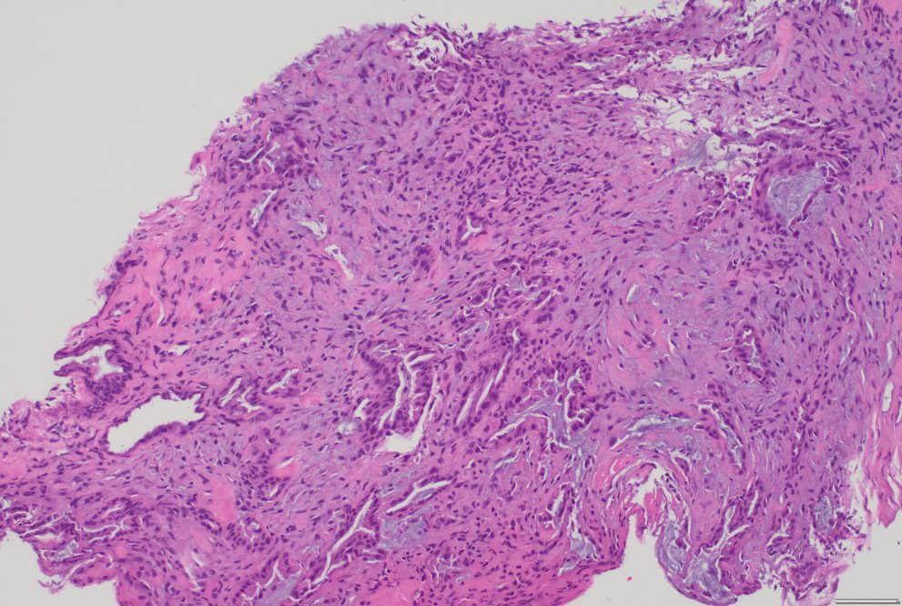
Clinical Course
The patient was planned for exploratory laparoscopy.
Exploratory laparoscopy revealed firm mass in recto-sigmoid colon adherent to pelvis, diffuse peritoneal studding, and innumerable nodules on small bowel and mesentery.
Also palpated nodules along right lobe of liver as well as firm mass at porta hepatis were identified.
Intraoperative frozen section of the peritoneal lesion was positive for malignancy. Decision was made to abort resection or diversion.
Permanent section of this peritoneal lesion was examined.
H&E,10x

Slide 6
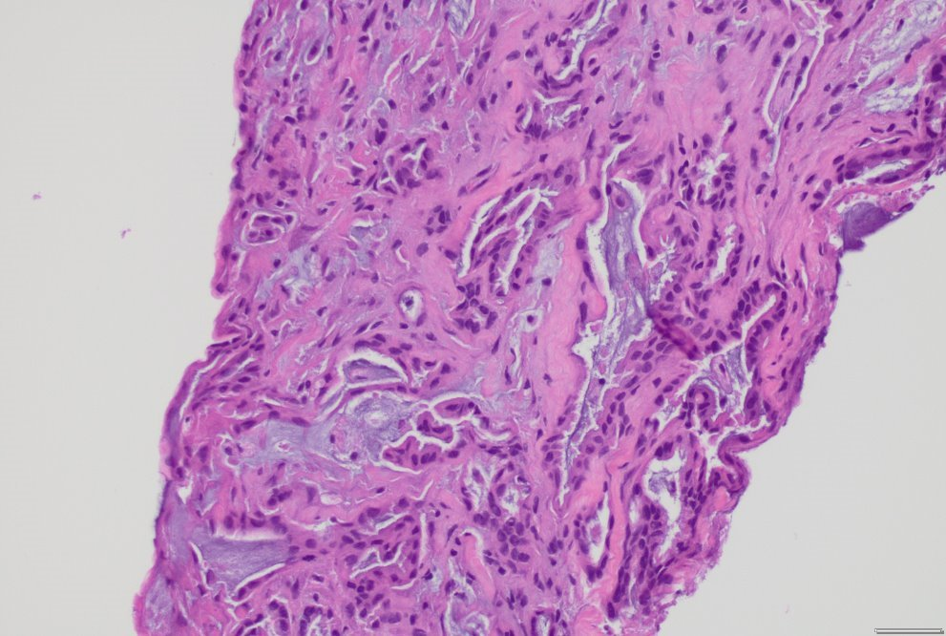
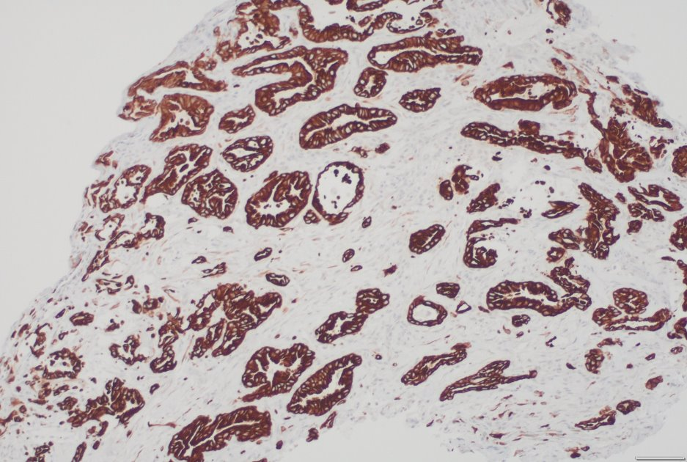
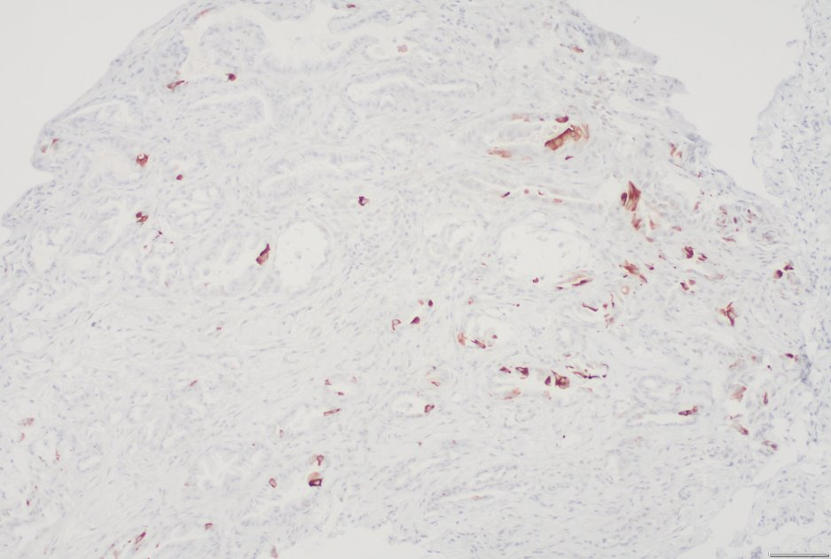
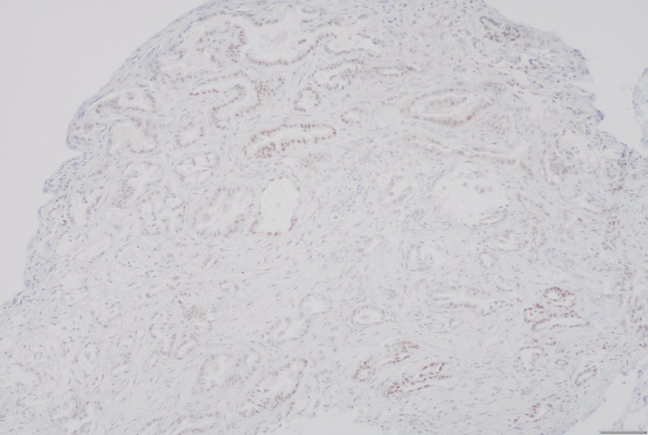
H&E,40x​
CK-7,10x​
CK-20,10x
CDX2,10x
The biopsy shows a moderately differentiated adenocarcinoma which is diffusely positive for CK-7, patchy positive for CK-20, and weak positive for CDX2.

Slide 7
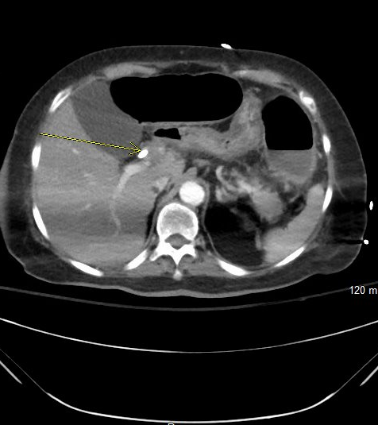
Chest CT revealed a mass along the CBD​
CT chest showed a 2x 2 cm mass along the common bile duct with moderate intrahepatic duct dilation.
The leftportal vein was either occluded or infiltrated by a mass (see imaging)​

Slide 8
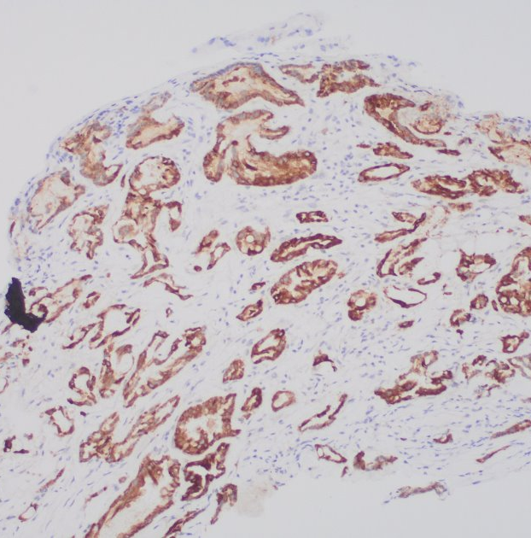
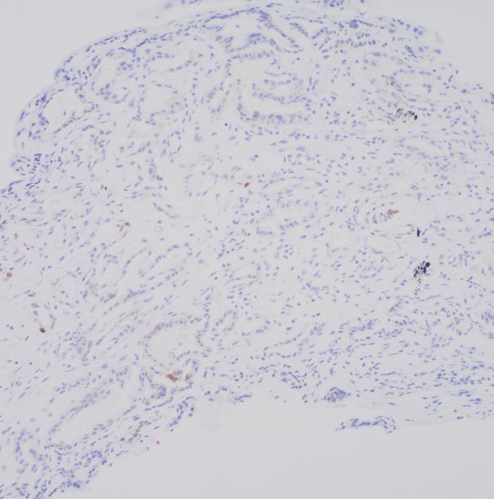
MUC-1, 10x
MUC-2, 10x​
Tumor cells are diffusely positive for MUC-1 and negative for MUC-2.

