Slide 1
Case of the month May 2025
Sonal Italiya, MD, (Pathology Resident,PGY-2)
Oluwaseyi Olayinka, MD (Assistant Professor)
E. Celia Marginean, MD (Professor, Director of GI/Liver fellowship)

Slide 2
The duodenum shows Brunner gland hyperplasia
The ampulla (arrow) and
pancreatoduodenal groove shows marked fibrosis, few abscess formation along with dilated and ruptured ducts containing
proteinaceous material (arrow heads)
H &E, 20x

Slide 3
The high-power view shows ampulla and pancreatoduodenal groove with marked fibrosis and dilated ducts containing proteinaceous material
(arrow heads)
H&E,40x

Slide 4
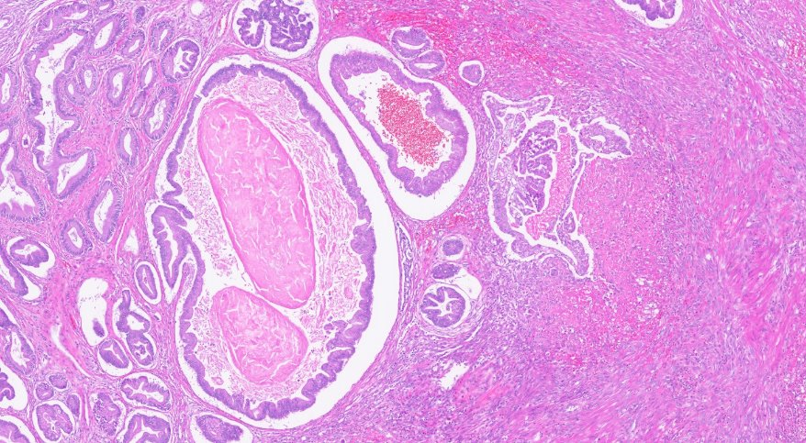
H&E,100x
An 1mm focus of invasive adenocarcinoma next to ampulla (circled). Ampulla shows focal low and high-grade dysplasia

Slide 5
H&E,100x
The high-power view shows dysplastic epithelium

Slide 6
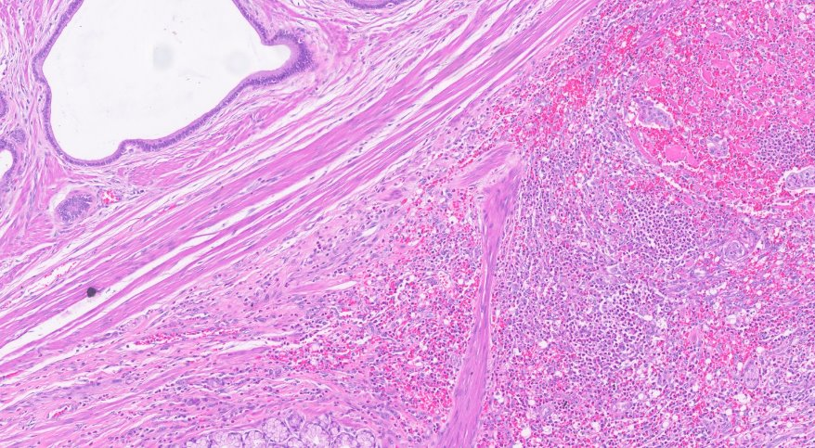
H&E, 100x
Minute foci and single cells of invasive adenocarcinoma (circled) admixed with purulent exudate

Slide 7
H&E,100x
The high-power view shows focus of invasive adenocarcinoma

Slide 8
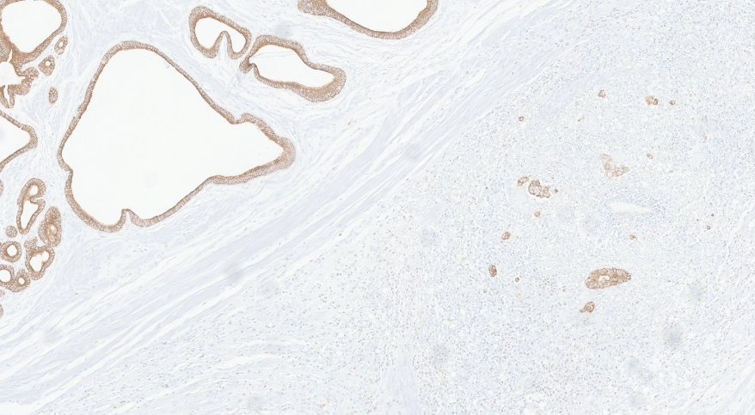
Keratin AE1/3, 100x
Minute foci and single cells of invasive adenocarcinoma (circled) confirmed by pan cytokeratin

