Slide 1
Case of the month
June 2025
Dorsay Sadeghian, MD (PGY2)
Roshan Raza, MD (Assistant professor)

Slide 2
Clinical History
A 47-year-old male patient presented with occasional dysphagia.
An upper gastrointestinal endoscopy was performed, revealing a 2.8 cm esophageal nodule with intact overlying epithelium, showing no signs of erosion or ulceration. Biopsies were obtained from the lesion for further evaluation.

Slide 3
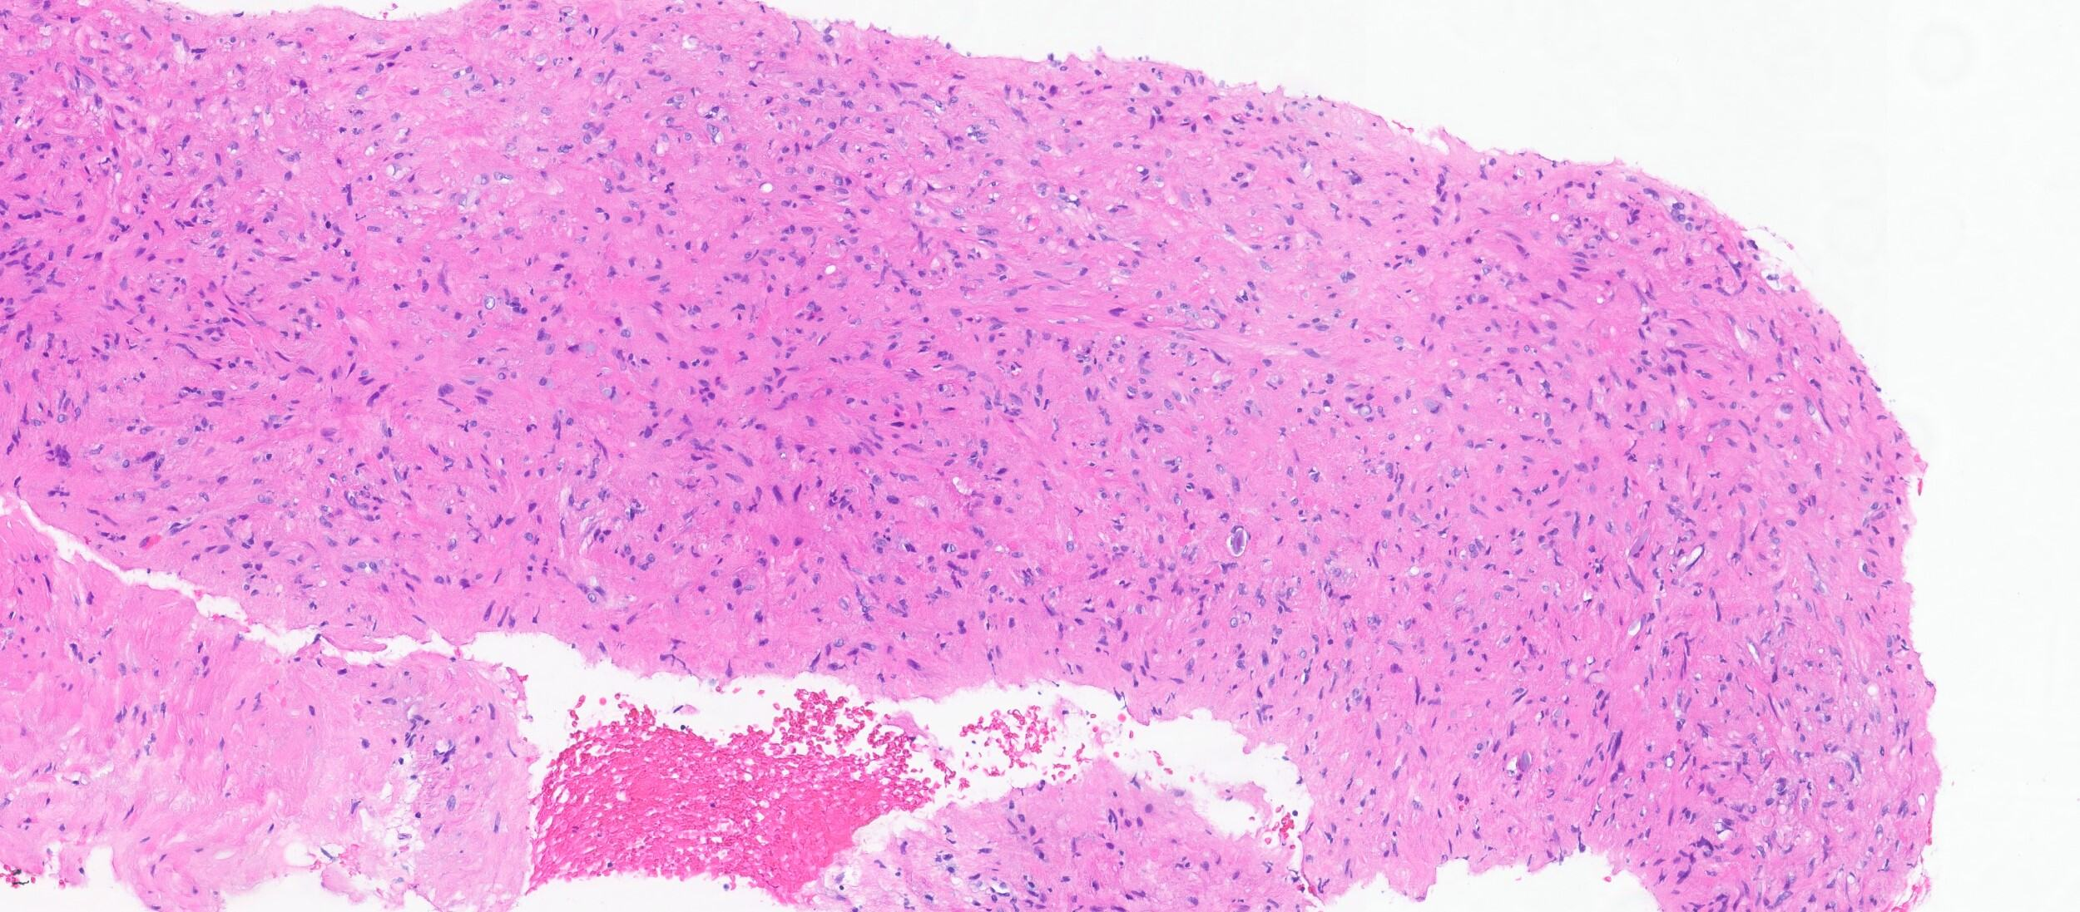
Microscopic examination of the biopsy revealed a moderately cellular neoplasm, consists of short fascicles of spindle cells with bland cytologic features. No evident mitotic activity or necrosis was observed.

Slide 4
Immunohistochemical staining for Desmin showed diffuse positive cytoplasmic expression.

Slide 5
Immunohistochemical staining for Smooth Muscle Actin (SMA) showed diffuse positive cytoplasmic expression.

Slide 6
Immunohistochemical staining for S100 showed negative results.

Slide 7
DOG1 and CD117 immunostaining demonstrated positive cytoplasmic and membranous expression in interspersed spindle cells, mimicking GIST.
CD117
DOG1

Slide 8
Discussion
Spindle cell neoplasms arising in the gastrointestinal tract encompass a spectrum of mesenchymal tumors. While gastrointestinal stromal tumors (GISTs) are the most frequently encountered, other possibilities include leiomyomas, leiomyosarcomas, and a variety of rare mesenchymal lesions.
Preoperative differentiation between a GIST and a leiomyoma is crucial, as leiomyomas are typically managed with enucleation, whereas GISTs may need more extensive resections, especially in esophageal GIST which in some cases may require esophagectomy.
Some leiomyomas have been found to contain a significant population of spindle-shaped cells that are positive for DOG1 and KIT, likely representing entrapped interstitial cells of Cajal (ICCs). These cells can be readily distinguished from mast cells by their spindled morphology, characterized by elongated dendritic processes that occasionally exhibit dichotomous branching.
Mast cells can also cause KIT positivity; however, they are usually presented in limited number, mainly oval shaped and have a denser chromatin pattern, in comparison with ICCs.
Interstitial cells of Cajal (ICCs) can be present in substantial number, distributing throughout the whole leiomyoma. Significant DOG1 and KIT positivity can raise suspicion for a gastrointestinal stromal tumor (GIST). This overlap can pose significant diagnostic challenges, particularly in small biopsy samples.
A combination of histomorphology of KIT positive cells (presence of dendritic cytoplasmic extensions), as well the immunohistochemical findings (including presence of extensive smooth muscle cell markers positivity) can be helpful in better distinction and categorization of these tumors.
Although this finding is predominantly seen in deep seated leiomyomas, there are some reports of superficial leiomyomas with entrapped DOG1 and CD117 positive ICCs.

Slide 9
References
Deshpande A, Nelson D, Corless CL, Deshpande V, O'Brien MJ. Leiomyoma of the gastrointestinal tract with interstitial cells of Cajal: a mimic of gastrointestinal stromal tumor. Am J Surg Pathol. 2014 Jan;38(1):72-7. doi: 10.1097/PAS.0b013e3182a0d134. PMID: 24145645.
Janevska V, Qerimi A, Basheska N, Stojkova E, Janevski V, Jovanovic R, Zhivadinovik J, Spasevska L. Superficial leiomyomas of the gastrointestinal tract with interstitial cells of Cajal. Int J Clin Exp Pathol. 2015 Dec 1;8(12):15977-84. PMID: 26884872; PMCID: PMC4730085.

