Slide 1
Case of the month
September 2025
Laura Cuello, MD (Pathology Resident, PGY-2)
E. Celia Marginean, MD

Slide 2
Clinical Presentation
48-year-old male with past medical history of metastatic esophageal adenocarcinoma, status post neoadjuvant chemotherapy and radiotherapy (2023) followed by esophagogastrectomy with no residual carcinoma (2024), on Xeloda-Nivo (capecitabine and nivolumab) presents with abdominal pain, worsening jaundice, and elevated liver function tests.
Alkaline phosphatase: 758 U/L, Total Bilirubin: 11.9 mg/dL, Direct Bilirubin: 8.1 mg/dL, AST: 321 U/L, ALT: 272 U/L.
Abdominal and pelvic CT showed mesenteric and retroperitoneal lymphadenopathy throughout the abdomen and pelvis. No focal liver masses or intra or extrahepatic biliary ductal dilation was seen.
An ultrasound guided liver core biopsy was performed.

Slide 3
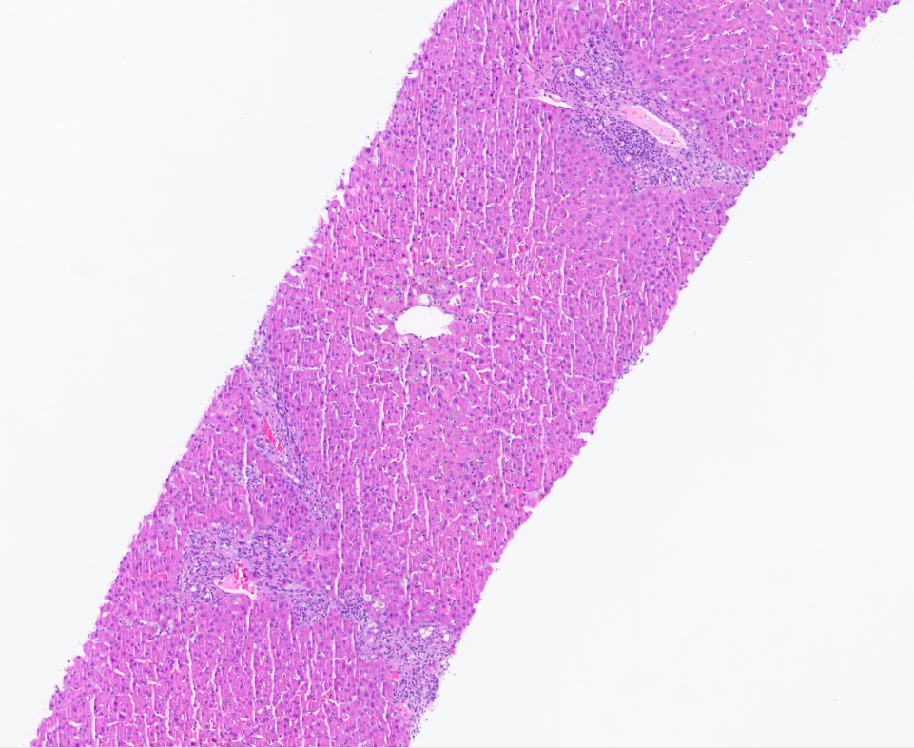
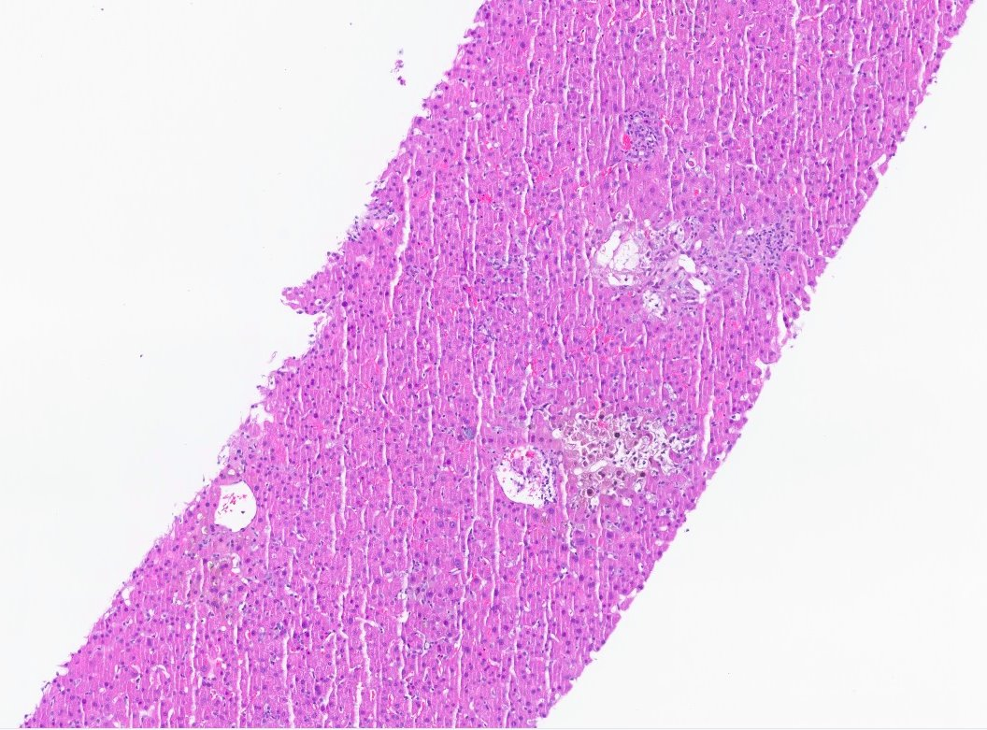
Features supporting a diagnosis of immune checkpoint inhibitor toxicity:
Severe perivenular cholestasis and perivenular hepatocytic dropout with perivenulitis (circled);

Slide 4
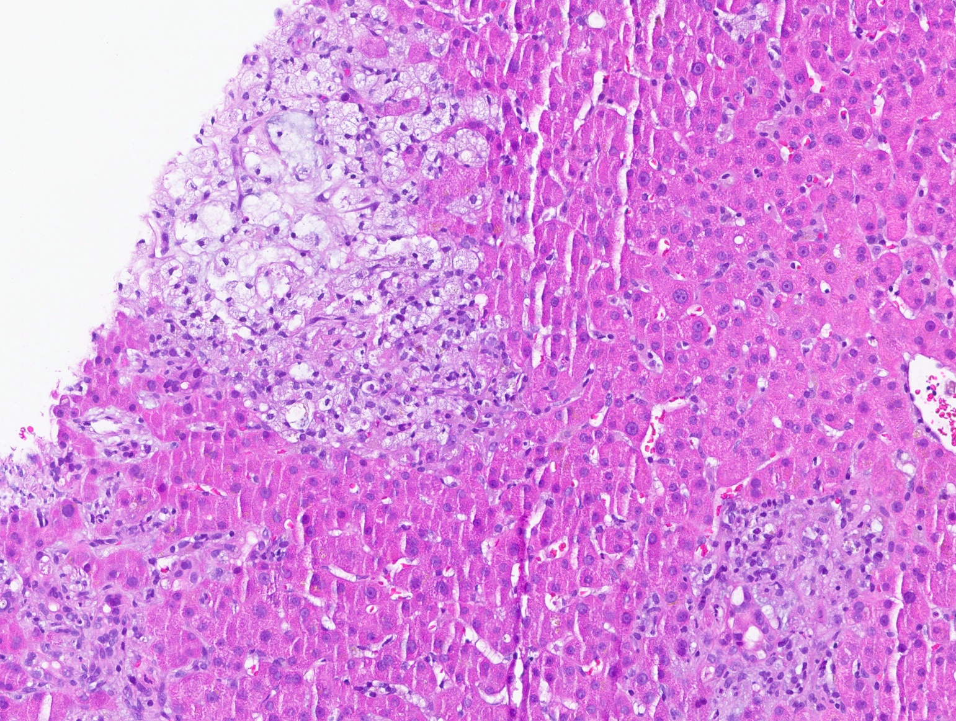
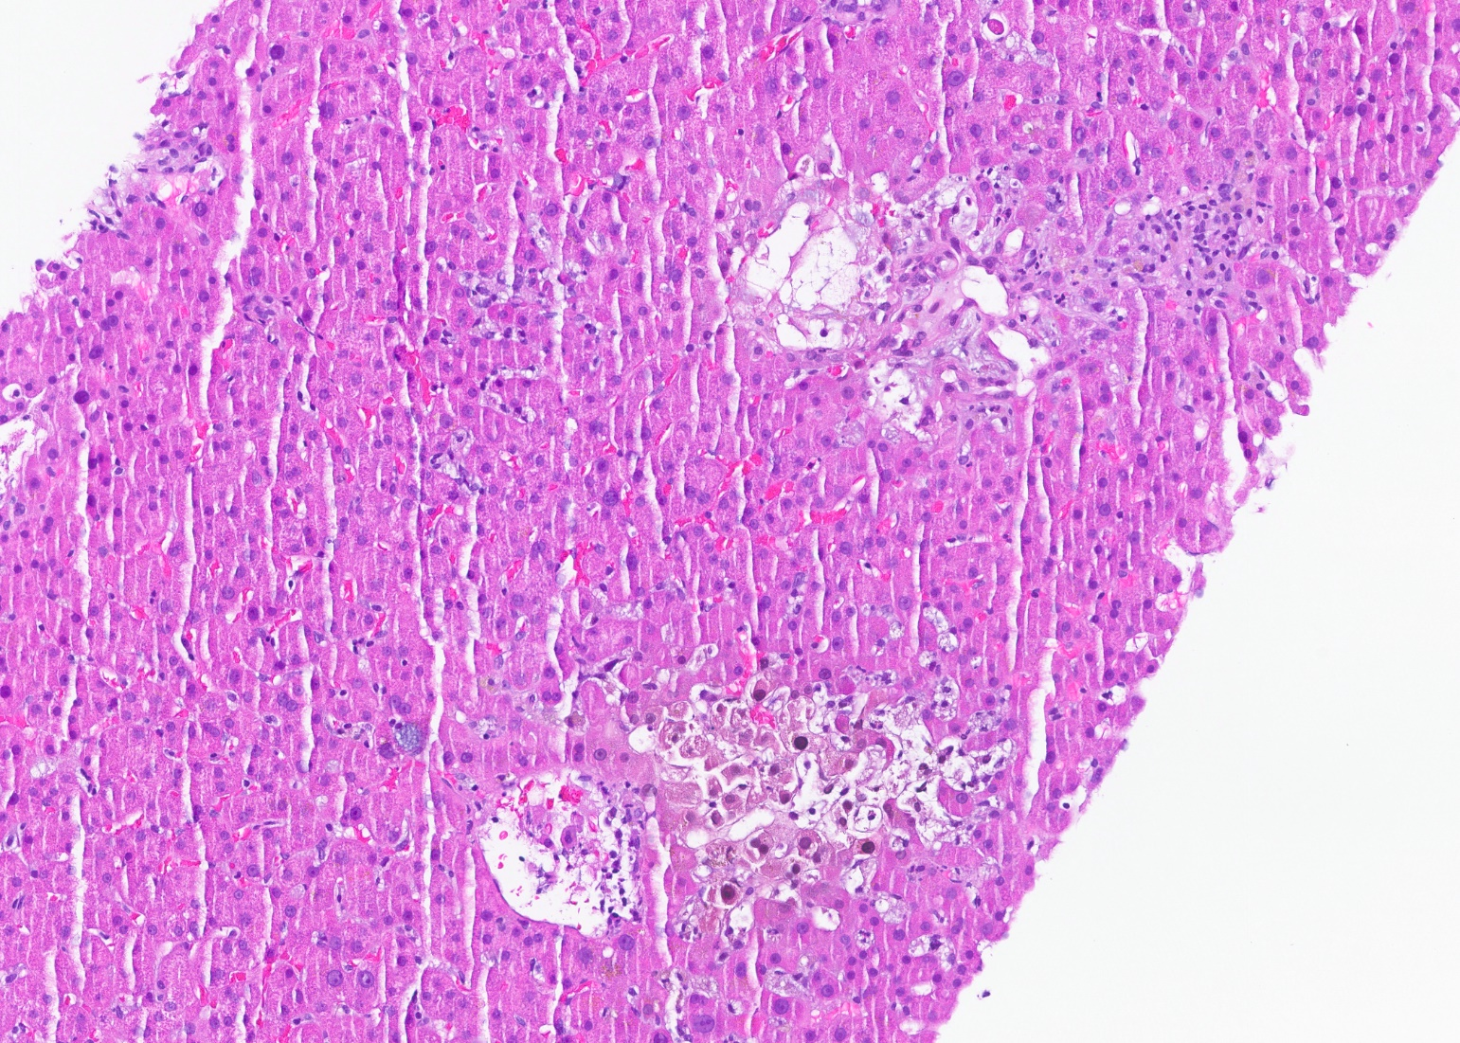
Collections of foamy histiocytes within the lobules, some forming granulomata, arrow
Perivenular cholestasis (arrow head)

Slide 5
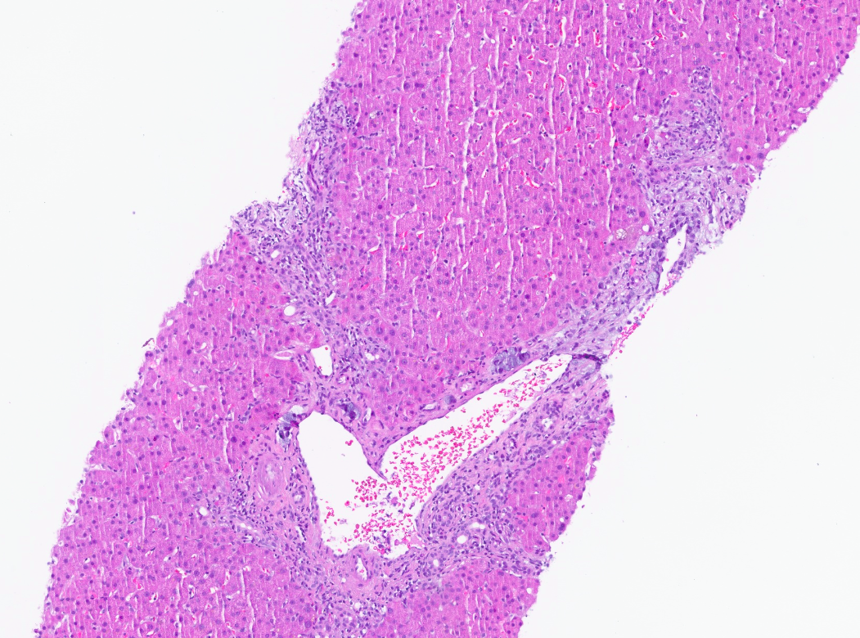
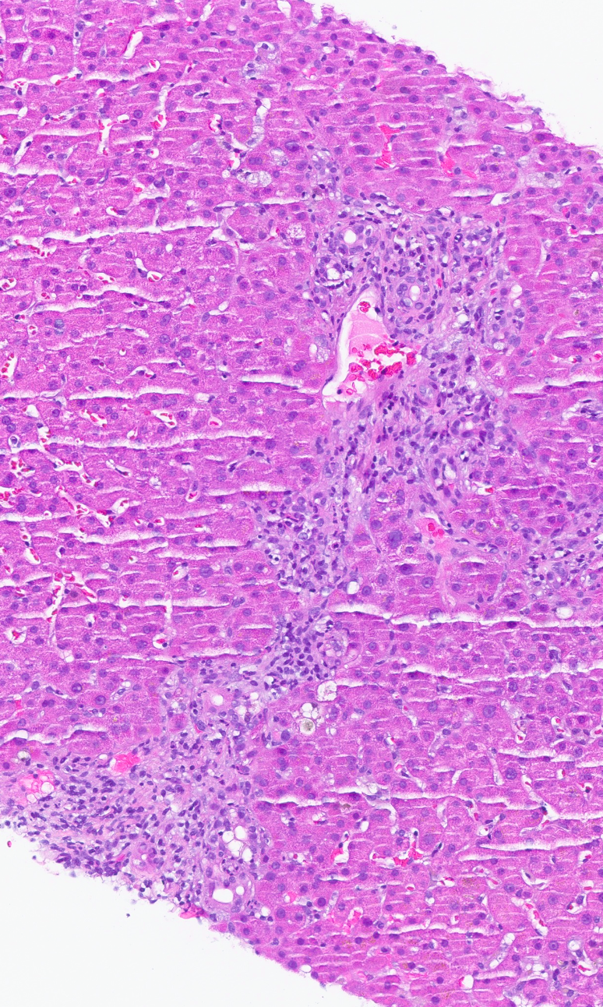
Features supporting a diagnosis of immune checkpoint inhibitor toxicity:
Portal expansion by mixed lymphocytic and neutrophilic inflammatory infiltrate with rare eosinophils and extensive bile ductular proliferation

Slide 6
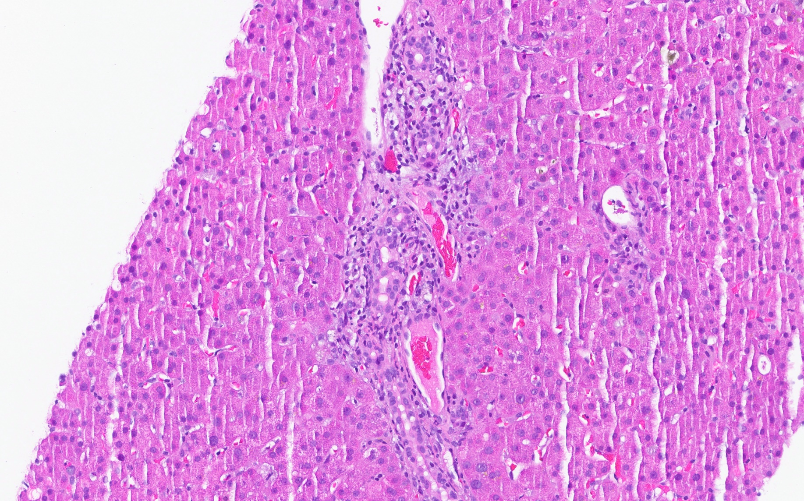
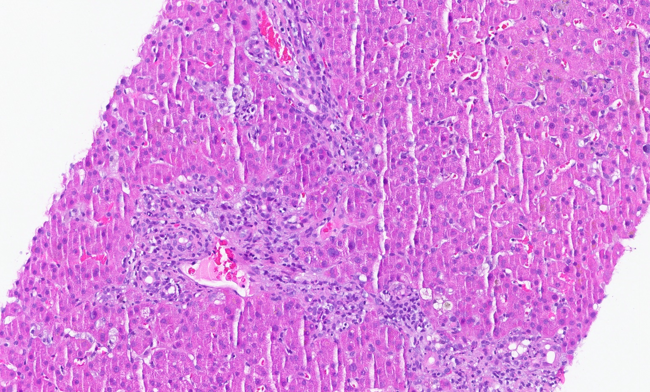
Mixed portal inflammation

Slide 7
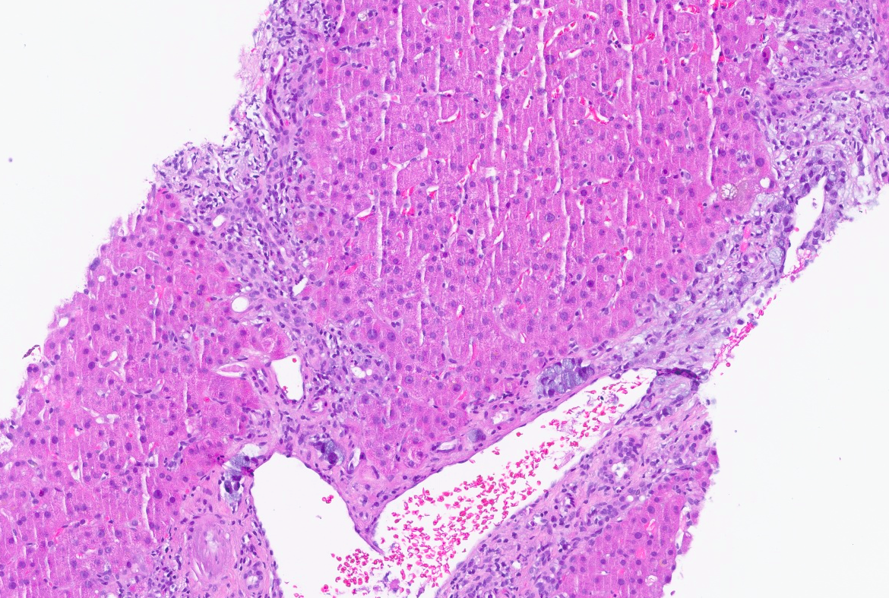
A single portal tract shows a few signet ring cells present within lymphatics and stroma (arrows).

Slide 8
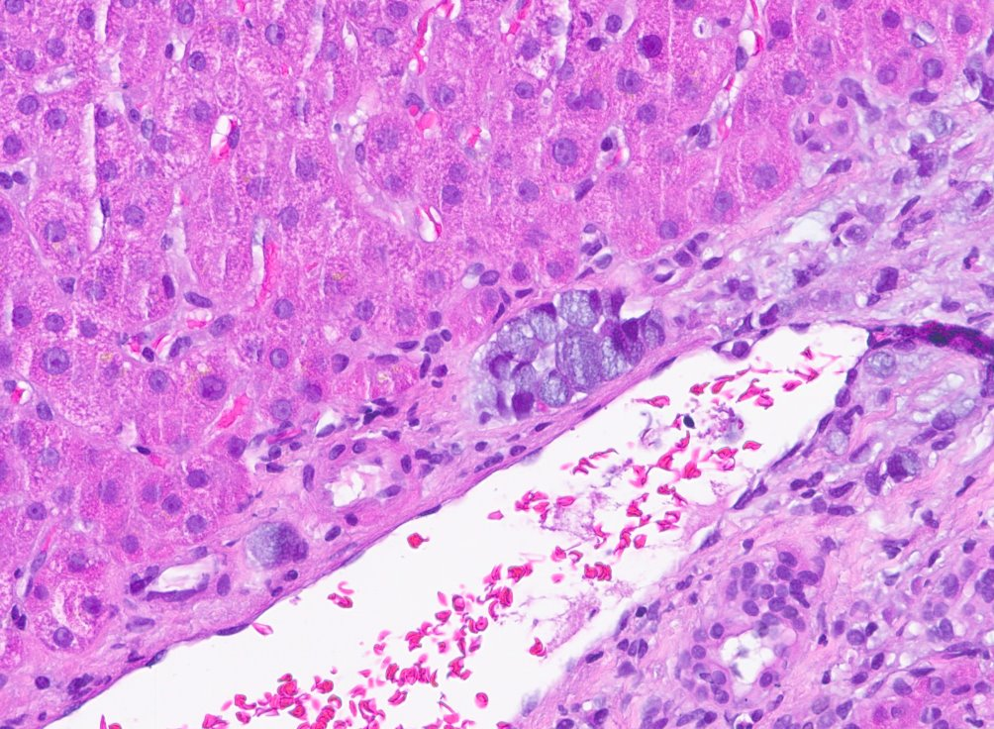
These cells have abundant intracytoplasmic mucin that pushes the nucleus to the side, giving the classic signet ring appearance. They are positive for CK7 and keratin CAM 5.2.

Slide 9
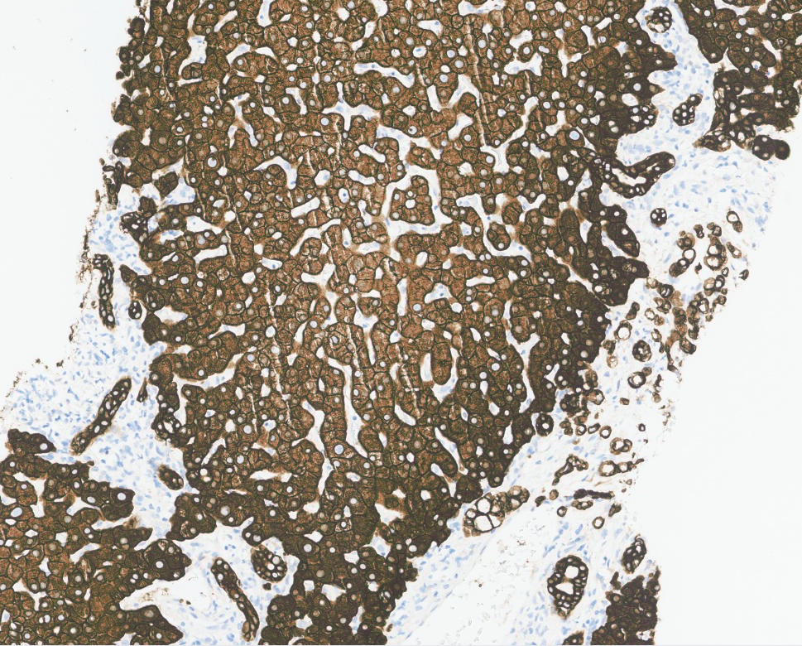
CAM 5.2

