Slide 1
Introduction to Disability
Vaishnavi Sankar

Slide 2
Disclosures:
This work is supported by the Texas Council for Developmental Disabilities through a grant from the U.S. Administration for Community Living (ACL), Department of Health and Human Services (HHS), Washington, D.C. 20201, with a 100% federal funding award totaling $6,121,860. Council efforts are those of the grantee and do not necessarily represent the official views of nor are endorsed by ACL, HHS, or the U.S. government.

Slide 3
Introductions!

Slide 4
Course Logistics
Attend interactive small group learning sessions, 1 excused absence permitted (email emacosta@bcm.edu)
Attend clinic visits with assigned patient/family
Reflect on clinical experience, brief (1 paragraph) reflection submitted
Ask questions and give feedback, this is a pilot/first iteration of this elective and we want to make it awesome

Slide 5
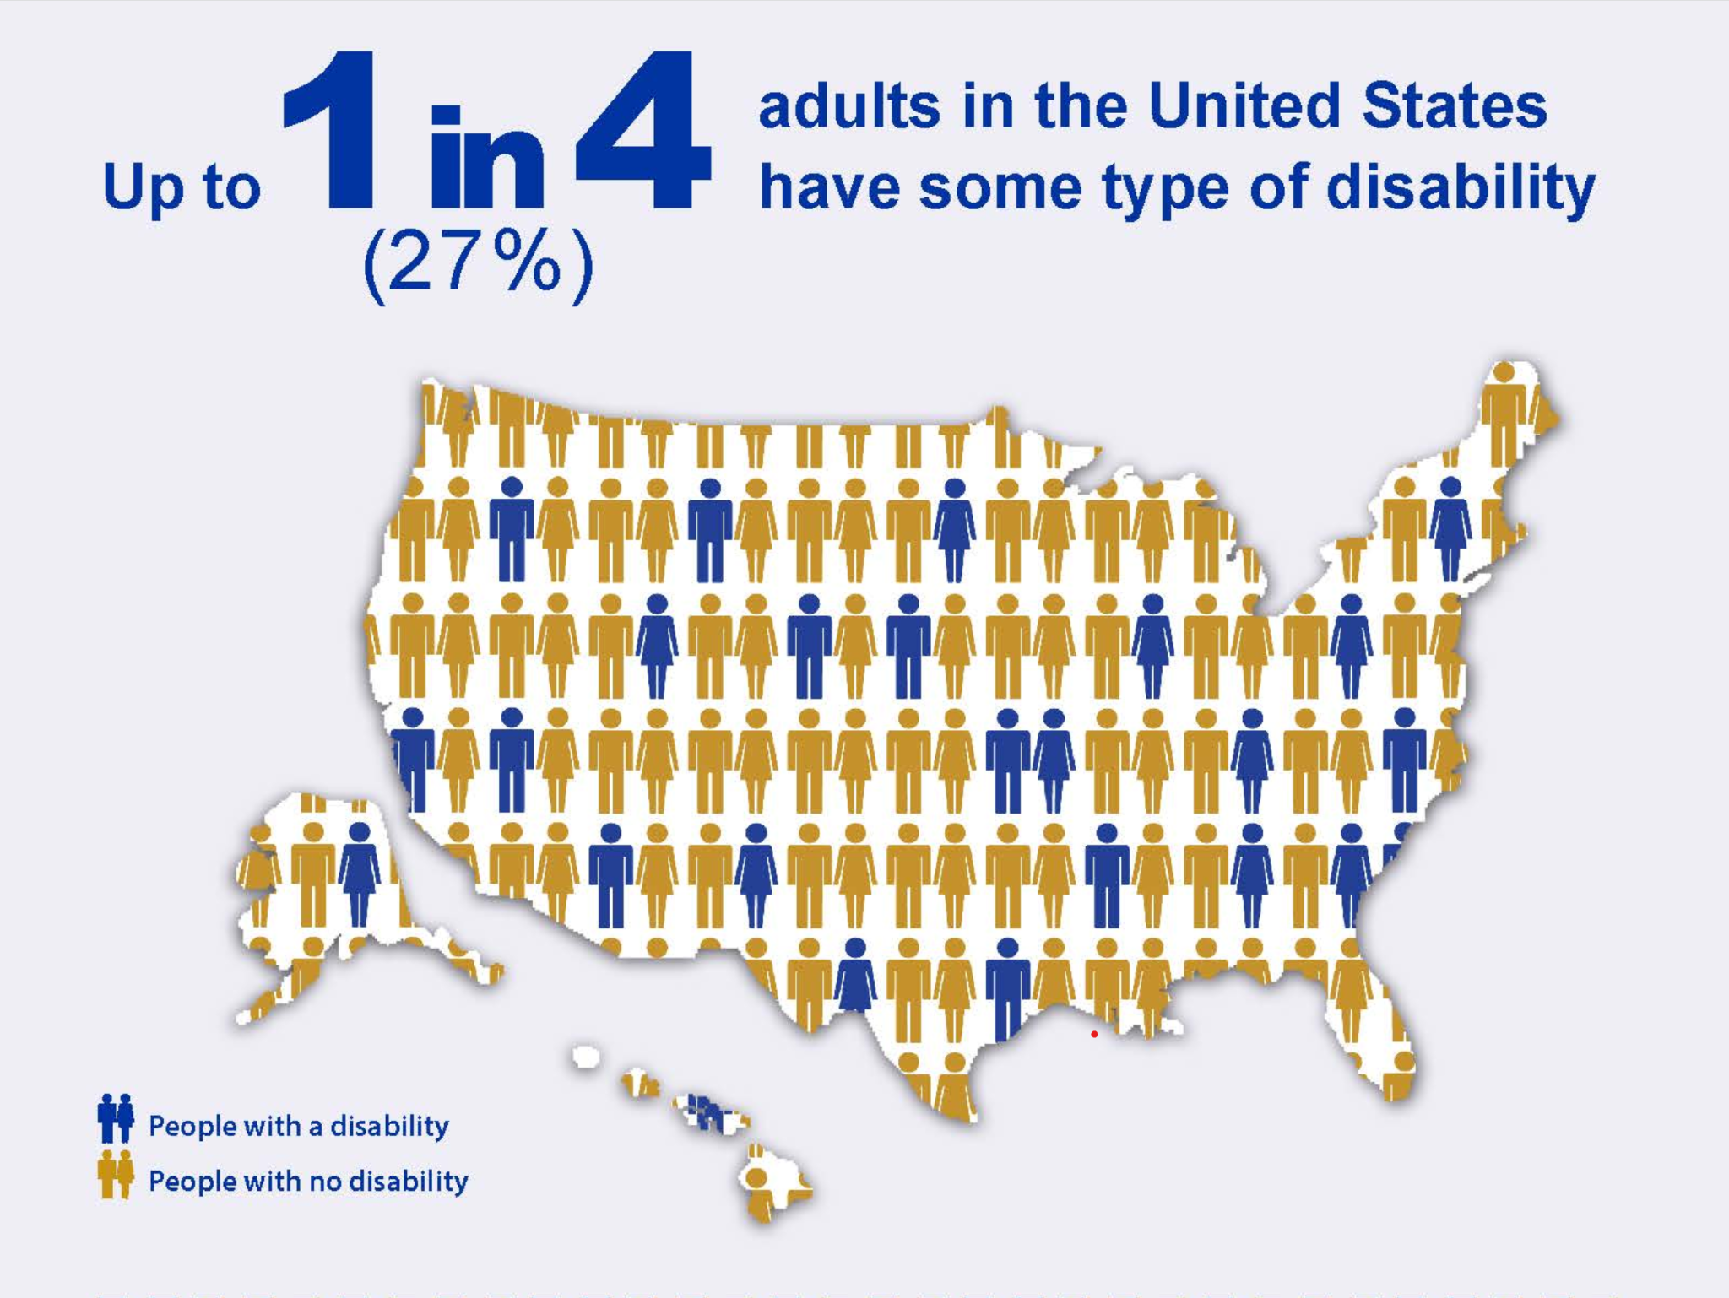
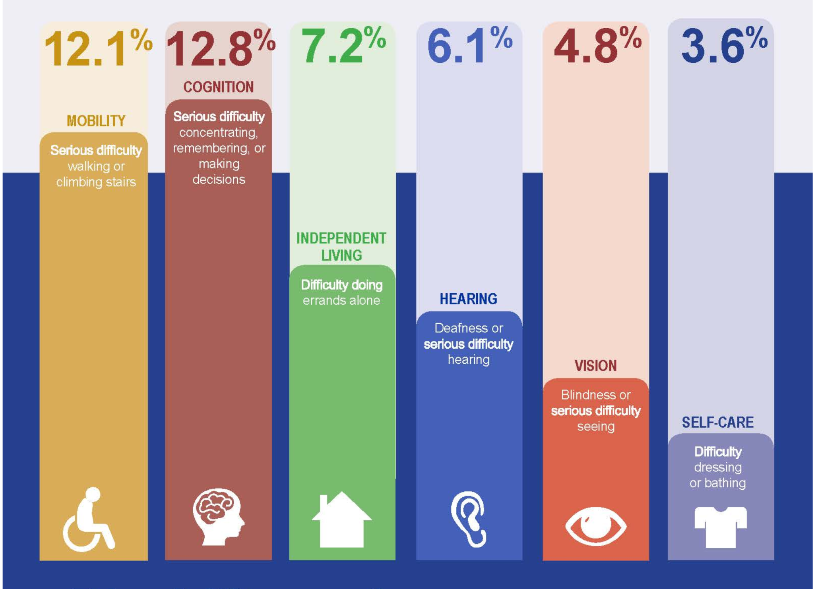
Disability in the US
Notes:
Ask: what % of americans do you think have a disability?
https://www.cdc.gov/ncbddd/disabilityandhealth/infographic-disability-impacts-all.html

Slide 6
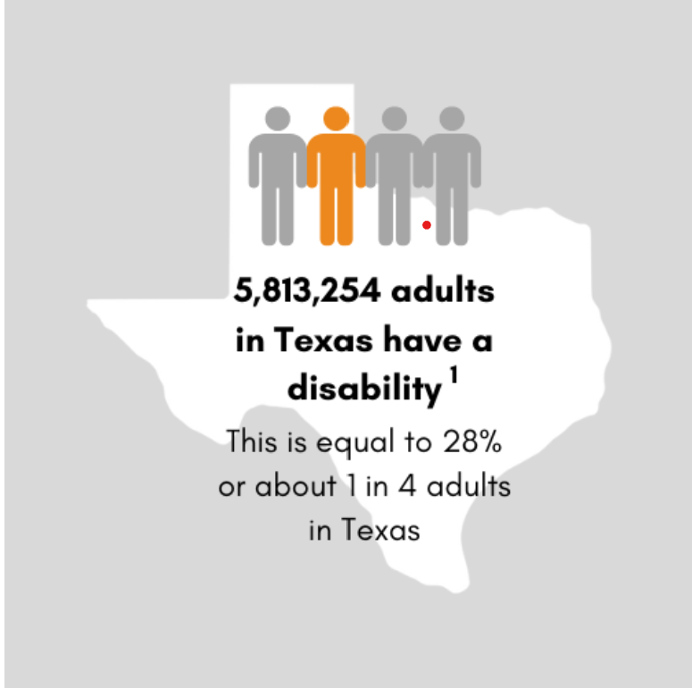
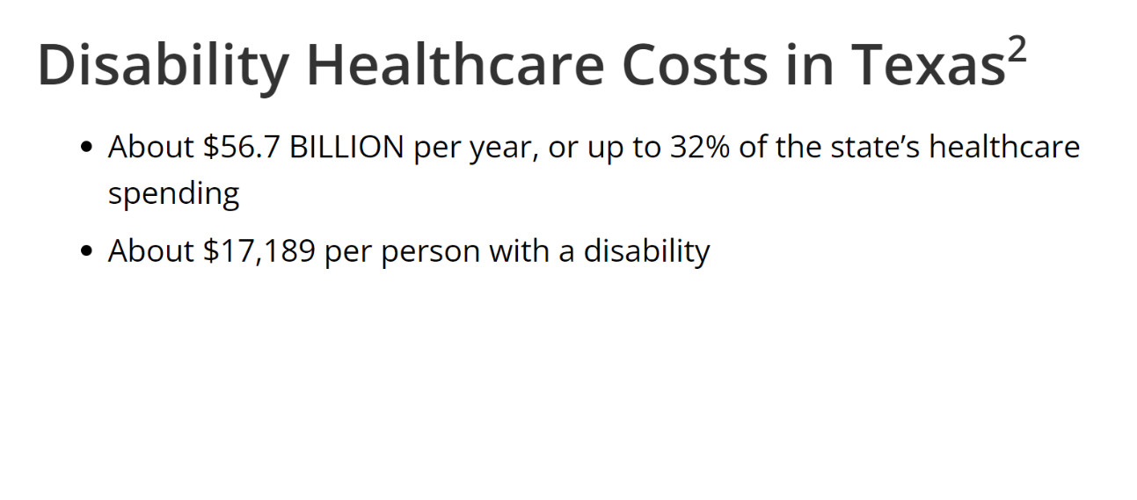
Harris County has the largest amount of people per county with disabilities (426,349 people or 9.2%)
Notes:
https://disabilitycompendium.org/compendium/2019-state-report-for-county-level-data-prevalence/TX
https://gov.texas.gov/uploads/files/organization/twic/Disabilities-Summary.pdf

Slide 7
Disability in Medicine
A 2019 study found that 4.6% of medical students identify as having a disability
A 2021 study found that 3.1% of providers identify as having a disability
Another 2021 study found that 80% of physicians perceive patients with disabilities to have a lower quality of life than patients without disabilities
Notes:
Iezzoni LI, Rao SR, Ressalam J, et al. Physicians’ perceptions of people with disability and their health care. Health Aff. 2021;40(2):297‐306. doi: 10.1377/hlthaff.2020.01452
Nouri Z, Dill MJ, Conrad SS, Moreland CJ, Meeks LM. Estimated prevalence of US physicians with disabilities. JAMA Network Open. 2021;4(3):e211254‐e211254. doi: 10.1001/jamanetworkopen.2021.1254
Meeks LM, Case B, Herzer K, Plegue M, Swenor BK. Change in prevalence of disabilities and accommodation practices among US medical schools, 2016 vs 2019. JAMA. 2019;322(20):2022‐2024. doi: 10.1001/jama.2019.15372
https://www.ncbi.nlm.nih.gov/pmc/articles/PMC8814984/

Slide 8
What are IDDs?
Intellectual and Developmental Disabilities are characterized by delays or limits in intellectual, cognitive, emotional, and/or social functioning. Examples of IDDs include:
Down Syndrome
Cerebral Palsy
ASD
Fragile X
FAS Disorder
Prader-Willi

Slide 9
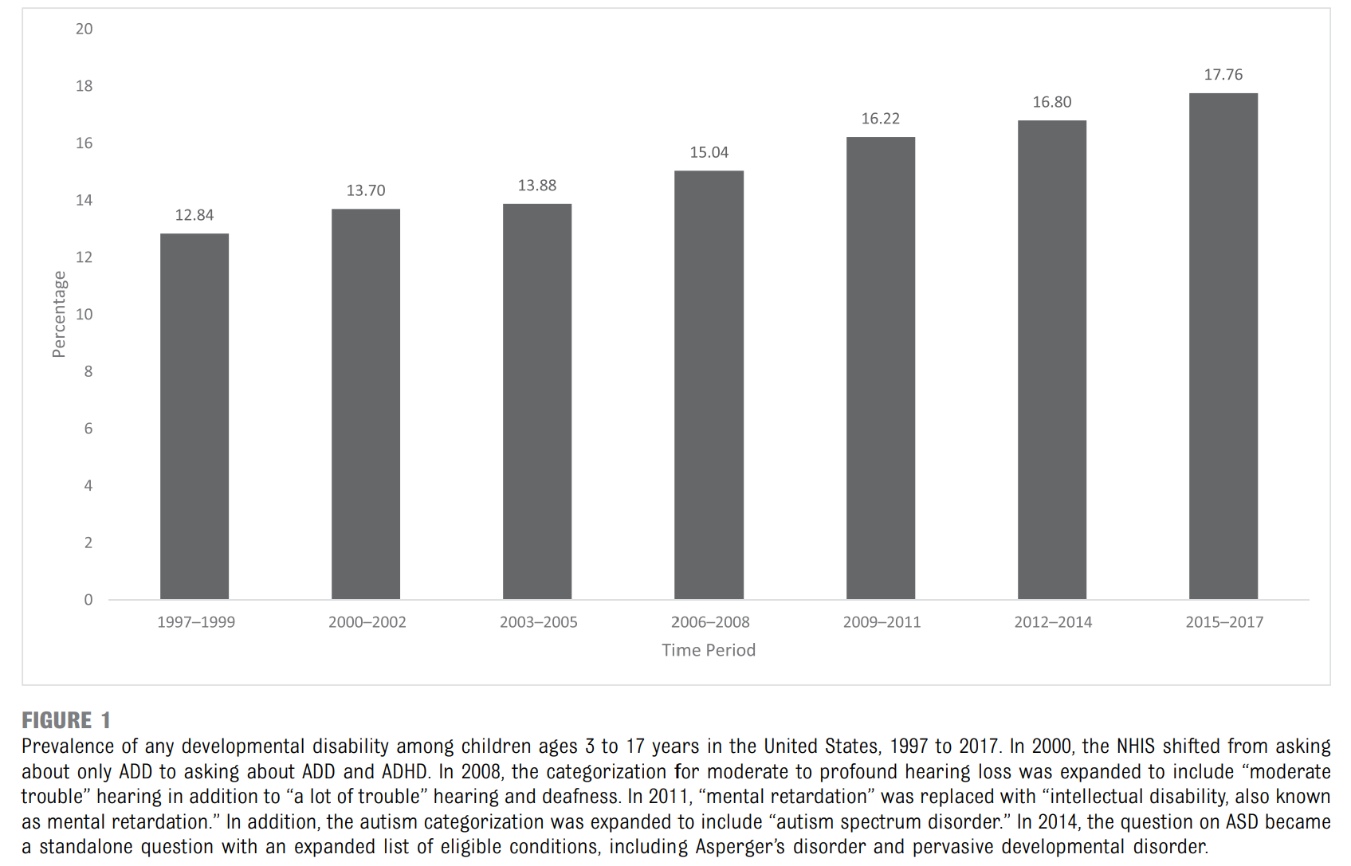
Trends in prevalence of IDDs among children in the US
Notes:
-increased prevalence of children with IDDs → increased need for c

Slide 10
How do you define health? How do you define disability?
Notes:
Spend 5 minutes asking people to brainstorm words they associate with health/disability and then share out

Slide 11
Defining Disability
According to the World Health Organization, disability has three dimensions:
Impairment in a person’s body structure or function, or mental functioning; examples of impairments include loss of a limb, loss of vision or memory loss.
Activity limitation, such as difficulty seeing, hearing, walking, or problem solving.
Participation restrictions in normal daily activities, such as working, engaging in social and recreational activities, and obtaining health care and preventive services.
Notes:
https://www.cdc.gov/ncbddd/disabilityandhealth/disability.html

Slide 12

Reading Break
Reflection Questions:
What assumptions do we make about disabled people?
What is ableism and how does it present in medical school/medicine?
What is the role/goal of medicine in supporting people with disabilities?
“Three Things Clinicians Should Know About Disability”
Notes:
https://journalofethics.ama-assn.org/article/three-things-clinicians-should-know-about-disability/2018-12
5 mins

Slide 13
“My Body Doesn’t Oppress Me, Society Does”
https://www.youtube.com/watch?v=7r0MiGWQY2g&ab_channel=BarnardCenterforResearchonWomen
Notes:
5 mins

Slide 14
What parts of the video did you resonate with?
Notes:
5 mins

Slide 15
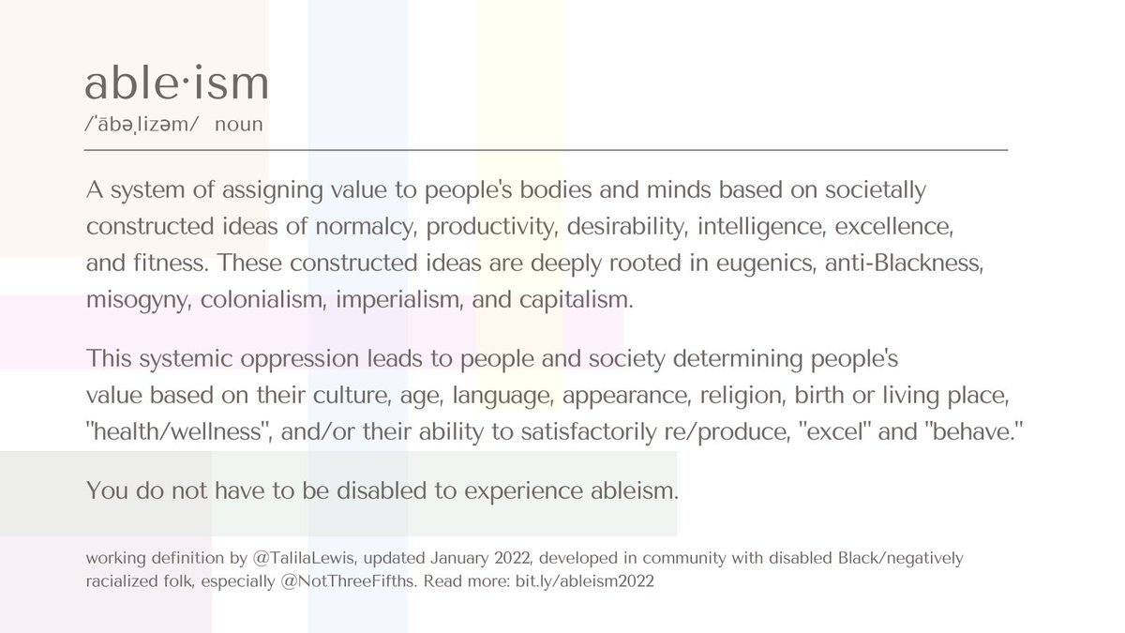
Notes:
-disability is inextricably linked with every other social determinant of health, ableism is very much rooted in racism sexism eugenics etc.

Slide 16
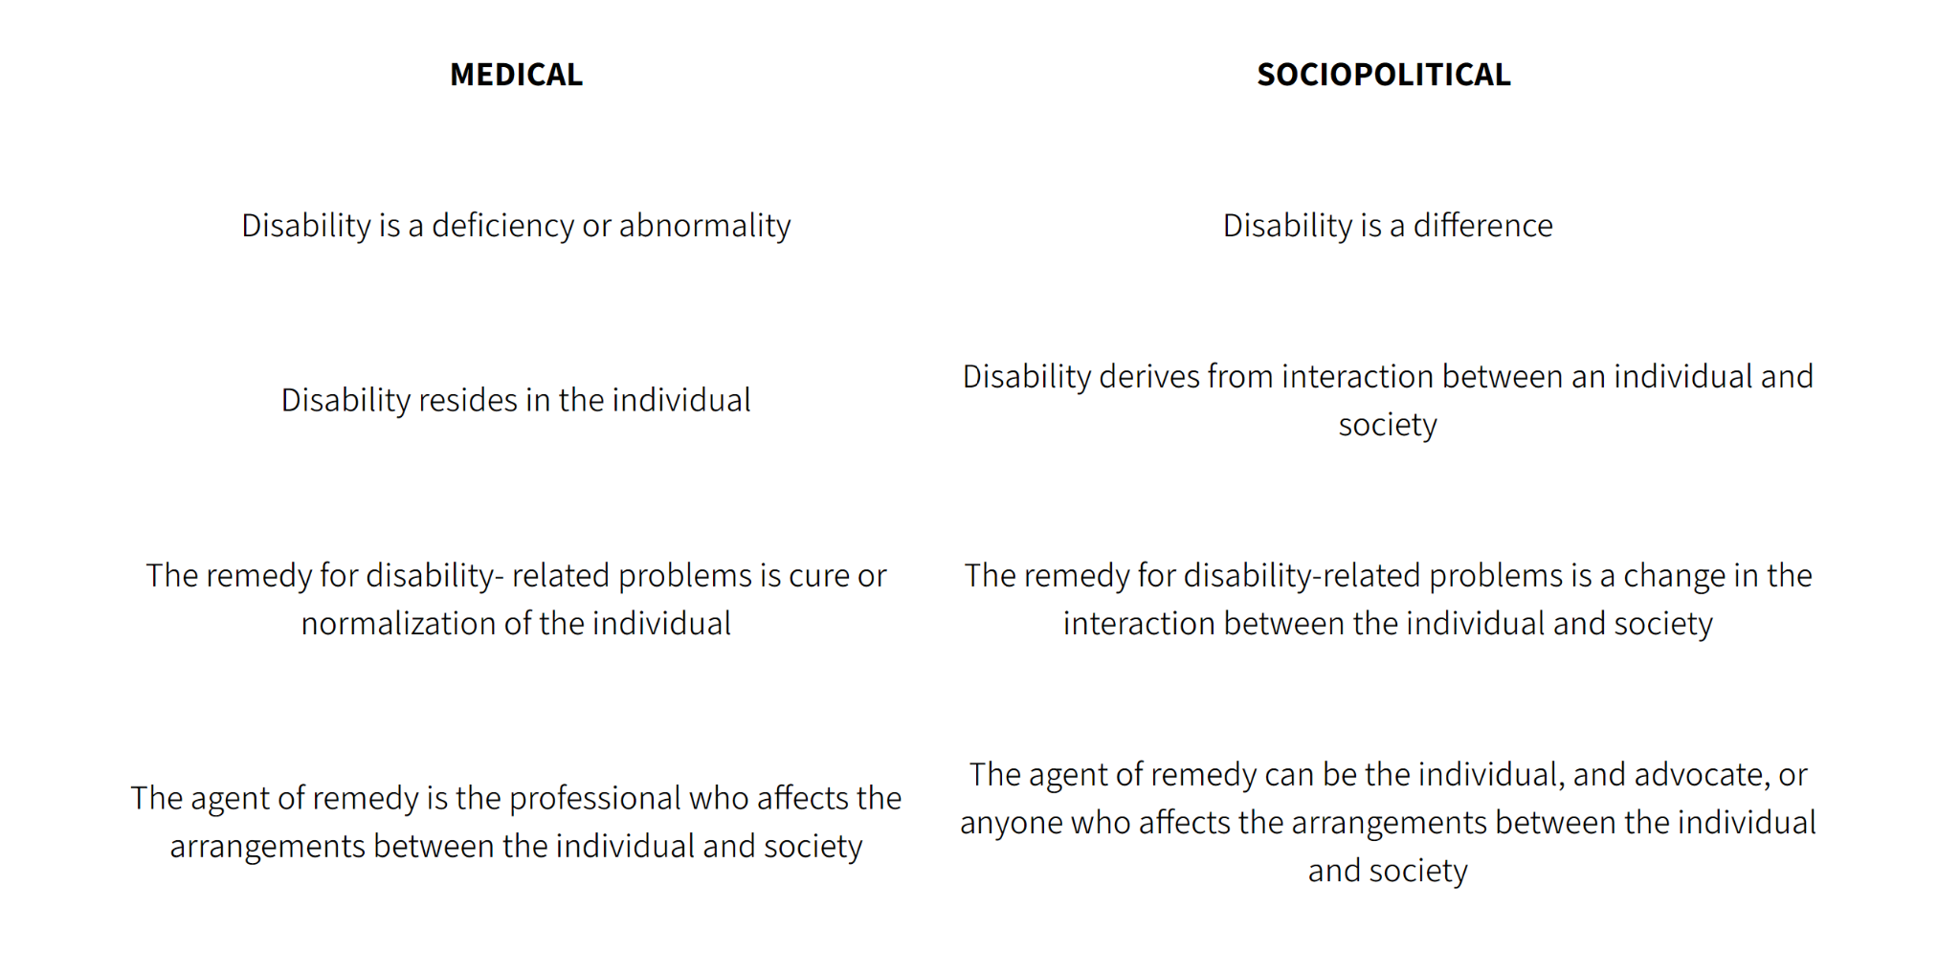
Medical Model vs. Social Model

Slide 17
What are some ways we learn/practice within the medical model of disability?
What are some ways we can incorporate the social model of disability in our learning/practice?

Slide 18
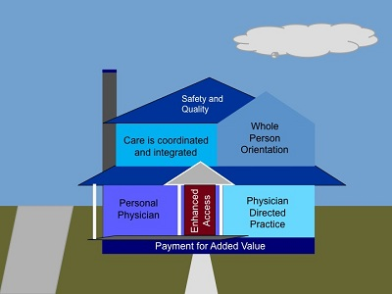
Patient-Centered Medical Home
PCMH is a model of care that puts patients at the forefront of care. It consists of 7 main principles:
Personal physician
physician -directed medical practice
Whole person orientation
Care coordination
Quality and Safety
Enhanced Access to Care
Payment reflects added value
Notes:
-each patient has their own personal physician who provides continuous, comprehensive care
-physician leads a team of providers who each have their own responsibilities in providing comprehensive care
-personal physician is responsible for providing/arranging care for all of the patient’s health needs alongside other healthcare professionals
-care is coordinated across home health agencies, subspecialty care, hospital care, nursing homes, community-based services, etc.
-patient satisfaction is a huge component of PCMH, patients and families are centered in decision-making process
-more scheduling flexibility, practices incorporate technology which allow for easier communication
-reimbursement by insurance acknowledges added value of having coordinated integrated care
-practices must be certified through outside agency to become a “medical home”. PCP will receive one flat payment from insurance to cover most of the care provided. The amount will be based on the patient's health issues and complexity.
https://pubmed.ncbi.nlm.nih.gov/25562484/

Slide 19
Utility of PCMH for People with Disabilities
Improved communication between multiple care providers
Integrated/Coordinated care
Continuity of care
Emphasis on patient-centered outcomes and patient autonomy
Increased access to care
The BCM Transition Medicine Clinic has NCQA’s PCMH Recognition!
Notes:
https://pubmed.ncbi.nlm.nih.gov/25562484/
Transition

Slide 20
Disparities Among People with Disabilities
Discussion Question:
What barriers may people with disabilities face in accessing healthcare services?

Slide 21
Houston, TX Statistics
32% of working-age people with disabilities live below poverty compared with 16% of those without disabilities.
37% of working-age people with disabilities are employed compared with 76% of those without disabilities
27% of households with a person with a disability pay >50% of their income for housing compared with 16% of those with no disability in the Houston Metropolitan Statistical Area.

Slide 22
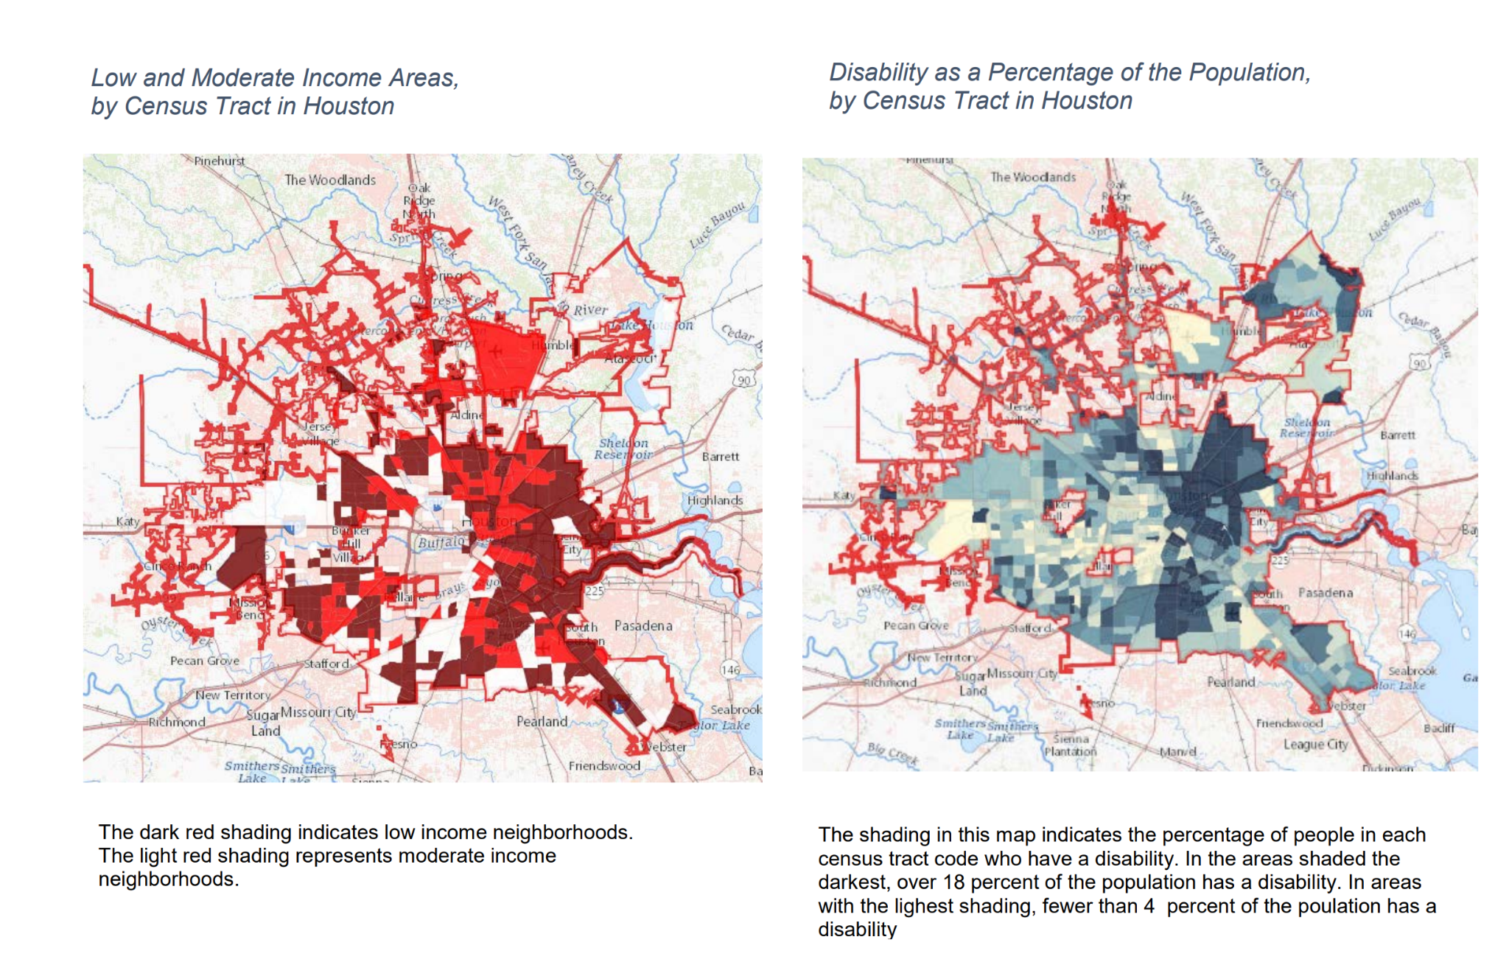
Poverty and Disability in Houston, TX
Notes:
https://www.houstontx.gov/disabilities/Houston-from-a-Disability-Perspective.pdf

Slide 23
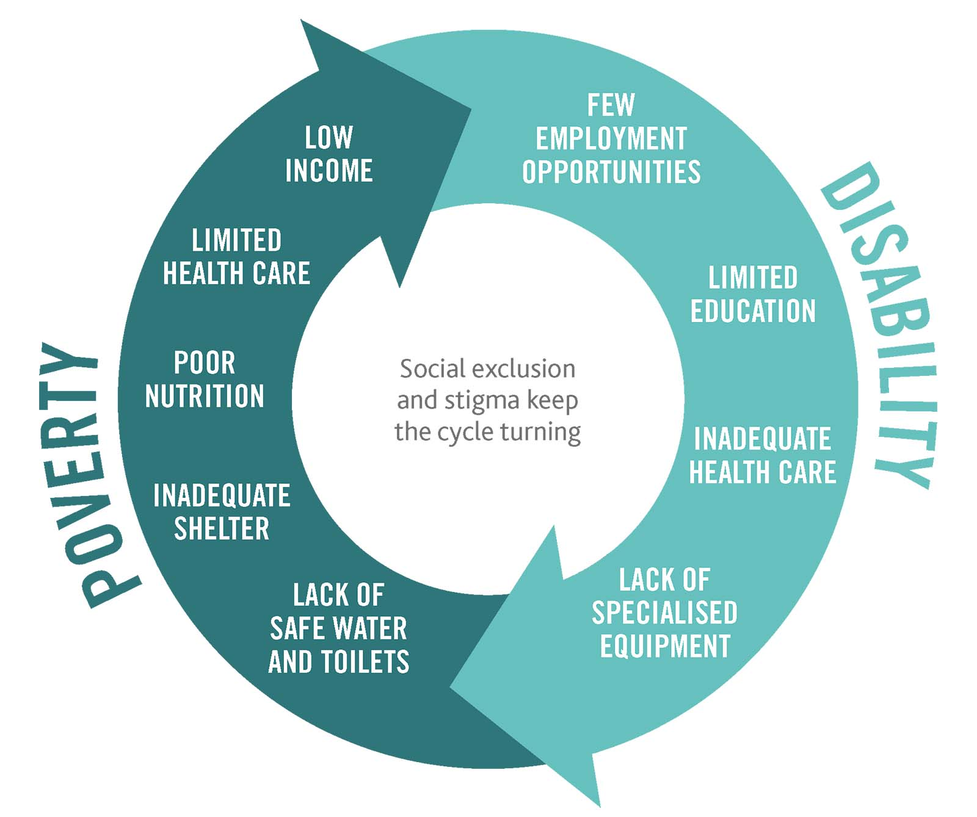
The cycle of poverty and disability
Poverty is a cause and consequence of disability
Disability is a cause and consequence of poverty
Notes:
Those living in poverty are more likely to become disabled, and those who are disabled are more likely to become poor

Slide 24
Federal Aid for People with Disabilities
Social Security Disability Insurance (SSDI): Payroll tax-funded federal insurance program that provides income supplements to people who are restricted in their ability to be employed because of a “qualifying” disability
“DAC” - disabled adult child
Supplemental Security Income (SSI): Provides payments to people with limited income and resources who are age 65 or older, blind, or have a qualifying disability. Children with a qualifying disability can also get SSI.
Notes:
https://www.ssa.gov/redbook/eng/overview-disability.htm
SSDI - must have a “qualifying disability” and must have worked enough to earn a certain # of “work credits” in the time before acquiring your disability (varies based on age/when you acquired disability)
Children who were receiving benefits as a minor child on a parent’s Social Security record may be eligible to continue receiving benefits on that parent’s record upon reaching age 18 if they have a qualifying disability.
DAC- age 18>, have a qualified disability that began before age 22 can receive benefits on their parent’s social security record
-DAC benefits typically end if the DAC gets married
SSDI - based on disability and work credits, SSI - based on age/income/disability/limited resources

Slide 25
Other Aid
Medicare - federal health insurance for people>65 and people with disabilities
Medicaid - provides health coverage to eligible low-income adults, children, pregnant women, elderly adults and people with disabilities. Funded jointly by federal govt and states and administered by states
SNAP - food assistance program for low-income people/families
CHIP - program for children without health insurance whose families earn too much to get Medicaid but cannot afford health insurance (does not provide long-term services)
Medicaid Buy-In for Children- offers low-cost Medicaid services to children with disabilities in families that make too much money to get Medicaid
TANF - provides cash payments to help low-income families pay for food, clothing, housing and other essentials.

Slide 26
References
“2019 State Report for County-Level Data: Prevalence.” 2019 State Report for County-Level Data: Prevalence | Annual Disability Statistics Compendium, disabilitycompendium.org/compendium/2019-state-report-for-county-level-data-prevalence/TX. Accessed 11 Aug. 2023.
Disabilities Summary - Office of the Texas Governor, gov.texas.gov/uploads/files/organization/twic/Disabilities-Summary.pdf. Accessed 12 Aug. 2023.
“Disability and Health Overview.” Centers for Disease Control and Prevention, 16 Sept. 2020, www.cdc.gov/ncbddd/disabilityandhealth/disability.html.
“Disability Impacts All of Us Infographic.” Centers for Disease Control and Prevention, 15 May 2023, www.cdc.gov/ncbddd/disabilityandhealth/infographic-disability-impacts-all.html.
Hernandez, Brigida, et al. “Patient-Centered Medical Homes for Patients with Disabilities.” Journal of Social Work in Disability &amp; Rehabilitation, vol. 14, no. 1, 2015, pp. 61–75, https://doi.org/10.1080/1536710x.2015.989562.
Iezzoni, Lisa I., et al. “Physicians’ Perceptions of People with Disability and Their Health Care.” Health Affairs, vol. 40, no. 2, 2021, pp. 297–306, https://doi.org/10.1377/hlthaff.2020.01452.
Kaundinya, Trisha, and Samantha Schroth. “Dismantle Ableism, Accept Disability: Making the Case for Anti-Ableism in Medical Education.” Journal of Medical Education and Curricular Development, vol. 9, 2022, p. 238212052210766, https://doi.org/10.1177/23821205221076660.
Meeks, Lisa M., et al. “Change in Prevalence of Disabilities and Accommodation Practices among US Medical Schools, 2016 vs 2019.” JAMA, vol. 322, no. 20, 2019, p. 2022, https://doi.org/10.1001/jama.2019.15372.
“My Body Doesn’t Oppress Me, Society Does.” YouTube, YouTube, 9 May 2017, https://www.youtube.com/watch?v=7r0MiGWQY2g&ab_channel=BarnardCenterforResearchonWomen. Accessed 11 Aug. 2023.
Nouri, Zakia, et al. “Estimated Prevalence of US Physicians with Disabilities.” JAMA Network Open, vol. 4, no. 3, 2021, https://doi.org/10.1001/jamanetworkopen.2021.1254.
Social Security - The Red Book - Our Disability Programs, www.ssa.gov/redbook/eng/overview-disability.htm. Accessed 11 Aug. 2023.
“Three Things Clinicians Should Know about Disability.” AMA Journal of Ethics, vol. 20, no. 12, 2018, https://doi.org/10.1001/amajethics.2018.1181.
Welcome to the City of Houston eGovernment Center, www.houstontx.gov/disabilities/Houston-from-a-Disability-Perspective.pdf. Accessed 12 Aug. 2023.
“Working Definition of Ableism - January 2022 Update.” TALILA A. LEWIS, www.talilalewis.com/blog/working-definition-of-ableism-january-2022-update. Accessed 11 Aug. 2023.

