Slide 1
Barriers to Quality Healthcare for Individuals with IDD
Elisha Acosta, MD

Slide 2

Video
Bridging the Gap: Improving Healthcare Access for People with Disabilities (short version) (youtube.com)

Slide 3
Discussion
What are some assumptions you think medical providers might make about individuals with IDD?
How might assumptions about a person’s disability affect their access to care?
What are some strategies students and providers can use to check their assumptions?

Slide 4
Access to Care
Definition: “the opportunity to reach and obtain appropriate healthcare services in situations of perceived need for care”
Levesque et al.’s (2013) conceptual framework of access to healthcare

Slide 5
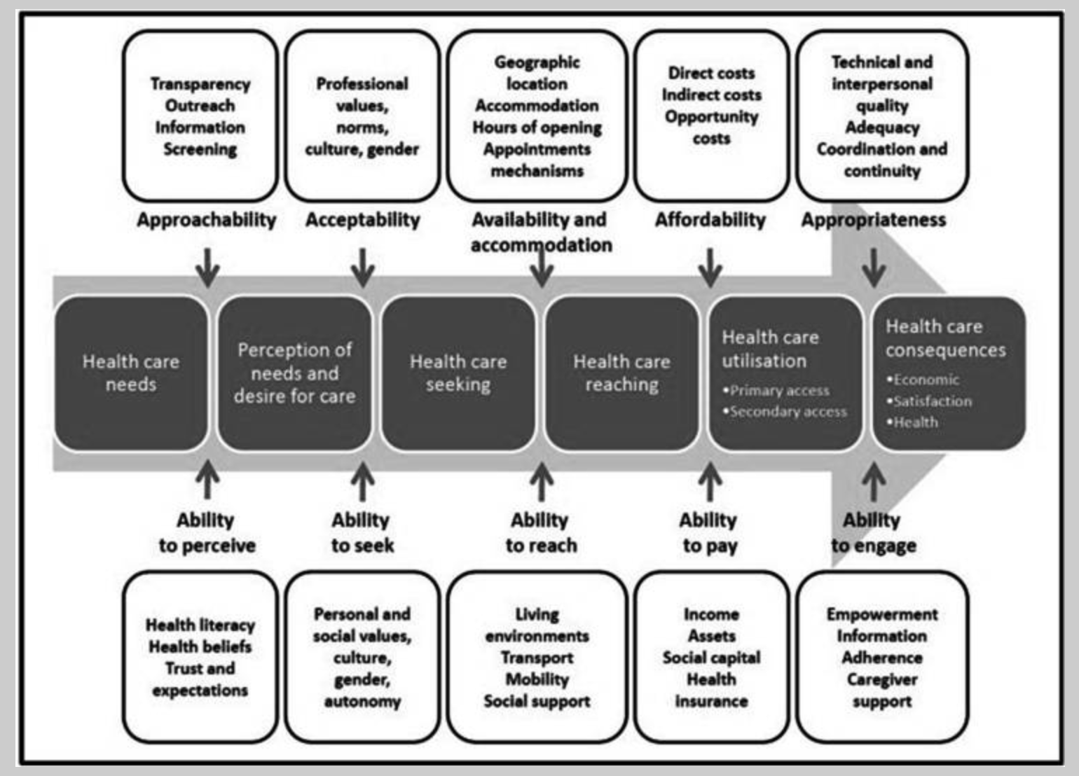

Slide 6
Improving access on the system side (supply side)
Knowledgeable providers
Ableism -> Providers perceived as less approachable → lack of preventive care
In network providers
Office accessibility
Wheelchair scale
Low exam tables
Ramp/elevator
Sedated procedures (dental, labs, ear cleaning)
Appropriate provider time
Communication
Care coordination/ continuity
Notes:
lack of provider education regarding the care needs of the adult IDD and CD population, and disparities in social determinants of health including stigma and discrimination, e.g. “ableism”
Negative experiences included perceptions that providers ignored their needs or failed to make accommodations, waiting rooms that were sensory-inappropriate, or being stigmatized or labelled in negative ways
Preventive care was challenging for both HCPs to deliver and the adult IDD/CD population to receive, particularly in the case of invasive examinations or tests such as Pap smears, blood draws, or vaccinations. Sensory concerns, insurance limitations, and/or ineffective communication and/or care coordination contributed to poor rates of preventive care
Long wait times -> increase anxiety and worsen clinic experience for the patient
HCPs described feeling frustrated with the additional time required during interactions with patients with IDDs and oftentimes don’t use patient’s preferred communication. Some nurses cited how using alternative or augmentative communication (AAC) methods or strategies would save time in the end and reduce patient frustrations. Tendency to communicate with caretaker rather than w patient. when HCPs and other staff relied completely on communication with supporters rather than the patient, the patient was disempowered. Instead, supporter assistance by sharing patient communication preferences or needs was identified as a strategy to preserve patient empowerment and improve care
Additionally, patients and supporters desired HCPs with a greater understanding of the individual’s medical history and communication style, as well as providers willing to learn the patient’s behaviors (Joseph-Kent, 2019; Stein Duker et al., 2019). This improved understanding was particularly important as illness often presented as a change in behavior or function in patients in the IDD/CD population; thus, establishing rapport with the patient prior to illness was described as monumentally important to care (Jones et al., 2008; Perry et al., 2014). Because patients with IDDs/CDs had an increased likelihood of being incorrectly triaged secondary to atypical presentations of illness, a carefully documented record of the patient’s behavior at baseline and a well-maintained patient-provider or patient-provider-supporter relationship was vital to the patient receiving proper treatment.

Slide 7

Accessibility Checklists
Accessibility Checklist for Medical Facilities (2015 ADA Standards for Accessible Design)
https://nwadacenter.org/sites/adanw/files/files/IdahoClinics%20Checklist_November2015.pdf

Slide 8
Strategies to Improve Access
Getting patients to the facility
Getting patients into the facility
Getting patients around within the facility
Getting patients into the examination room
Getting patients examined in the rooms
Getting patients scheduled for follow up
Notes:
Is there an accessible parking lot, are there enough spaces? Transportation?
Ramps? Are the doors wide enough
Are there accessible elevators? Bathrooms/ railings in bathrooms? Clear directions/ appropriate signage? Water fountains reachable via wheelchair?
Doors wide enough? Are the doors easy to open? What is the check in process like? Do patients have an opportunity to describe their needs? Assistive devices? Communication needs? Is everyone in the clinic educated on how to use these devices/ what they are?
Adjustable beds/chairs, hoyer lifts, are providers trained on tools they can use to do an exam differently if pt is uncomfortable, provider bias/training, clinic timings/schedules
Documentation! How to anticipate needs in the future

Slide 9
Discussion
What are some strategies you can use as a student to improve access for patients with IDDs in their clinic visit?
Speaking directly to the patient
Involving caregiver to use best communication strategies
Asking about social concerns
Explain physical exam before doing it
Using times/numbers/counting to help patients get through difficult exams
Take time to explain things in multiple ways
Ask both patient and caregiver if they have concerns
Encourage independence – try setting goals for patients
Keep a broad differential. Expect atypical presentations
Educate yourself on disability topics! <3

Slide 10
Improving access on the patient side (demand side)
Communication limitations (~57% of people with IDDs)
Health care literacy
Transportation
Funding
Autonomy
Fear -> previous negative experiences
Notes:
Communication difficulties (CD) are prevalent among individuals with IDD; an estimated 57.9% of those with intellectual disabilities (ID) and 40% of those with ASD struggle with communication (Autism Statistics and Facts, n.d.; García et al., 2020). These difficulties involve challenges in sending, receiving, processing, and/or comprehending abstract ideas, verbal and nonverbal communication, and/or graphic symbol systems and range from mild to profoundly severe
-patients w IDDs may be unable to comprehend written info, verbal information, lack of different educational tools (diagrams, infographics) to improve health literacy
preventive screening needs were unclear, patients experienced a barrier to approachability. Patients were unsure of the purpose and importance of screening because invitations were poorly designed and discussions with providers did not validate patients’ comprehension of relayed information
Patients w idds usually face a lot of problems with insurance. Transportation for some people with mobility needs/ sensory needs that limit their ability to use public transportation
Patient autonomy was limited during interactions in which HCPs communicated directly with supporters instead of the adult with IDD/CD, and decisions were made without the involvement of the patient
Previous negative experiences with healthcare providers who didn’t adequately understand them or make an attempt to understand. Fear of being stigmatized that affects how likely patients with IDDs are to seek out preventive care

Slide 11

Guide for Patients with Disabilities
Getting the Care You Need – Guide for People with Disabilities
https://www.cms.gov/files/document/getting-care-you-need-guide-people-disabilities.pdf

Slide 12
Implications of Poor Access to Care
Preventative care less frequently -> emergency care more frequently
Higher rates of comorbidities -> shorter life spans
4x higher healthcare costs
Notes:
Individuals with IDDs use preventive care less frequently and report higher rates of unmet healthcare needs and increased use of emergency departments (ED) compared to neurotypical individuals
Disparities in access contribute to shorter life spans, lots of comorbidities
due in part to their significantly higher rates of comorbidities, including sleep problems, diabetes, obesity, seizures, problems of the gastrointestinal, autonomic, nervous, immune, metabolic, and respiratory systems, skin conditions, and food allergies (Anderson et al., 2013; Nicolaidis et al., 2014). These complex health issues lead to increased healthcare utilization needs. As a result, adults with IDD are estimated to have four times higher annual healthcare costs than individuals without IDD

Slide 13
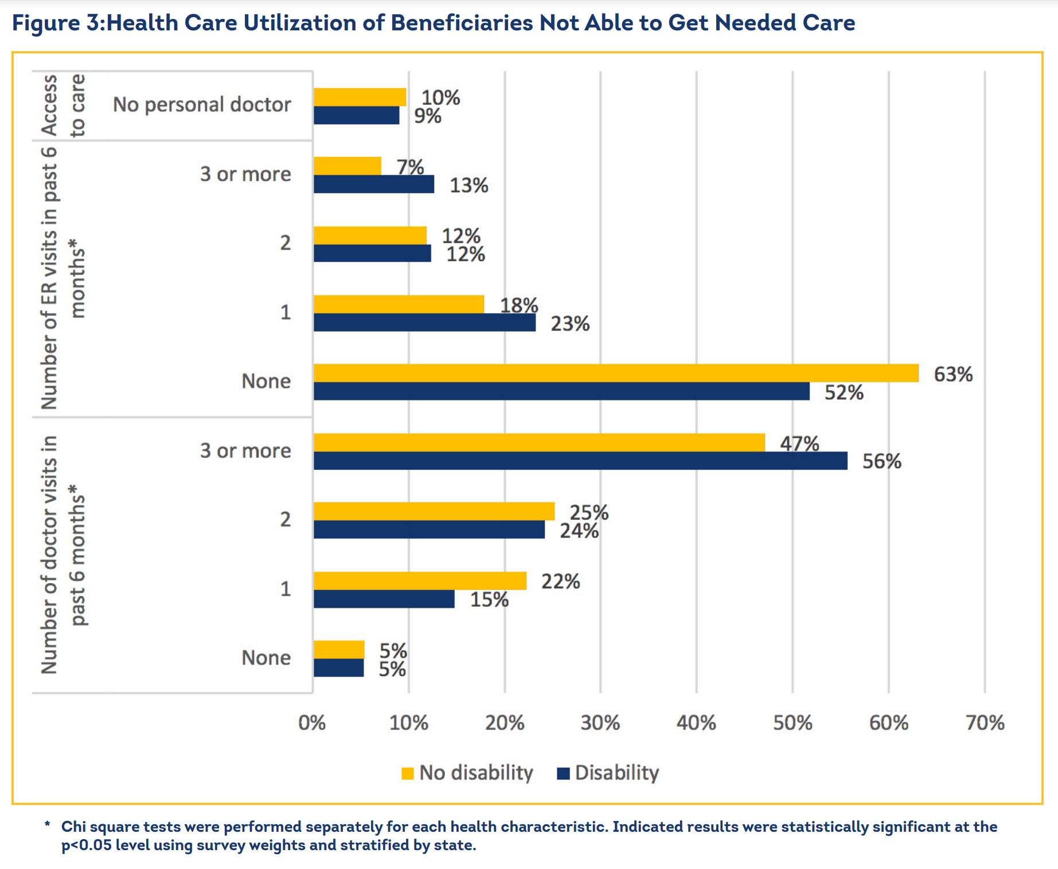
Data Highlight: How Does Disability Affect Access to Health Care for Dual Eligible Beneficiaries?
Notes:
Study by CMS - examining access and utilization among adults who self-reported having a disability, are eligible for both Medicaid and Medicare (dual eligible), and said they were unable to get the care they needed
Although the dual eligible respondents with a disability were more likely to report difficulty in accessing needed care compared to respondents with no disabilities, those with disabilities reported higher health care utilization rates than their counterparts without a disability. For example, as Figure 3 shows, among beneficiaries who experienced difficulty accessing care, 56 percent of respondents with disabilities reported having three or more doctor visits in the previous six months, compared to 47 percent of those without disabilities (see Table A2 in the Appendix for more details). Similarly, nearly twice as many beneficiaries with disabilities as those without disabilities reported having three or more emergency room (ER) visits in the past six months (13 percent and 7 percent respectively)

Slide 14
Legislation
Home and Community-Based Services Relief Act- would provide dedicated Medicaid funds to states to stabilize home and local services for people who are disabled
Better Care, Better Jobs Act - would expand home and community-based services for older adults, injured workers and people with disabilities while also increasing Medicaid reimbursement
Notes:
HCBS Act introduced 10/2023, still needs to be passed by senate
BCBJ Act – introduced 01/2023, still also needs to be passed by senate

Slide 15
Resources
Accessibility checklists. Accessibility Checklists | ADANW. (n.d.). https://nwadacenter.org/toolkit/accessibility-checklists
Haynes, L. (2024, June 1). Health advocacy can help improve access to care for people with idd. The Nation’s Health. https://www.thenationshealth.org/content/54/4/11.1
Improving access to care for people with disabilities. CMS.gov. (n.d.). https://www.cms.gov/priorities/health-equity/minority-health/resource-center/health-care-professionals-researchers/improving-access-care-people-disabilities
Shady K, Phillips S, Newman S. Barriers and Facilitators to Healthcare Access in Adults with Intellectual and Developmental Disorders and Communication Difficulties: an Integrative Review. Rev J Autism Dev Disord. 2022 May 30:1-13. doi: 10.1007/s40489-022-00324-8. Epub ahead of print. PMID: 35669718; PMCID: PMC9148936.

