Slide 1


Barriers to Healthcare Transition
John Berens, MD
Assistant Professor of Medicine, Section of Transition Medicine

Slide 2
Disclosures
This work is supported by the Texas Council for Developmental Disabilities through a grant from the U.S. Administration for Community Living (ACL), Department of Health and Human Services (HHS), Washington, D.C. 20201, with a 100% federal funding award totaling $6,121,860. Council efforts are those of the grantee and do not necessarily represent the official views of nor are endorsed by ACL, HHS, or the U.S. government.

Slide 3
Learning Objectives
Define healthcare transition (HCT)
Discuss the importance of HCT for individuals with IDD
Review common barriers that make HCT difficult:
  Psychosocial transitions
  Specialist transitions
  Changes to funding/financial support
  Legal/medical decision-making implications
Outline six key features that facilitate HCT

Slide 4

What is healthcare transition?
Notes:
Open-ended discussion to gauge prior knowledge/understanding

Slide 5
HCT = Process
Preparation/Planning
Transfer
Integration
“The process of moving from a child / family-centered model of health care to an adult/patient-centered model of health care, with or without transferring to a new clinician.”

Slide 6

Why does HCT matter?
Why do you think HCT matters?
Are there bad outcomes you can think of that individuals (especially with IDD) might experience if HCT doesn’t go well?

Slide 7
Case example
22-year-old female with high lumbar spina bifida, neurogenic bladder w/ recurrent UTI, borderline mild intellectual disability, ventriculoperitoneal shunt, neurogenic bowel
Frequent admissions for UTI / sepsis
Doesn’t have regular urology follow-up
Watches nieces/nephews at home, hard to take time for doctor visits + relies on available family for rides, spotty wifi for televisits
Sometimes forgets to catheterize her bladder
1-2 BM per week, doesn’t like meds because they cause incontinence

Slide 8

Worst case scenarios?
What are some possible worst-case scenarios that could happen with this patient?
Notes:
Group discussion. While the clinical details should be beyond expected level of understanding, this question helps lead to a discussion of the gravity of what’s at stake for many of these patients during this vulnerable period.

Slide 9
Case example
22-year-old female with high lumbar spina bifida, neurogenic bladder w/ recurrent UTI, borderline mild intellectual disability, ventriculoperitoneal shunt, neurogenic bowel
Frequent admissions for UTI / sepsis
Doesn’t have regular urology follow-up
Watches nieces/nephews at home, hard to take time for doctor visits + relies on available family for rides, spotty wifi for televisits
Sometimes forgets to catheterize her bladder
1-2 BM per week, doesn’t like meds because they cause incontinence
Sepsis can be life-threatening if not treated in time
Overdistended bladder can eventually lead to hydronephrosis & renal failure
Severe/untreated constipation can lead to bowel obstruction and numerous other issues

Slide 10
Vulnerable times
During transition period, data consistently shows:
  Worse measures of disease control
  Higher morbidity/mortality
  Worse engagement with healthcare system
Notes:
This is for any number of chronic, childhood-onset diseases. Data most robust for type 1 DM, renal transplant status, sickle cell, cystic fibrosis.

Slide 11
Learning Objectives
Define healthcare transition (HCT)
Discuss the importance of HCT for individuals with IDD
Review common barriers that make HCT difficult:
  Psychosocial transitions
  Medical transitions
  Changes to funding/financial support
  Legal/medical decision-making implications
Outline six key features that facilitate HCT
Notes:
Now we’ve defined what HCT and discussed what’s at stake / why HCT matters. Let’s dive in next to some of the reasons why HCT is not an easy process.

Slide 12

Psychosocial considerations
Questions for reflection:
  What were some sources of life stress between ages 16-22?
  What were some big changes that happened around this time?
Notes:
Consider all the life changes (not even related to medical stuff) that typically occur during this life period.

Slide 13
Psychosocial considerations, cont.
Growing independence
Shift from school → vocation
Potential change in living situation
Potentially more serious dating relationships
Potential risk-associated behaviors (sex, substance use/abuse)

Slide 14
Medical transitions
Transition medical care to adult world
Models to approach HCT
Real-world considerations (Pedi ≠ Adult)
  May not need adult specialist
  Adult equivalent may not exist
  Some surgical procedures may need to be pedi driven
  Insurance limitations
Notes:
Can start HCT with primary care and then work on the rest (e.g. Transition Medicine Clinic); can have consult service; if Fam Med/Med-Peds may stay in same clinic but gradually change approach.
Not always a lateral pedi→ adult switch (eg hypertension management).

Slide 15
Medical transitions, etc.
Pedi side:
  May be reluctant to let go (also hard for family/patient)
  Prep hindered by lack of time/$$
  Difficult to find adult home
Adult side
  Less training on childhood-onset conditions
  Less staff/ancillary support
  Difficult culture (less hand-holding)

Slide 16
Changes to funding
Adult Medicaid
  Different (less) coverage
  (Re)qualify at age 18 (individual income + disability in TX)
  Funding ≠ Access
More in future talk

Slide 17
Medical decision-making
Fluidity of capacity
Autonomy vs support spectrum
What does guardianship mean?
More support
More autonomy
Full
Guardianship
Partial
Guardianship
Supported Decision-making
Informal support
No support
Notes:
Decision-making capacity is a temporary distinction and can change both gradually over time (growth, maturity, practice, dementia, mental illness) and acutely (delirium, severe illness, mental illness, medication/drug effect).
Autonomy and support are often thought of as dichotomous with more restrictive options on one end and least restrictive on the other, but in reality it is a spectrum of how much support is needed.
Describe differences between the options (substituted vs supported decision-making). Least restrictive option is the goal. Line represents loss of civil rights.
Reasons to consider MDM on pedi side: guardianship takes a long time and is $$; may run into barriers with adult system if nonverbal/notable ID

Slide 18

How can we facilitate HCT?
If you were to design a system that addressed HCT, what would it include?
  Consider specifics for each phase (preparation/planning, transfer, integration)
Notes:
Reflect & report

Slide 19
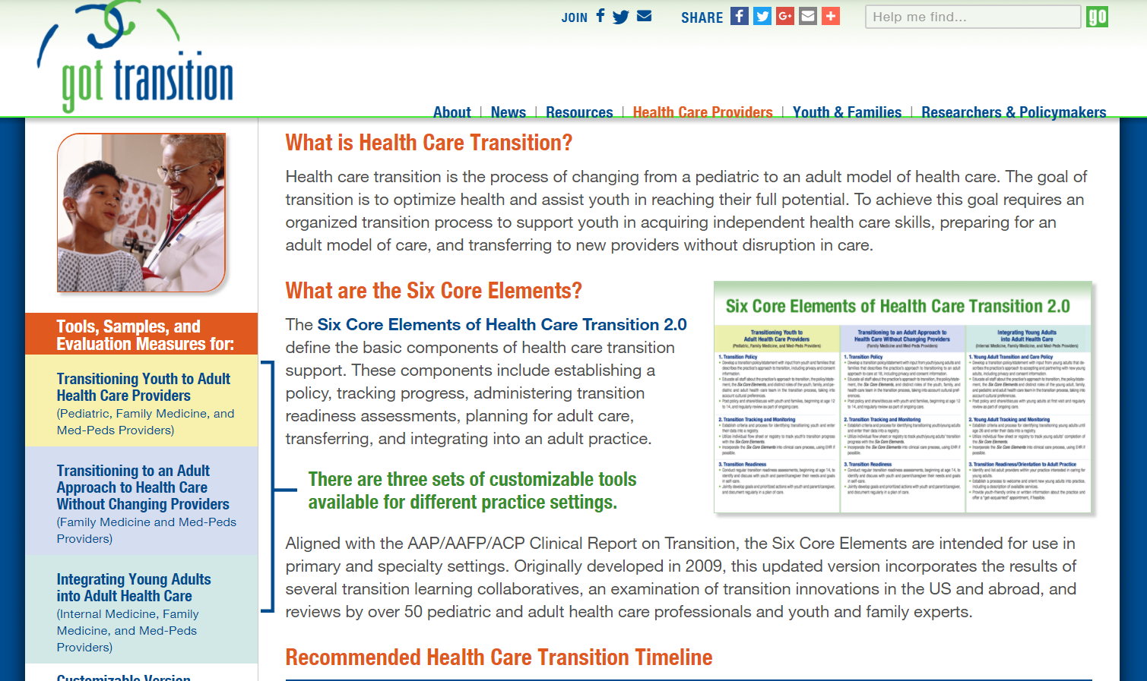

Slide 20
GotTransition.org
Transition policy
Transition tracking and monitoring
Transition readiness
Transition planning
Transfer of care
Transfer completion
Notes:
1 is straightforward, though deceivingly tough to implement– have a transparent, clearly defined, fair clinic/institutional policy regarding HCT.
2 harkens to population health and finding ways to automate systems to identify & track patients who are near/at transition age.

Slide 21
Case example
21-year-old with autism spectrum, mild-moderate intellectual disability, type 2 diabetes on insulin
How can we prepare this patient to be ready for adult care?
  What are some physical skills he can learn to manage his own health?
  What are some important facts he should know about his health?
  What are other basic skills all adults should know about managing their own health?

Slide 22
GotTransition.org, cont.
Transition policy
Transition tracking and monitoring
Transition readiness
Transition planning
Transfer of care
Transfer completion
Notes:
4 goes back to making a transition plan for the medical, social, legal, insurance aspects of the care.
5 is the actual transfer of care to adult world. There are different ways to do this such as returning to pedi side after initial adult visit, meeting adult providers in pedi setting (at least at first), etc.
6 is a continuation of the work that has already been started and in may ways, may encompass 1-5 (adult clinic should have its own related policies and track recently transitioned young adults; should continue to optimize skills to manage own health, work on planning/transferring any remaining pieced of the plan).

Slide 23
New visit at Transition Clinic– what to do?
22-year-old female with high lumbar spina bifida, neurogenic bladder w/ recurrent UTI, borderline mild intellectual disability, ventriculoperitoneal shunt, neurogenic bowel
Frequent admissions for UTI / sepsis
Doesn’t have regular urology follow-up
Watches nieces/nephews at home, hard to take time for doctor visits + relies on available family for rides, spotty wifi for televisits
Sometimes forgets to catheterize her bladder
1-2 BM per week, doesn’t like meds because they cause incontinence
Discuss clinic policy / on-call MD
Refer/assist getting urology
Address neurogenic bowel
Social work re: transportation
Discuss vocation/goals
Troubleshoot cath regimen
Build trust, frequent follow-up

Slide 24

Key points
Name 1-2 highlights you’ve learned today

Slide 25
Take-home message
HCT is a three-pronged process
Young adulthood is a vulnerable time with big stakes
There are many barriers to a smooth transition
  Physician and family attitudes, psychosocial changes
  Insurance, legal changes
  Many moving parts requiring own transitions
There are established guidelines to help us out
Notes:
The three phases are _____?

Slide 26
Thank you!!
John.Berens@bcm.edu
Twitter/X: @DocBerens

