Slide 1
Patient Navigators
Camille Maya, BS in Healthcare Disparities, Diversity, and Advocacy Patient Navigator, Care Coordination Specialist
Jordan Kemere MD, MS

Slide 2
Disclosures
This work is supported by the Texas Council for Developmental Disabilities through a grant from the U.S. Administration for Community Living (ACL), Department of Health and Human Services (HHS), Washington, D.C. 20201, with a 100% federal funding award totaling $6,121,860. Council efforts are those of the grantee and do not necessarily represent the official views of nor are endorsed by ACL, HHS, or the U.S. government.

Slide 3

What is a patient navigator?
Notes:
Group to brainstorm

Slide 4
CDC says….
Patient navigation helps people get the health care and other resources they need to be as healthy as possible. Patient navigators work with people, their families, and their caregivers to overcome barriers to screening and diagnosis, care, and resources needed.
Patient barriers may include—
Lack of transportation
Lack of care for children or elderly relatives
Not understanding why they should get screened
Speaking a language other than English
Mistrust of the health care system
Fear of finding out they have a disease or fear of the screening procedures

Slide 5

Who can be a patient navigator?

Slide 6
Nurses
Social workers
Physicians
Physician assistants
Trained lay persons such as community workers and patients (e.g. former cancer patients)
Often recruited from the community they serve as they understand the barriers, can gain patient trust, and empower others
Work as part of the clinical team
Camille how did you become a patient navigator and what was your training?
Budde H, Williams GA, Scarpetti G, et al. What are patient navigators and how can they improve integration of care? [Internet] Copenhagen (Denmark): European Observatory on Health Systems and Policies; 2022.
Notes:
HOW DID CAMILLE COME TO BE A PATIENT NAVIGATOR?

Slide 7
Data supporting patient navigators
CKD and Kidney failure – review of multiple studies showing improved transplant workup and listing and peritoneal dialysis utilization
Diabetes – telephone navigators improved Hgb A1C and patient self-efficacy
Cancer – largest amount of data in both screening, early detection, and survival
Primary care access – access to FQHC (including Thomas Street in the Harris Health system!)
Taha et al, Kidney Med. 2022 Aug 24;4(10):100540.
Loskutova et al, J Am Board Fam Med. 2016 Jan-Feb;29(1):78-89.
Dohan et al, Cancer. 2005 Aug 15;104(4):848-55.
Potvin et al, Can Fam Physician. 2019 Apr;65(Suppl 1):S47-S52.

Slide 8
Patient Navigators in IDD care
Very few studies
Though in studies that looked at what patients and families wanted → navigation through the healthcare system was repeatedly requested
2021Feinberg et al -- Family navigation improved the likelihood of diagnostic ascertainment among children from racial/ethnic minority, low-income families who were detected as at risk for ASD in primary care.
Feinberg et al, JAMA Pediatr. 2021 Jan 11;175(3):1–8. doi: 10.1001/jamapediatrics.2020.5218

Slide 9

Effectiveness of Patient Navigation During Transition To Adult Care
Samuel et al JAMA Pediatr. Published Online: February 10, 2025 2025;179;(4):375-382. doi:10.1001/jamapediatrics.2024.6192

Slide 10
Patient Navigation in Pediatric Complex Care and Transition to Adult Health Care
TCH Pediatric Complex Care Clinic provides primary care to children with medical complexity
What does patient navigation look like in this clinic?

Slide 11
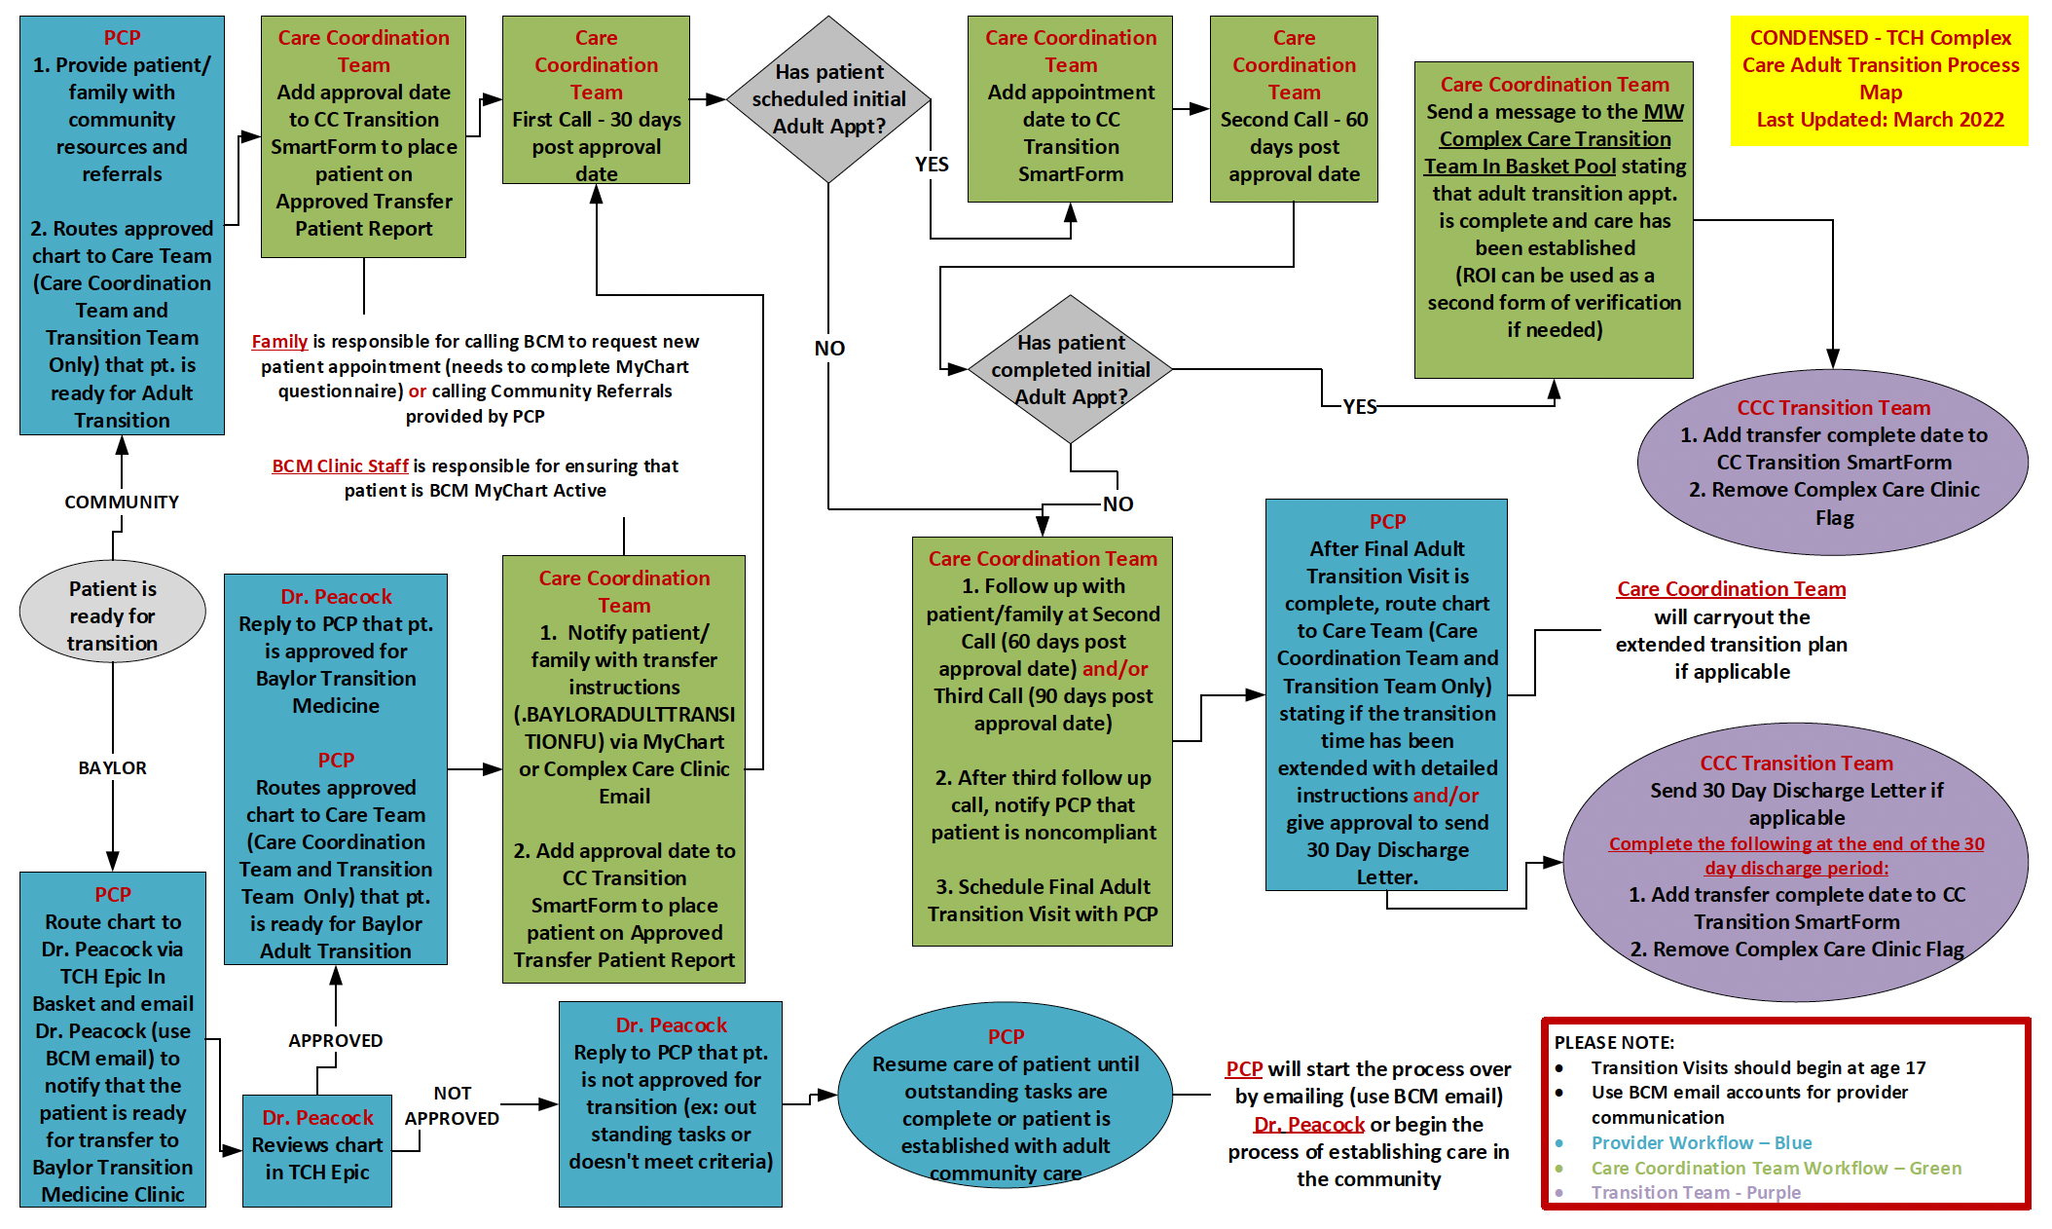

Slide 12
Case – assist this patient in transition to adult care
21 YO female-cerebral palsy, gastrostomy dependent, intellectual disability, impaired mobility. Mom is assisting patient.
What barriers can you foresee just with this patient stem alone?
NO SHOWED to multiple complex care clinic appointments (even with phone calls and my chart reminders, would confirm with me and still no show)
Hypothesize what might be going on?

Slide 13

BEFORE TRANSITION
mobility clinic for adaptive car sear, hoyer and wheelchair
Referrals for BAYLOR PULMONOLOGY
Referrals BAYLOR ENDROCRINOLOGY
switching to Adult Star Plus Medicaid Insurance and contacting assigned service coordinator
Guardianship/decision-making supports if needed
How would you help them approach this “to-do” list? What might barriers be in attempting to do these things?
BIG GOAL -- Empower people to advocate for themselves

