Slide 1


Patient &
Healthcare team
Relationship
Angela “Angie” Panzica, LMSW
Elisha Acosta, MD

Slide 2
Funding Disclaimer
Disclosures:
This work is supported by the Texas Council for Developmental Disabilities through a grant from the U.S. Administration for Community Living (ACL), Department of Health and Human Services (HHS), Washington, D.C. 20201, with a 100% federal funding award totaling $6,121,860. Council efforts are those of the grantee and do not necessarily represent the official views of nor are endorsed by ACL, HHS, or the U.S. government.

Slide 3
Language
Dr. Marcus Robins, the 2nd year resident on Medicine Team B, is recapping overnight events for his patient during rounds. He starts his presentation with, “This is a diabetic, obese 64yo who has been admitted for 3 days with DKA.”

Slide 4
Does the phrasing “diabetic, obese man” vs. “man with diabetes and obesity” conjure a different image for you?

Slide 6
Highlights
Person first v Identity first language: either can be ok!
Read the room – listen to how patient/family describes themselves v just ask!
Avoid known offensive terms: r-word, “normal people”

Slide 7
Honesty
Jonas Nickle, a 4th year medical student, is doing an elective in the Complex Care Clinic at a large Children’s Hospital. He is obtaining history from the family of a 6yo child with a rare genetic condition called Coffin Lowry syndrome. The patient’s mom states, ”It gives me so much comfort to be at a large children’s hospital where people know so much about even rare diseases. Can you tell me how likely it is for my child to live into adulthood?”

Slide 8
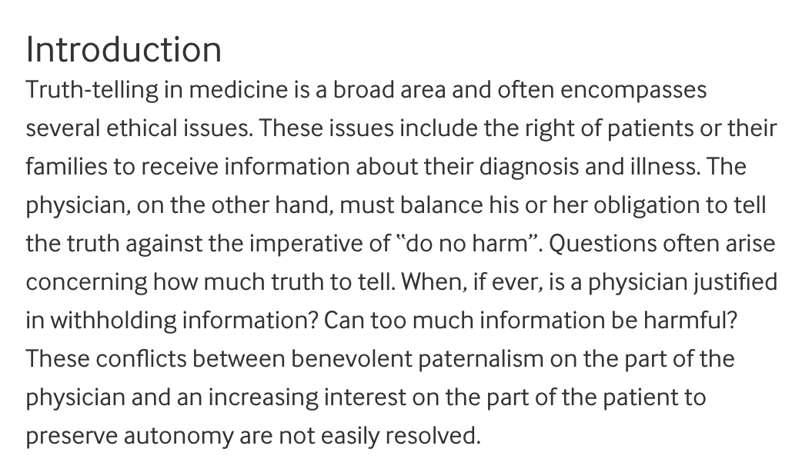


Slide 9
Highlights
“I don’t know” is not bad – best if “will look into that and get back to you”, ”will review with team”, “what have you heard from others?”

Slide 10
Physical Contact
Dr. Rosa Driver, an intern working at her continuity clinic, has developed good rapport over the last with an older patient she seen every 6-8 weeks over the last year while they worked to improve the patient’s diabetes control. Finally, about 10 months after they’d first met, Mr. Santos’ HbA1c comes back at goal. He flashes a big smile and says, “Doc, I’d love to give you a big hug in thanks!”

Slide 11
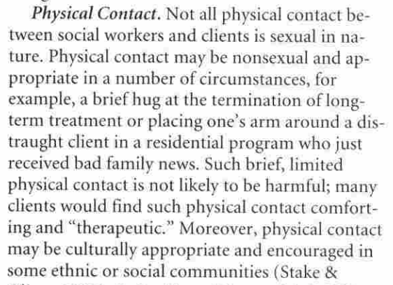

Slide 12
Highlights
Situation important – patient/client initiation a consideration, asking
Power differential important
Absolute no: sexual contact

Slide 13
Gifts/Money
Tamara Stevens is a 40yo woman with a rare genetic condition that requires several costly medications. She is a single mom whose sole source of income is SSI from disability. On recent testing her PCP discovered she was deficient in Vitamin B12 and asked Tamara to start an over the counter B12 supplement. She reports she is unable to afford this supplement and her insurance (Medicaid) will not cover it because it is an over the counter medicine. Tamara’s PCP gives her $20 to cover the cost of the supplement for 2 months.

Slide 14
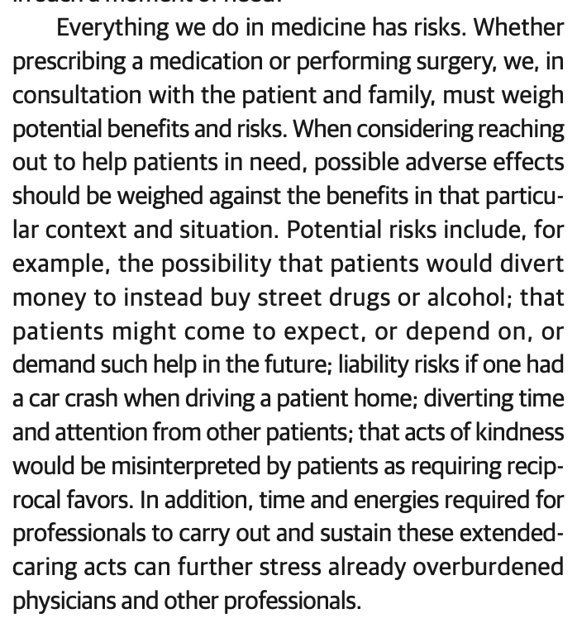

Slide 15
Highlights
Expectations – for this patient/physician relation and others
Limitations

Slide 16
Conclusions
Boundaries are important for patient and physician safety
Any concerns or surprises regarding the discussion today?

