Slide 1

Patient Navigator: Insurance and Funding for Individuals with IDD in Texas Ellen Fremion, MD, FACP, FAAP Ellen.fremion@bcm.edu

Slide 2

Funding
This work is supported by the Texas Council for Developmental Disabilities through a grant from the U.S. Administration for Community Living (ACL), Department of Health and Human Services (HHS), Washington, D.C. 20201, with a 100% federal funding award totaling $6,121,860. Council efforts are those of the grantee and do not necessarily represent the official views of nor are endorsed by ACL, HHS, or the U.S. government.

Slide 3
Insurance Qualifications 101
PRIVATE INSURANCE | MEDICARE - FEDERAL | MEDICAID - STATE | UNDER or NON-INSURED
Job’s benefits Family’s plan (parent up to 26 or spouse) Healthcare MarketPlace “Obama Care” | Need to qualify for (Social Security Disability Insurance) SSDI to receive Medicare either by working or being a dependent | Under 18 and household is low income Over 18 and qualify for supplemental social income (SSI) due to disability and low income (Texas) In some states, low income alone Low income and pregnant or have child on Medicaid If you meet criteria for disability determination and work, but your income is too high, you may qualify for Medicaid Buy-in. | Federally qualified health centers County Systems, etc

Slide 4
Medicaid Eligibility in Texas
Permanent legal resident or Citizen and:
<18- household income per person
>18- disability determination/individual income
The person must qualify for SSI based on a disability limiting them from full-time employment
Low-income adults caring for a child on Medicaid or pregnant +income
Star
(kids, moms, TANF)
Star-Kids
(<21, SSI or waiver)
Star-Plus
(21+ SSI or waiver)

Slide 5
Children with Special Healthcare Needs Eligibility (CSHCN)
Title V program from Maternal-Child Health
Texas resident (not a citizen or PLR)
20 or younger (out of the hospital 14+ days)
Income criteria
Medical attestation to medical need/diagnosis (renew annually)

Slide 6
Important Insurance Ages
Age 18
Adult disability determination to stay on Medicaid
Age 21
CSCHN ends
Age 26
Sign disability wavier to stay on family's insurance plan
Change to Star-Plus Medicaid
Parent turns 65 or dies
Dependent adult with IDD will be SSDI eligible, Medicare/Medicaid

Slide 7
Texas Home and Community Based Services Waivers
Wavier | Eligibility | Services
Star-Plus (MCO) | 21 and up, income, meet level of care for nursing facility admission | home nursing, adaptive aids, respite, dental
Star-Kids/MDCP (MCO) | 0-20, income, medical necessity and level of care for nursing facility | respite, family support, minor home modifications, adaptive aids, transition, employment assistance, and financial
DBMD | All ages, income, deaf/blind, adaptive behavior deficit | Therapy, dental, translation, adaptive supports
CLASS | All ages, income, related diagnosis, adaptive behavior deficit | home modifications, therapy, adaptive supports, transportation, employment supports
HCS (LIDDA) | All ages, income, IQ <75 and related diagnosis, adaptive behavior deficit | housing, behavioral, dental, therapy, social/employment
TxHmL (LIDDA) | Same as HCS | behavioral, dental, therapy, social/employment
YES (mental health) | 3-18, income, inpatient criteria for mental health | mental health supports

Slide 8
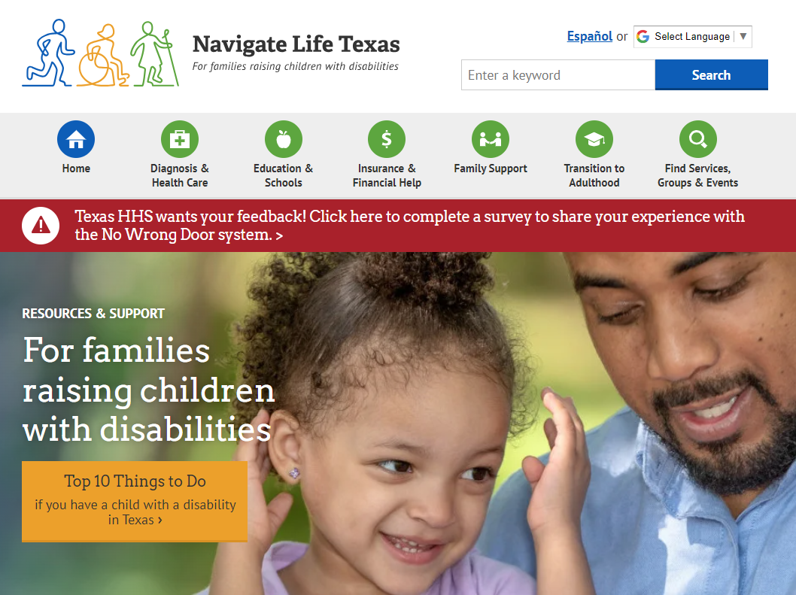
Everyone with IDD needs Navigatelifetexas.org
English and Spanish
All age supports
School, community resources, and transition!

Slide 9
Case 1
George is a 17-year-old with type 1 diabetes requiring an insulin pump. He doesn’t have any physical or intellectual limitations. He is currently on Star Medicaid, what will his insurance options be after he turns 18?

Slide 10
Case 2:
Billie is an 18-year-old who has cerebral palsy, is wheelchair dependent, and has intellectual disability. She is on her dad’s private insurance plan. Does she need to do anything different about her insurance and funding options?

Slide 11
Case 3:
Taylor is a 40-year-old with Down syndrome. Her dad is retiring this year. She currently has Medicaid and an HCS waiver. How does her dad’s retirement affect her insurance?

Slide 12
Case 4
Angelina is a 12-year-old whose family has recently migrated from Honduras. Here family is pending asylum determination and she has spina bifida and is wheelchair dependent. What sources of funding are options for her?

