Slide 1
Healthcare Transition: Outside of Healthcare
Vrunda Vithalani, MD

Slide 2
Funding Disclaimer
Disclosures:
This work is supported by the Texas Council for Developmental Disabilities through a grant from the U.S. Administration for Community Living (ACL), Department of Health and Human Services (HHS), Washington, D.C. 20201, with a 100% federal funding award totaling $6,121,860. Council efforts are those of the grantee and do not necessarily represent the official views of nor are endorsed by ACL, HHS, or the U.S. government.

Slide 3



Objectives:
Identify areas of transition need outside of medical care.
Describe methods to support independence in iADLs.
Discuss additional supports required to help transition, including medical decision-making.

Slide 4


Julie is a 17yo female with spastic quadriplegic cerebral palsy, moderate intellectual disability, and seizures. She is here with her mother, who helps her makes decisions. She is in the process of her healthcare transition, has identified adult providers to help her. They want to talk about what her next steps are to help her maintain independence.
What areas of independence should we discuss?

Slide 5












CHOOSE YOUR OWN ADVENTURE!
School
Transport
Cooking
Housing
Finances
Decision-Making
Health Insurance

Slide 6





Julie is a junior in high school. She has an Individualized Education Plan and has gotten As/Bs in her classes with some individualized 1:1 support. She notes the most difficulties in her math class, but really enjoys school!
What are some options that Julie has once she completes her primary education?
Who might be a good community partner to help Julie make some of these decisions?
18+ programs in the school district
Vocational Schools
Junior College
Post-secondary transition programs
Traditional 4-5 year College programs
Day programs
Entering the workforce with supported employment
Notes:
Work with IEP/School district, disability office at college, TWC for jobs.
Supported Programs within 4 Year Colleges: Lonestar College, VAST Academy, Texas A&M, Clemson. In many many states, typically at state colleges

Slide 7
On exam, you notice that Julie has worse spasticity in her lower extremities compared to her upper extremities, she uses a rolling walker majority of the time, but uses a wheelchair for long distances. She has decent fine motor coordination in her hands and is able to button her shirts.
What methods of transportation might Julie be able to use?
Transport
All of the transportation options are available to her!
Own vehicle
Family/friends
Rideshare
Public Transportation
Paratransit/Public Transport for individuals with Disabilities (Like Metrolift in Harris County)
Medicaid Transportation
Julie tells you that she really wants to drive.
What things do we need to consider/take into account?
What kinds of supports might she need to be able to achieve this goal?
Notes:
Methods - getting a ride with family/friends, rideshare, medicaid transport, public transport, driving.
Driving considerations: Safety, adaptations required to meet physical needs. What type of vehicle?
Modifications for vehicles: Ramps or lifts to get into the car, adaptive mirrors, adaptive steering wheels, hand controls for the accelerator/brake, etc.
Still need to take the driving test, take a class. And then modifications to the vehicle if needed.

Slide 8
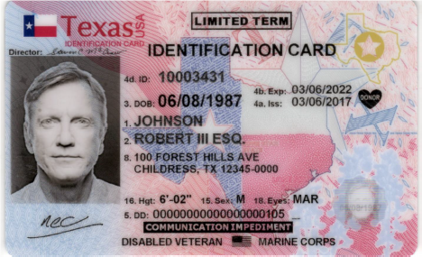
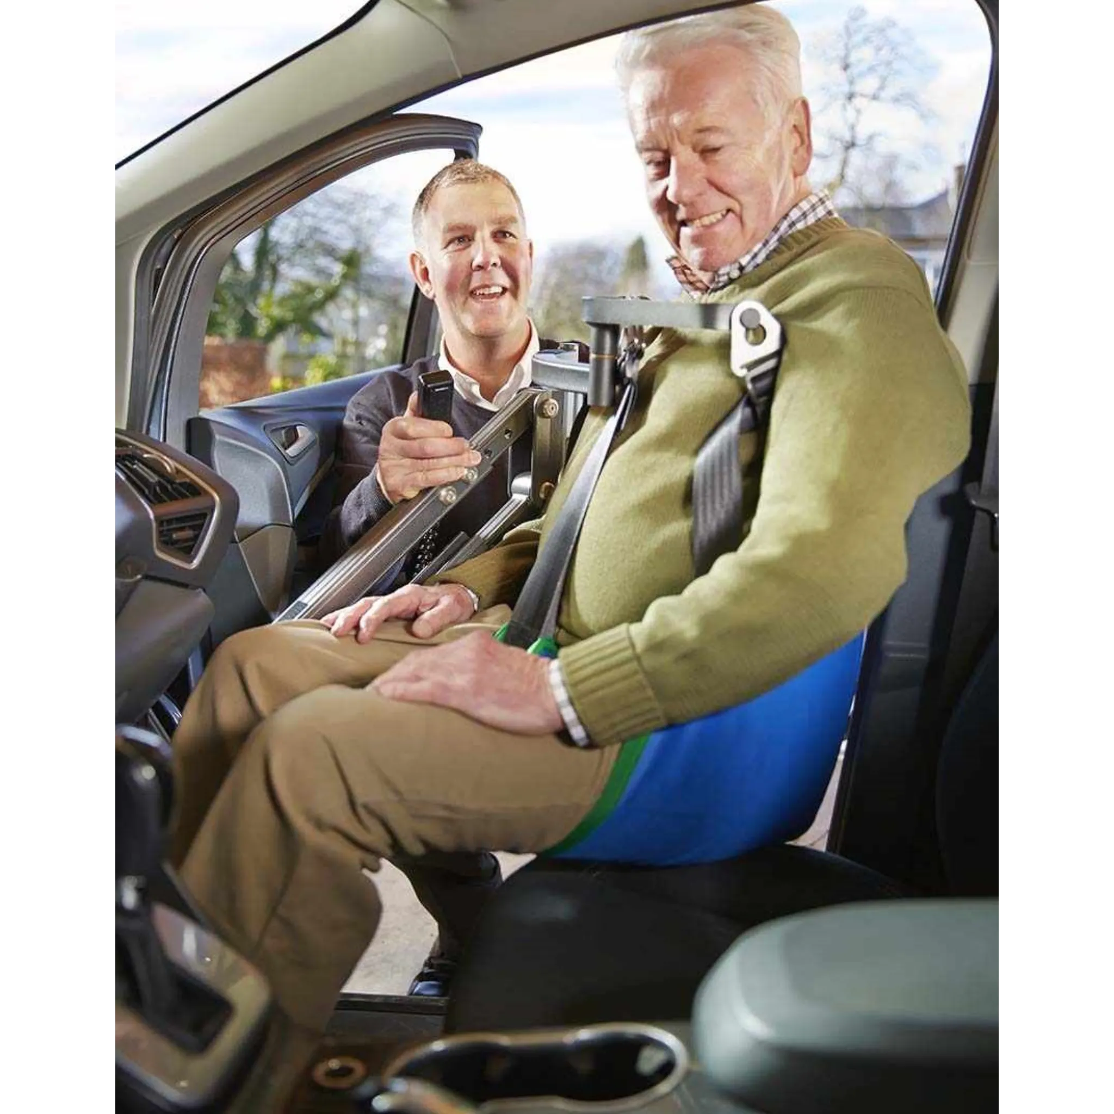
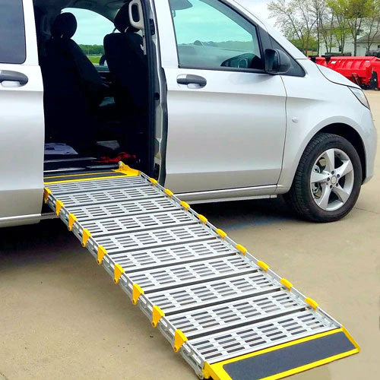
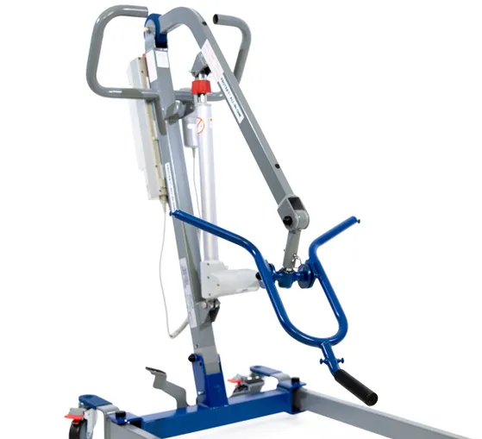
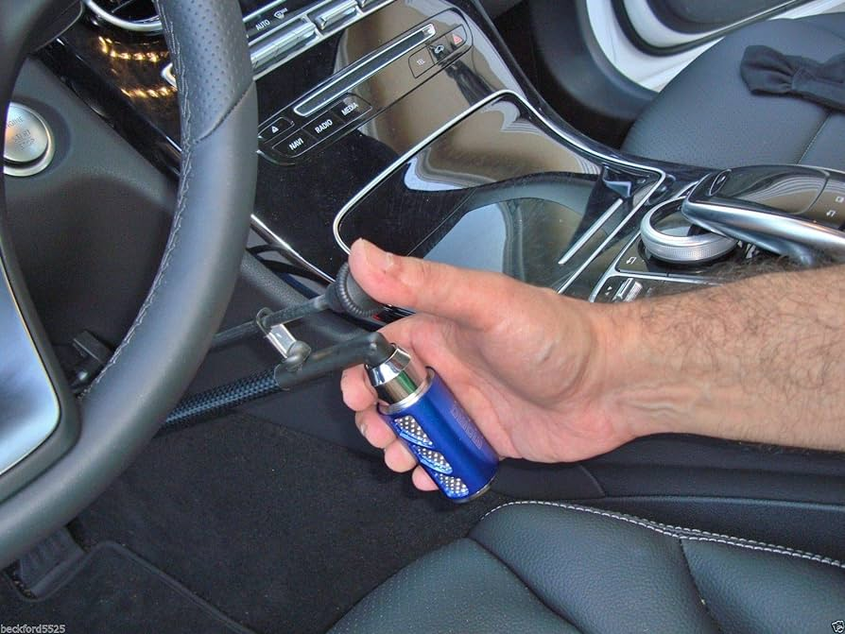
For communication difficulties:
Speech apraxias
Autism
Any difficulties communicating with an officer of the peace
Assistance getting into the vehicle
https://www.mobilityinnovations.com/products/driving-aids/steering-aids/
Adaptations for Driving

Slide 9


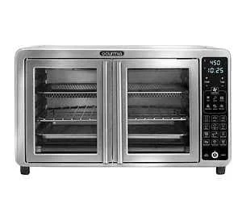
Cooking
When talking about her interests, Julie mentions that she loves painting, enjoys dancing, and loves watching cooking shows. She wishes that she could try some of these recipes, but they are worried about her safety when using some kitchen appliances.
What kinds of safety considerations should we take into account?
How can we help her adapt?
Basic safety:
Optimize your setup
Safe, stable location
Non-slip rug/chair
Non-slip cutting board
Keep knives sharp - easier to cut through, less chances for accidents
Magnetic measuring cups/tools
Using the right equipment
Declutter the space
Keep things to clean up
Notes:
Let’s get creative about what people could need:
Getting magnets on your tools (cutting board, etc) to magnet onto the table?
Microwave - button better than handle for the microwave?
Toaster oven - downward opening door, upward opening door, double doors that open directly towards you?
Hot plates that you can plug in at your level.

Slide 10
Julie hasn’t really thought about where she wants to live, but would love to talk about options for the future.
What might be consider?
Housing
Many options for housing:
Stay with family
Stay with family in adjacent area - like a place above the garage, camper in the backyard, etc
Independent living
  Do they need someone to check in on them?
Group home with other individuals with disabilities
  Someone checks in daily or need more full-time care?

Slide 11





Stay Active!
Notes:
The key is to stay active and allow for recreational activities with people you can be friends with.
Friends are important!

Slide 12




Julie loves going to the store and buying art supplies. But she struggles with bills/coins and hesitates to go into places like the bank or post office (“they ask too many questions!”). She asks you for help.
Finances
Notes:
Many ways to spend money - debit or credit card?
Can someone (like mom) help her balance finances at the end of the weeks or the end of the month?
Mobile/online banking can help people go to the bank without needing to go inside the bank.

Slide 13
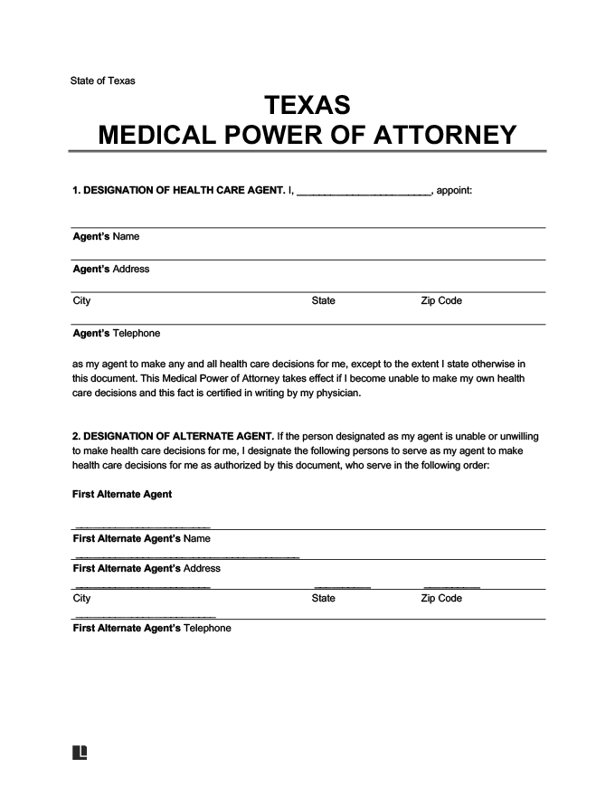


During your visits, Julie is able to communicate with you and tell you her wishes. But she sometimes needs some prompting/help asking the right questions before making medical decisions. What kind of support might she need to make decisions once she turns 18?
Decision-Making

Slide 14


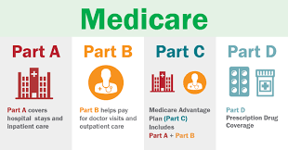

Insurance is important! And can be confusing.
Notes:
There are many factors involved in insurance, which can really affect their overall care and things like day programs, group homes, etc.

Slide 15
Navigate Life Texas is a great website with more resources and things we can think about to help people transition!
https://www.navigatelifetexas.org/en/

Slide 16





Life is Exciting!
Let’s get creative in our solutions/life hacks!

