Slide 1
Case of the Month October 2025
Gladson Scaria, MBBS (GI Pathology Fellow)
Celia Marginean, MD

Slide 2
Clinical Presentation
45-year-old male with past medical history of hypertension, hyperlipidemia, type 2 diabetes, prior H. pylori–associated peptic ulcer disease, and gastric outlet obstruction requiring dilation
Symptoms
Progressive nausea/vomiting
Severe weight loss
Prior interventions:
Prior hospitalization revealed substantial gastric stasis requiring endoscopic decompression
Previous H. pylori treatment
Pyloric stent placed with only short-lived symptom relief
Current workup:
CT A/P: 4.1 × 4.8 cm pancreatic tail mass with upstream ductal dilation; abnormal pylorus with fat stranding; suspicious gastrohepatic nodes
Endoscopy/EUS: Severe pyloric stenosis (biopsied); heterogenous pancreatic tail mass; cystic lesion also noted

Slide 3
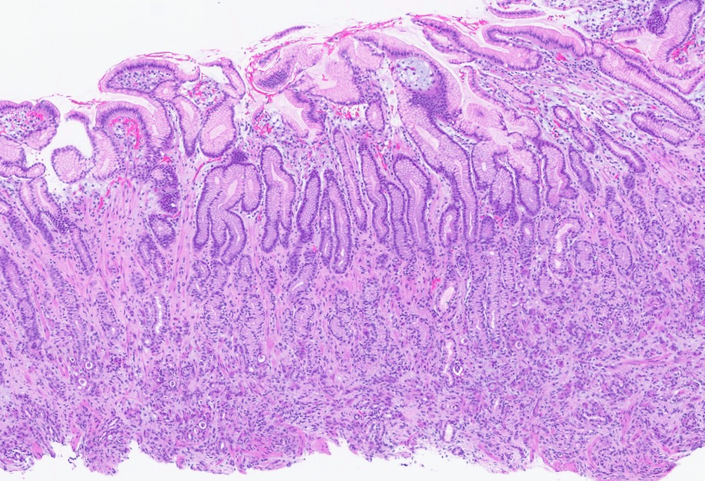
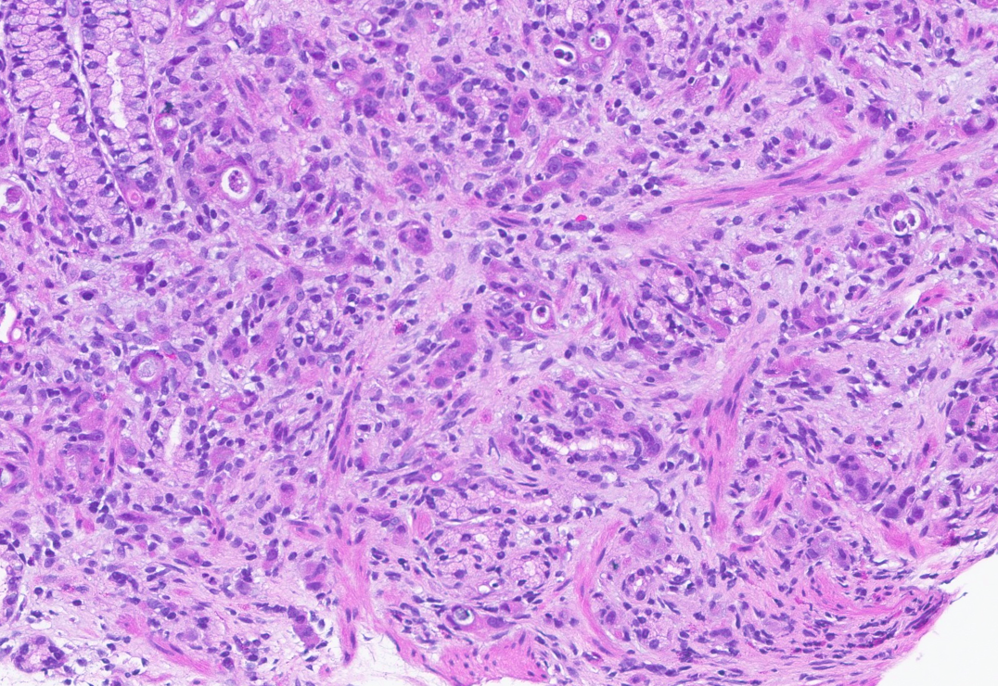
Part A: Gastric biopsy of the thickened pre-pyloric region

Slide 4
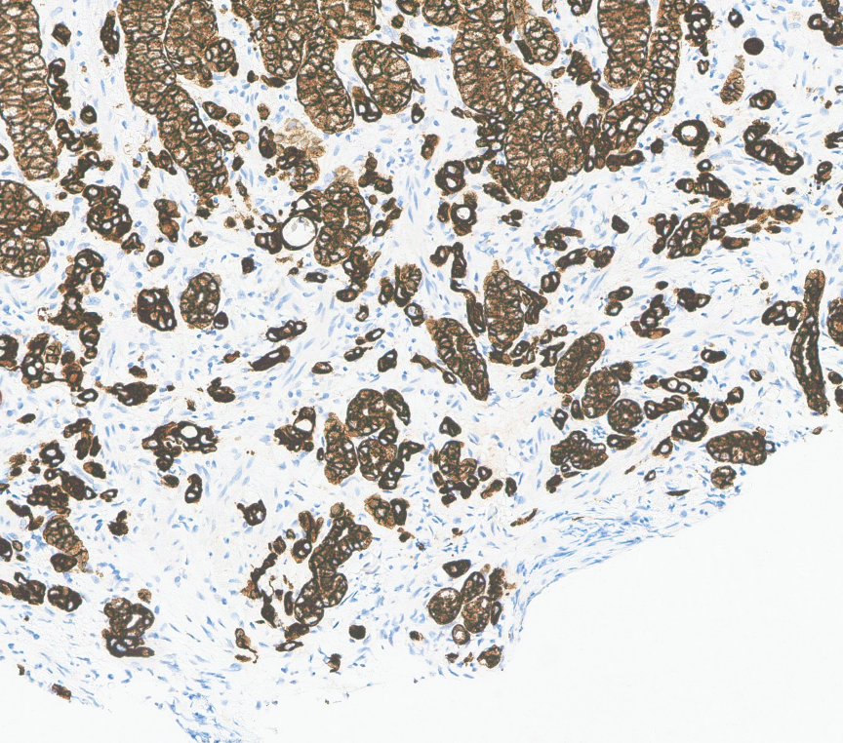
Keratin Cam 5.2
Highlights the normal gastric glands, and the poorly formed neoplastic glands and infiltrative single cells

Slide 5
Dx
A. Stomach with poorly cohesive carcinoma with signet ring cells
IHC Stain | Result | Interpretation / Comments
HER2 (IHC) | Negative (Score 0) | No HER2 protein overexpression
MLH1, MSH2, MSH6, PMS2 | Intact nuclear expression | MMR proficient
Keratin (CAM 5.2) | Positive | Highlights infiltrating single tumor cells and abortive glands
Synaptophysin | Negative | No neuroendocrine differentiation
Chromogranin | Negative | No neuroendocrine differentiation

Slide 6
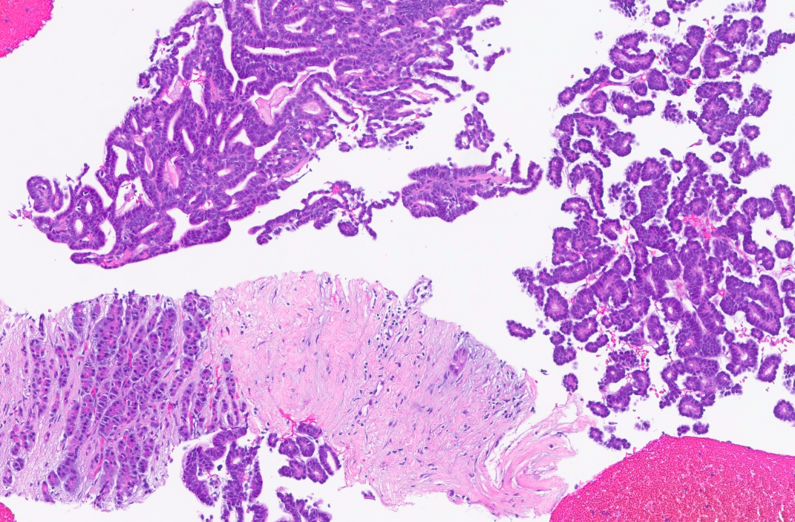
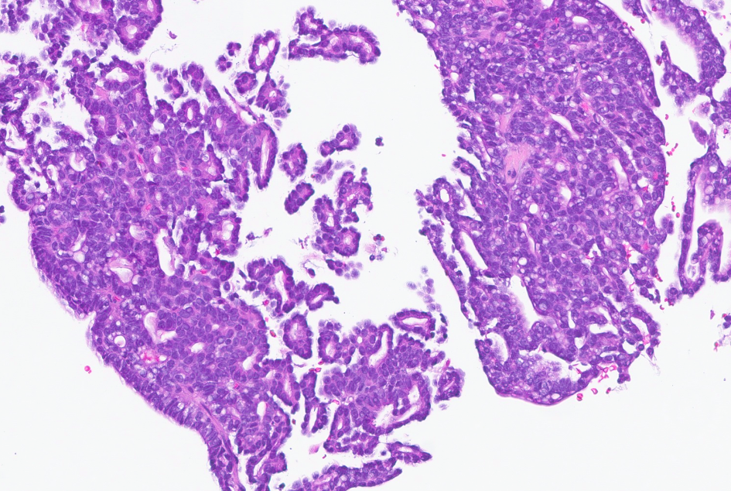
Part B: Biopsy of the pancreatic tail mass

Slide 7
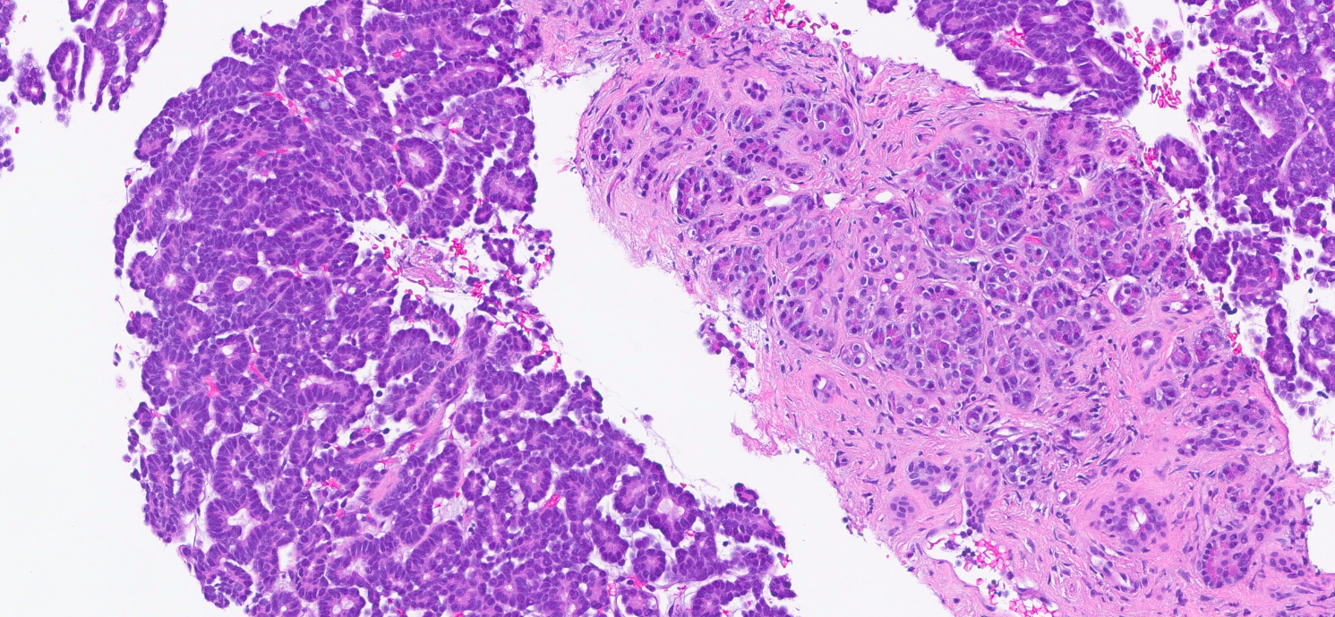

Slide 8
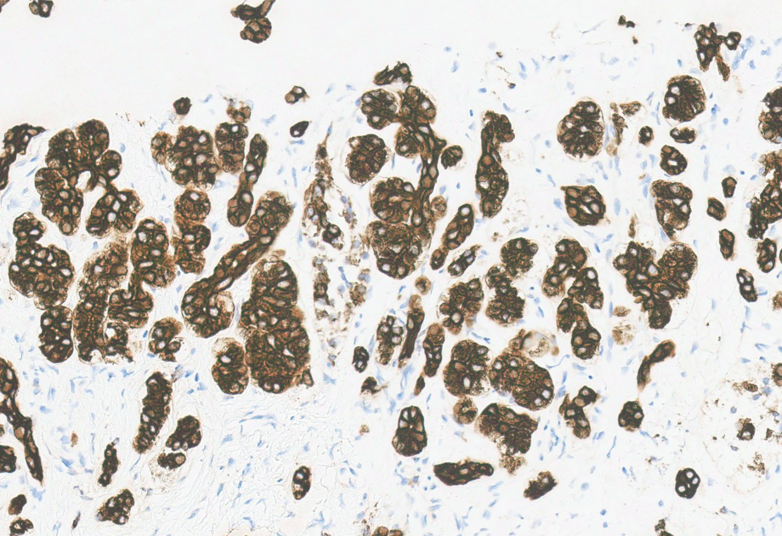
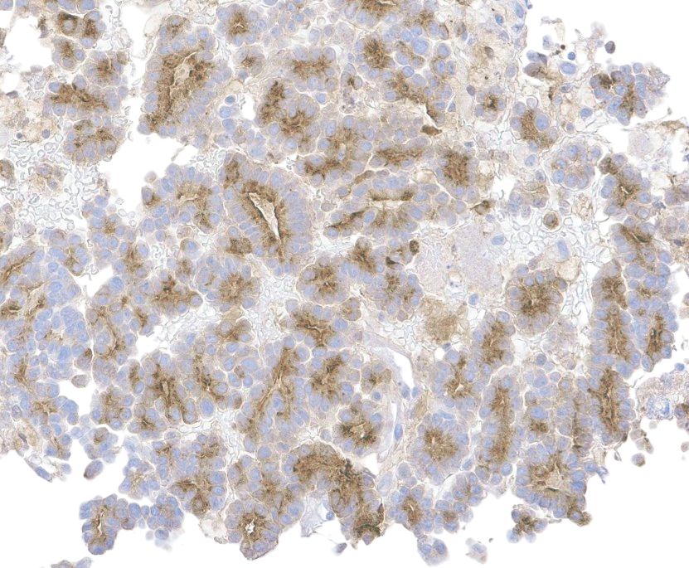
CAM 5.2
Trypsin

Slide 9
Dx
B. Pancreatic acinar cell carcinoma
IHC Panel | Result | Interpretation / Comment
HER2 (IHC) | Negative (Score 0) | No HER2 protein overexpression
MLH1, MSH2, MSH6, PMS2 | Intact nuclear expression | Mismatch-repair (MMR) proficient
Trypsin | Positive | Supports pancreatic acinar differentiation
CK7 | Positive | Favors pancreaticobiliary phenotype
CAM 5.2 | Positive | Confirms epithelial nature of tumor
CDX2 | Weak, focal positivity
Synaptophysin | Negative | No neuroendocrine differentiation
Chromogranin | Negative | No neuroendocrine differentiation
Ki-67 (Proliferation Index) | ~50% (in hotspots) | Indicates high proliferative activity

Slide 10
Clinical management
1. Treatment Plan
Unresectable
Current regimen: mFOLFIRINOX (targets both gastric carcinoma and pancreatic acinar cell carcinoma)
2. NGS / Molecular Testing
Comprehensive molecular testing ordered
Results pending to guide therapy and identify actionable mutations
3. Genetics Evaluation
Genetic counseling recommended given dual primaries and age

