Slide 1
Case of the month November 2025 Hong Yu - PGY2, Dr. Roshan Raza, Dr. Celia Marginean

Slide 2
Case presentation
45-year-old male with sickle cell disease (frequent transfusions), ESRD on hemodialysis, and portopulmonary hypertension, evaluated for portal hypertension/cirrhosis. Alcohol: 4 tall beers daily ×7 years, quit 2001. Serologies: Hep A IgG reactive (07/2022); Hep B surface Ag: nonreactive.
MRI findings: significant hepatic iron overload, no cirrhotic morphology, no portal hypertension, and no focal hepatic lesions. Additional findings included an atrophic scarred spleen (consistent with sickle cell disease) and atrophic bilateral kidneys with acquired cystic changes.
Laboratory data: persistent elevation of liver function tests for several months, markedly high alkaline phosphatase (346-582 U/L), elevated total bilirubin (2.4-4.4 mg/dL, both direct and indirect fractions), mildly elevated AST (up to 78 U/L), normal ALT, and occasional hyperproteinemia.
An ultrasound-guided transjugular liver core biopsy was performed.

Slide 3
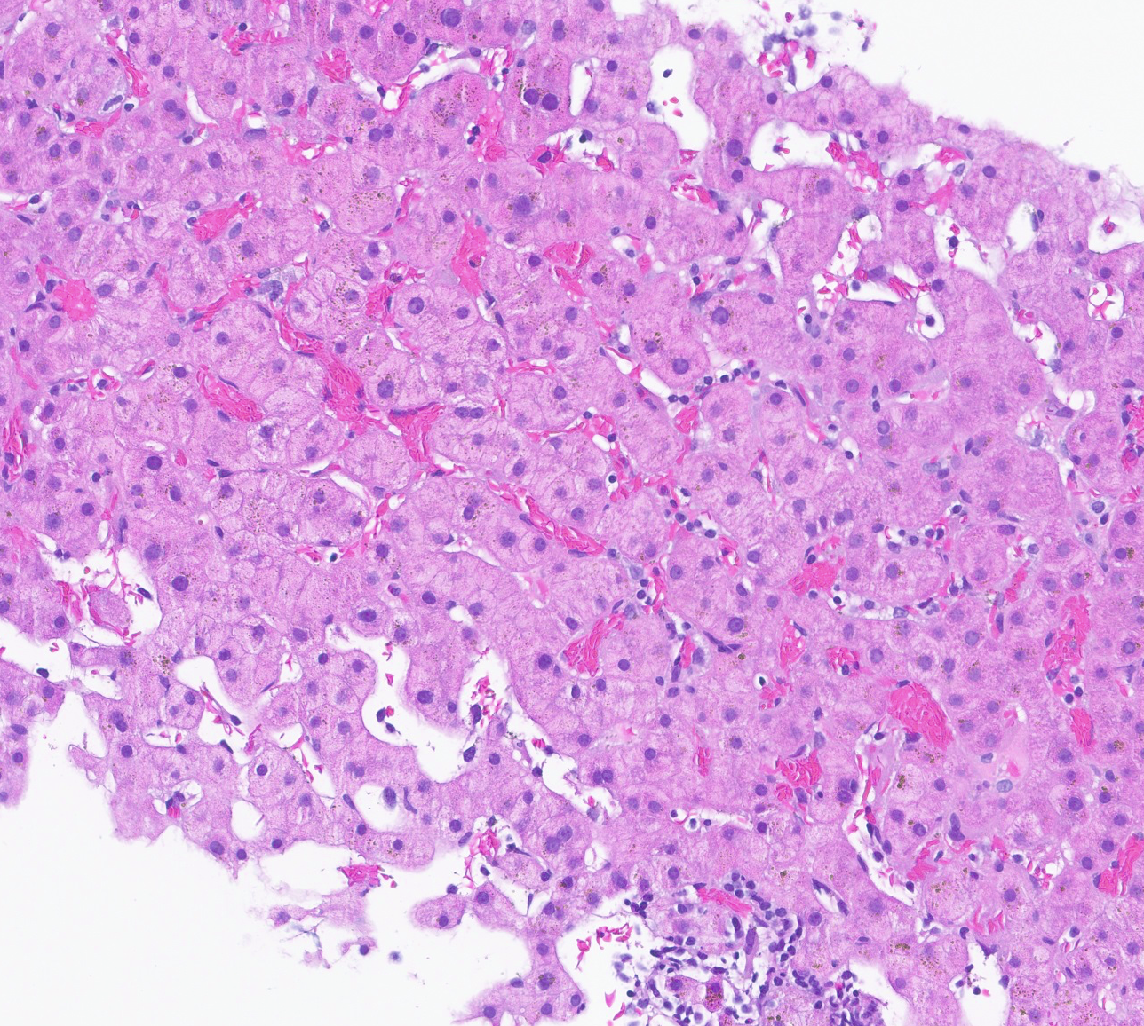
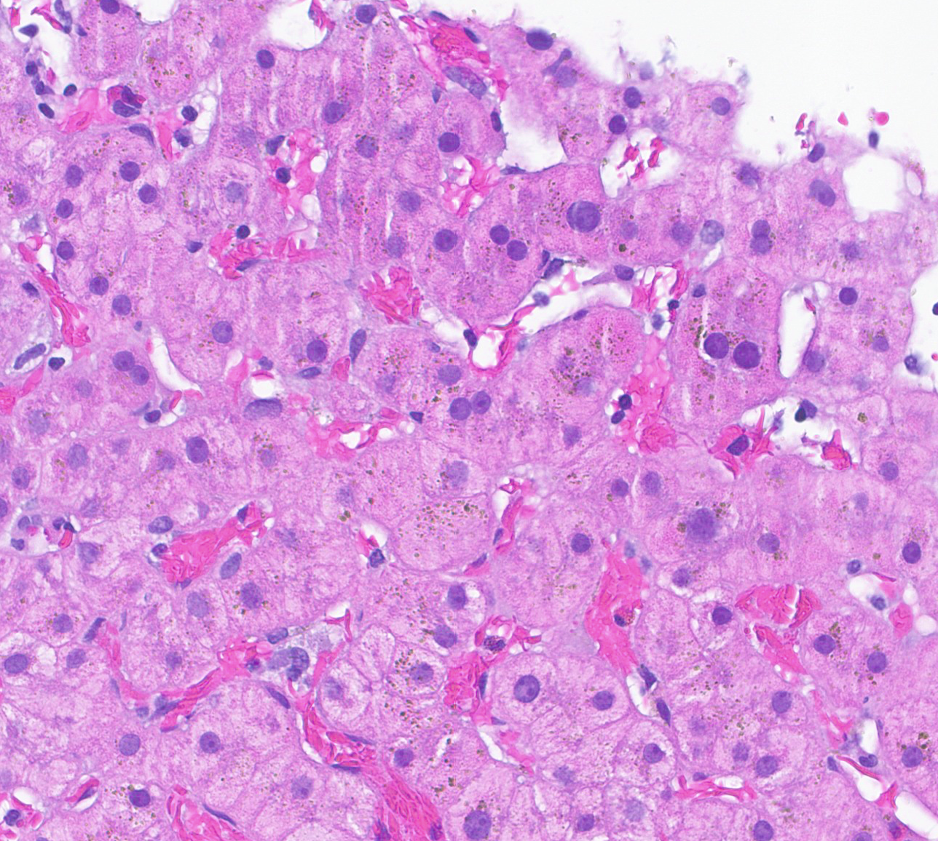
20x
40x
Histologic features:
Prominent sinusoidal dilation and congestion with sickled RBCs

Slide 4
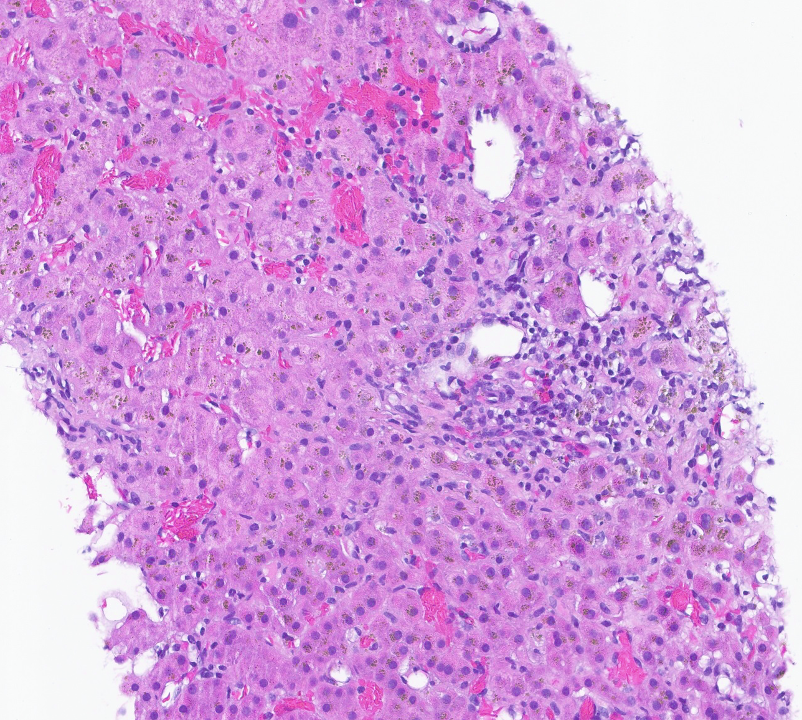
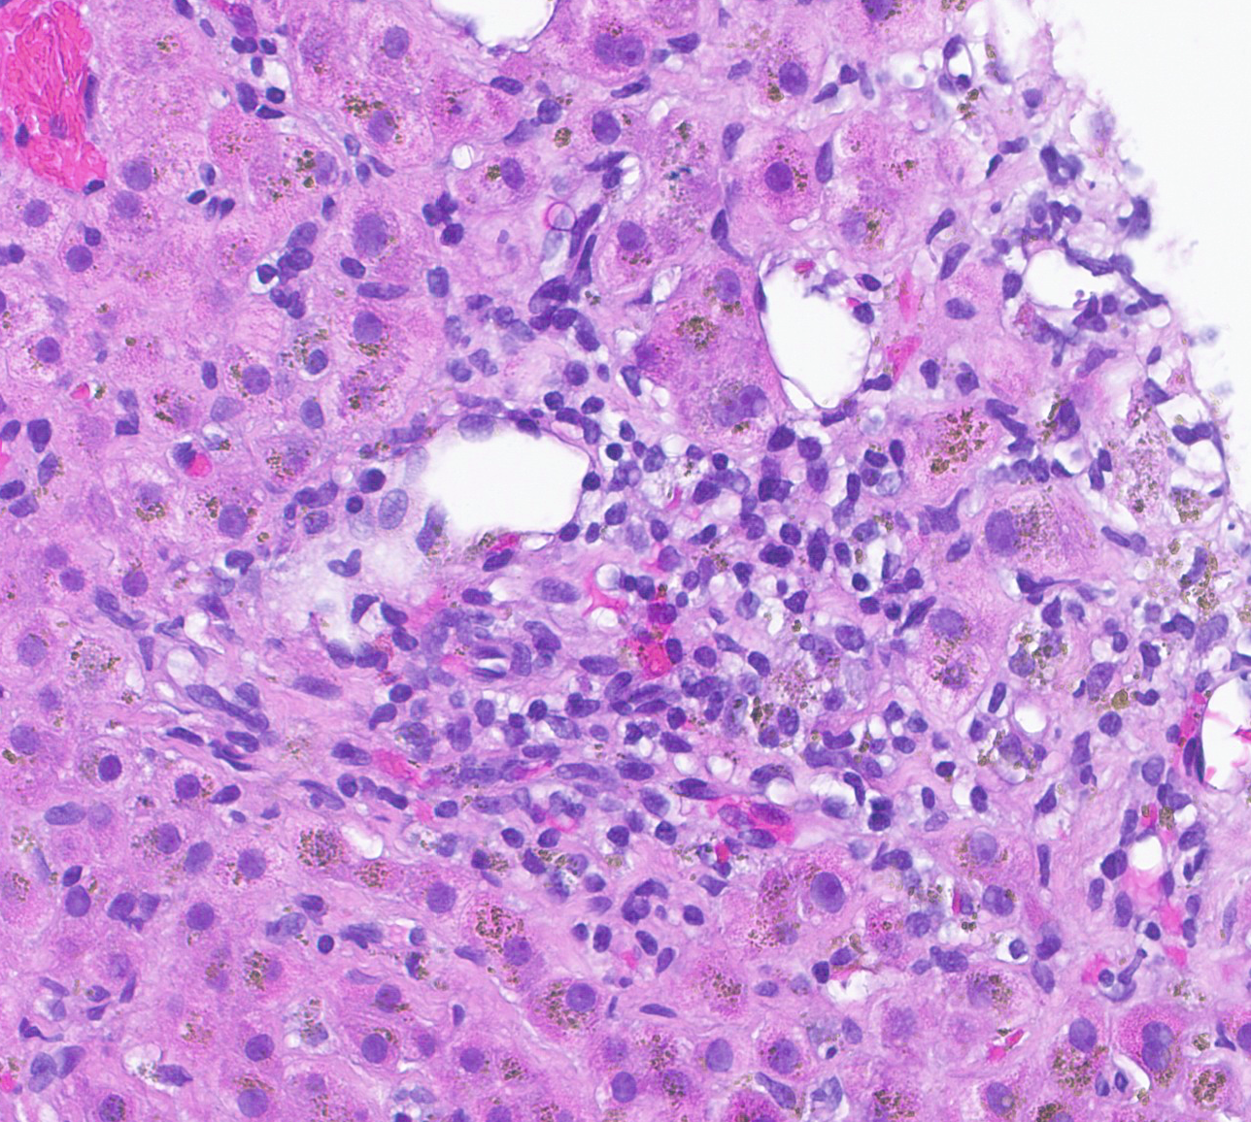
20x
40x
Histologic features:
Mild portal and lobular inflammation

Slide 5
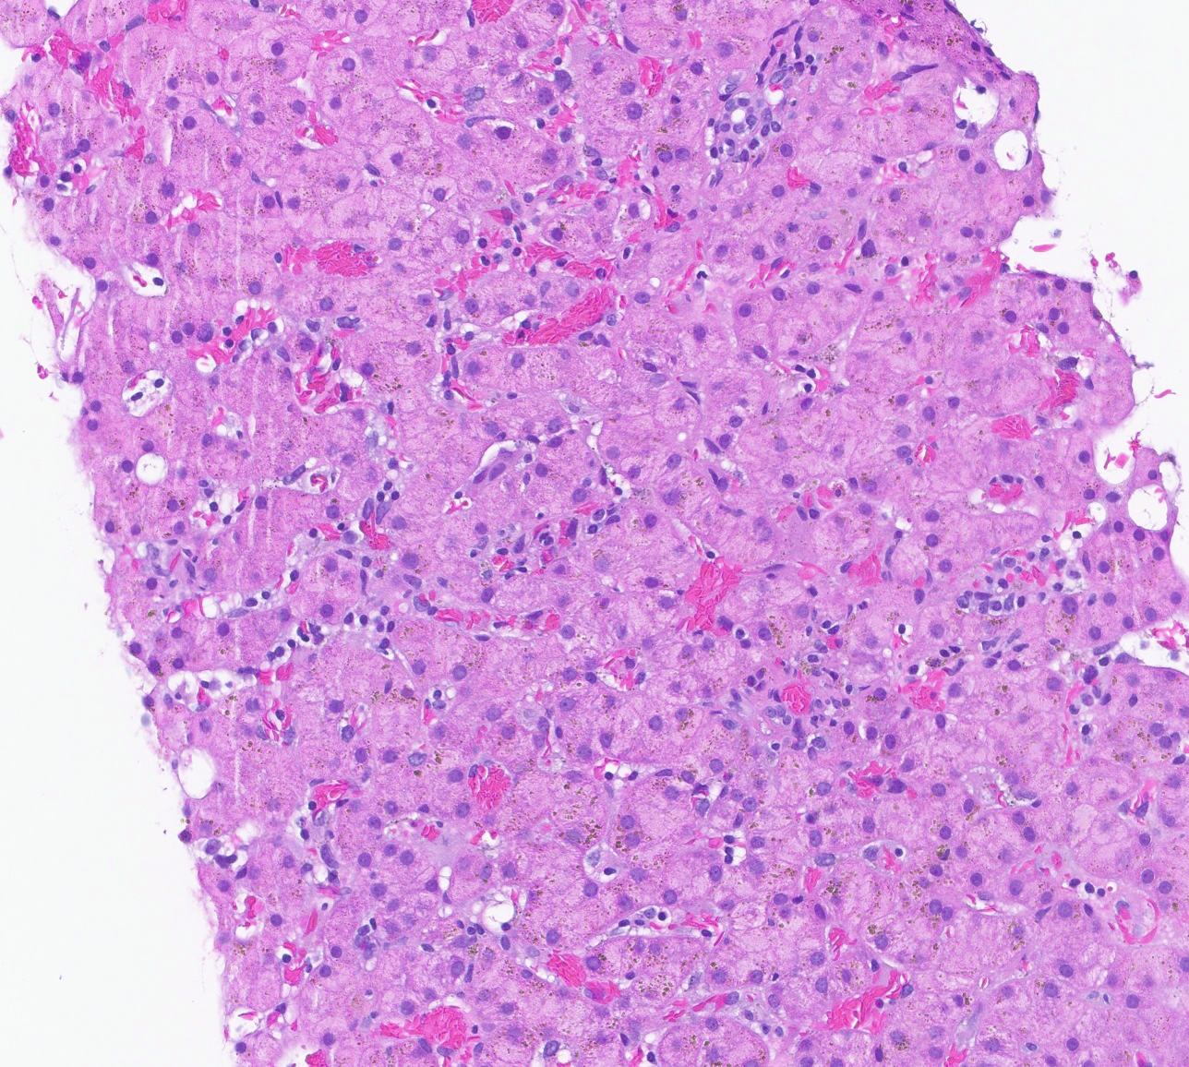
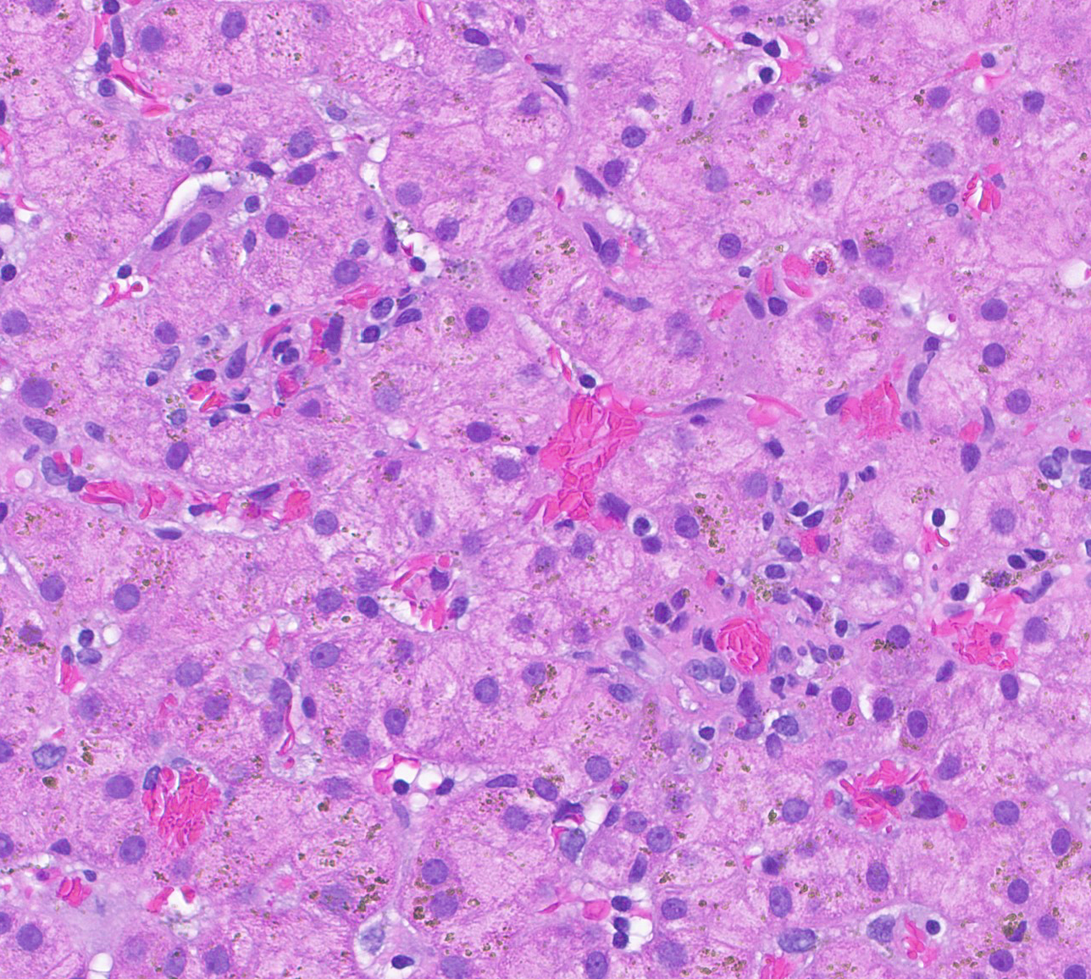
20x
40x
Histologic features:
Mild lobular inflammation

Slide 6
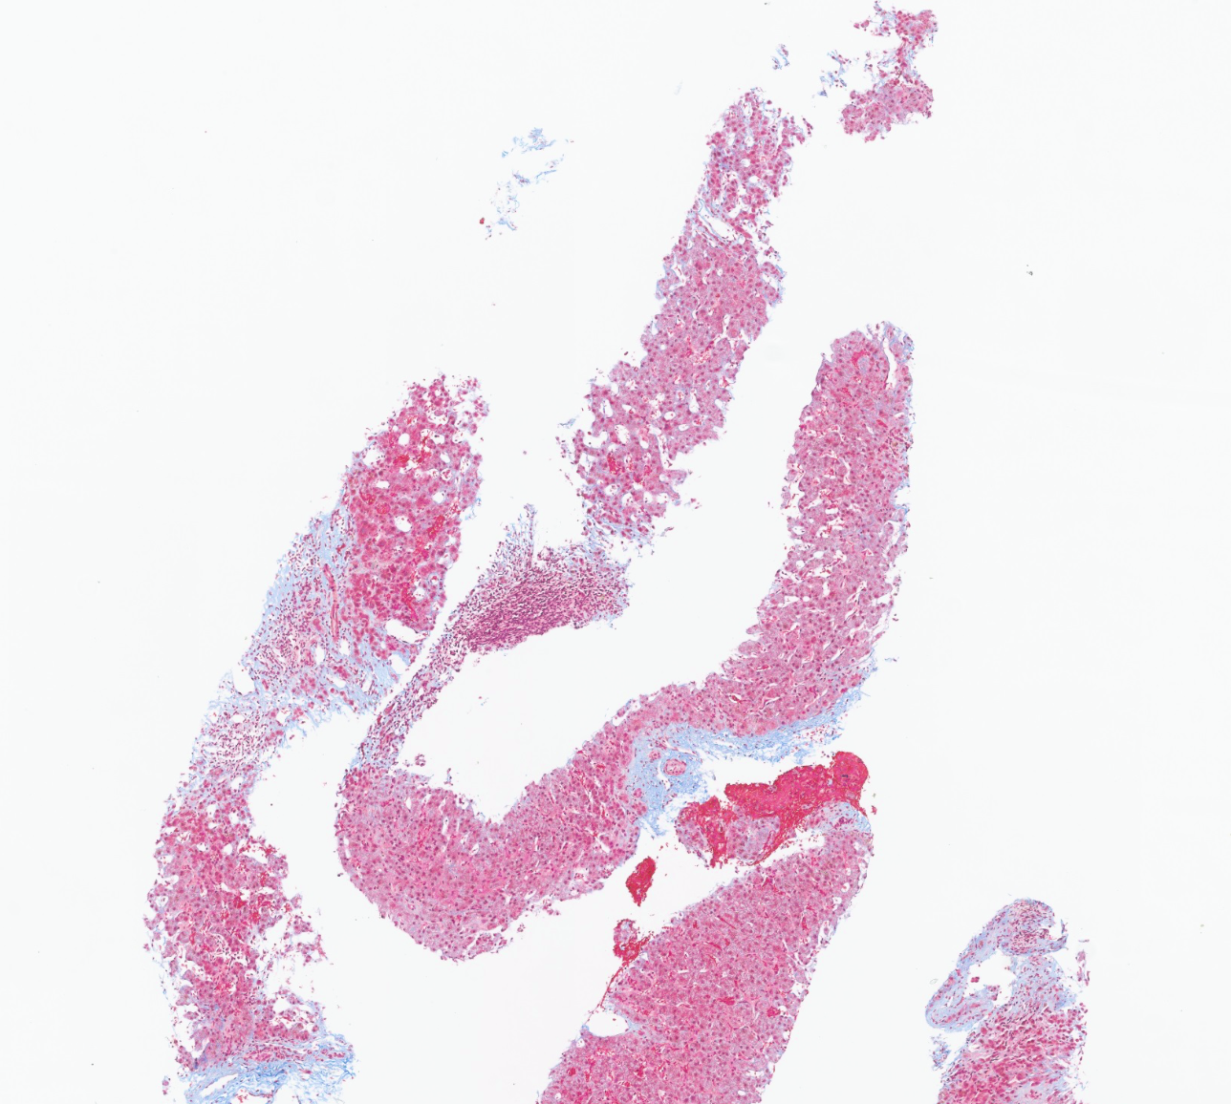
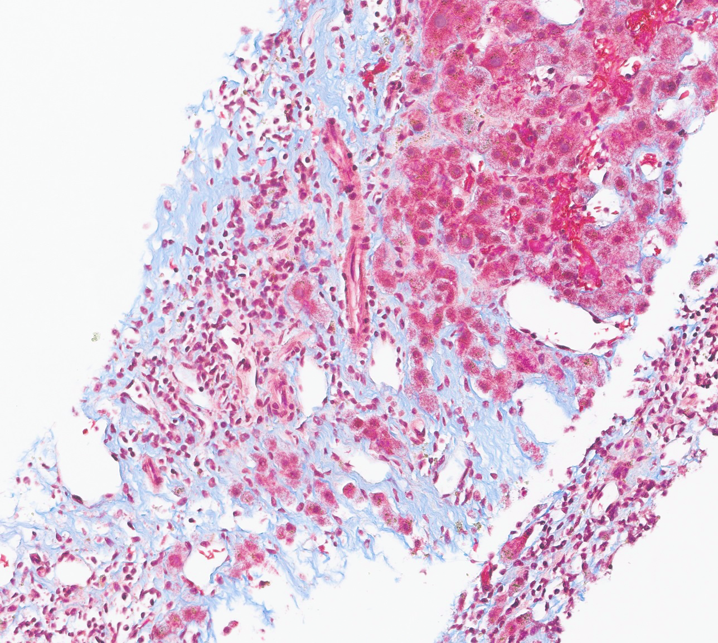
Trichrome
4x
10x
Special stains:
Portal, periportal, and pericellular fibrosis (stage 2/4), no bridging fibrosis or cirrhosis

Slide 7
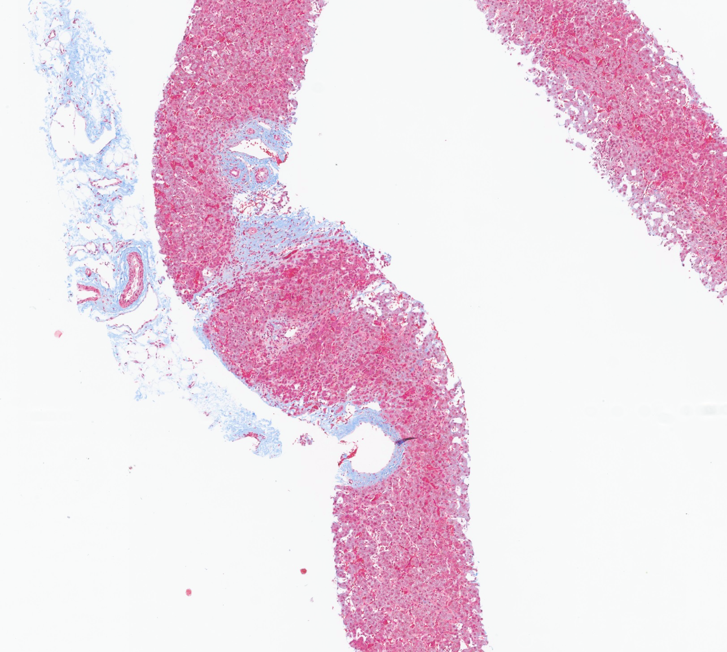
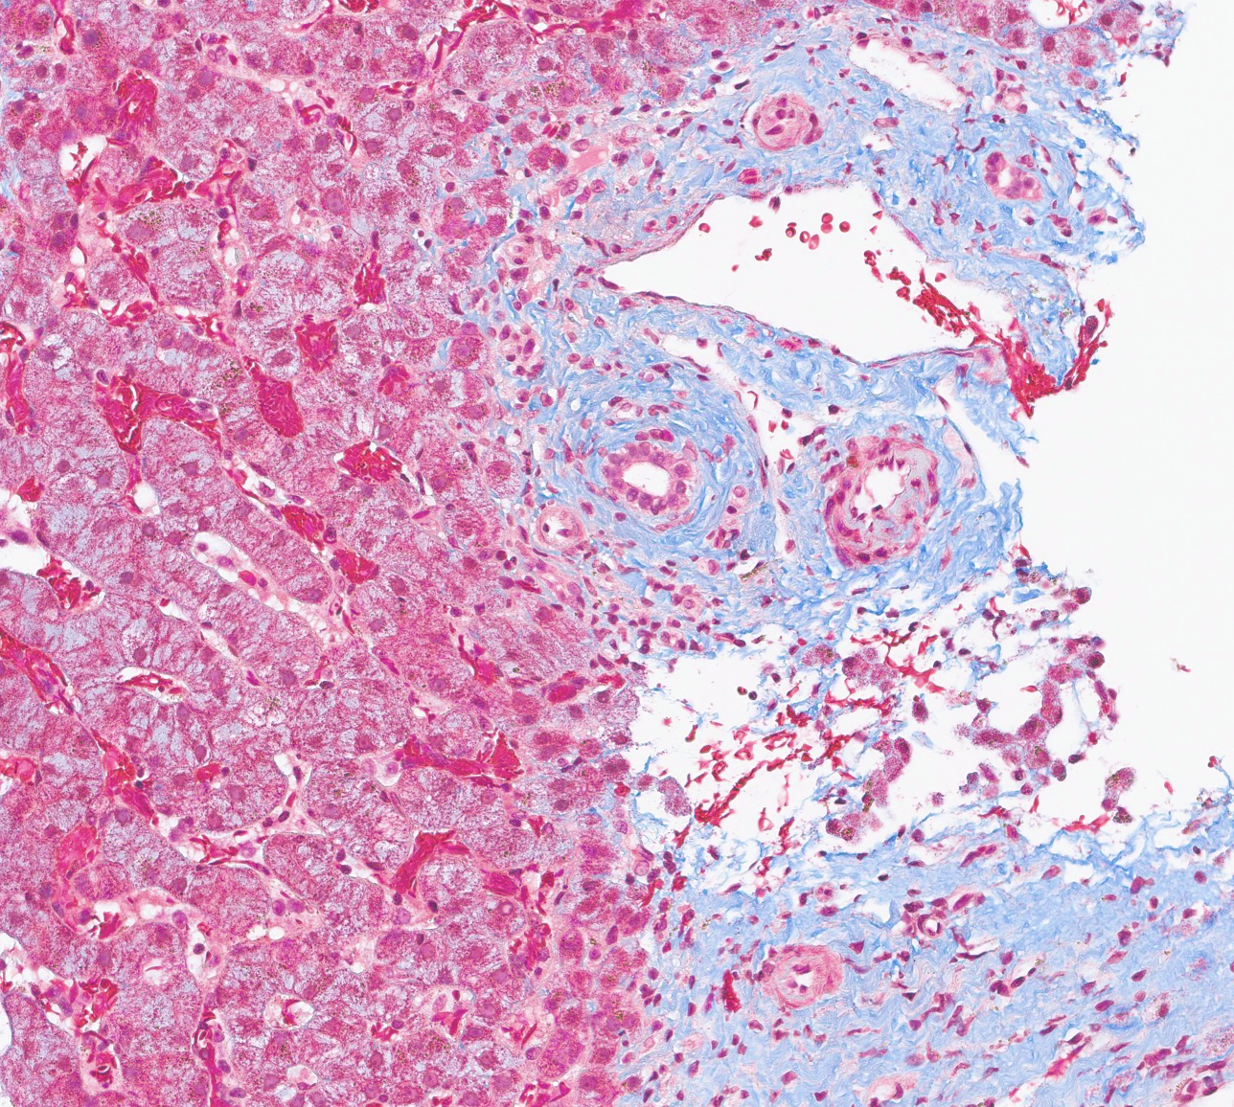
Trichrome
4x
10x
Special stains:
Portal, periportal, and pericellular fibrosis (stage 2/4), no bridging fibrosis or cirrhosis

Slide 8
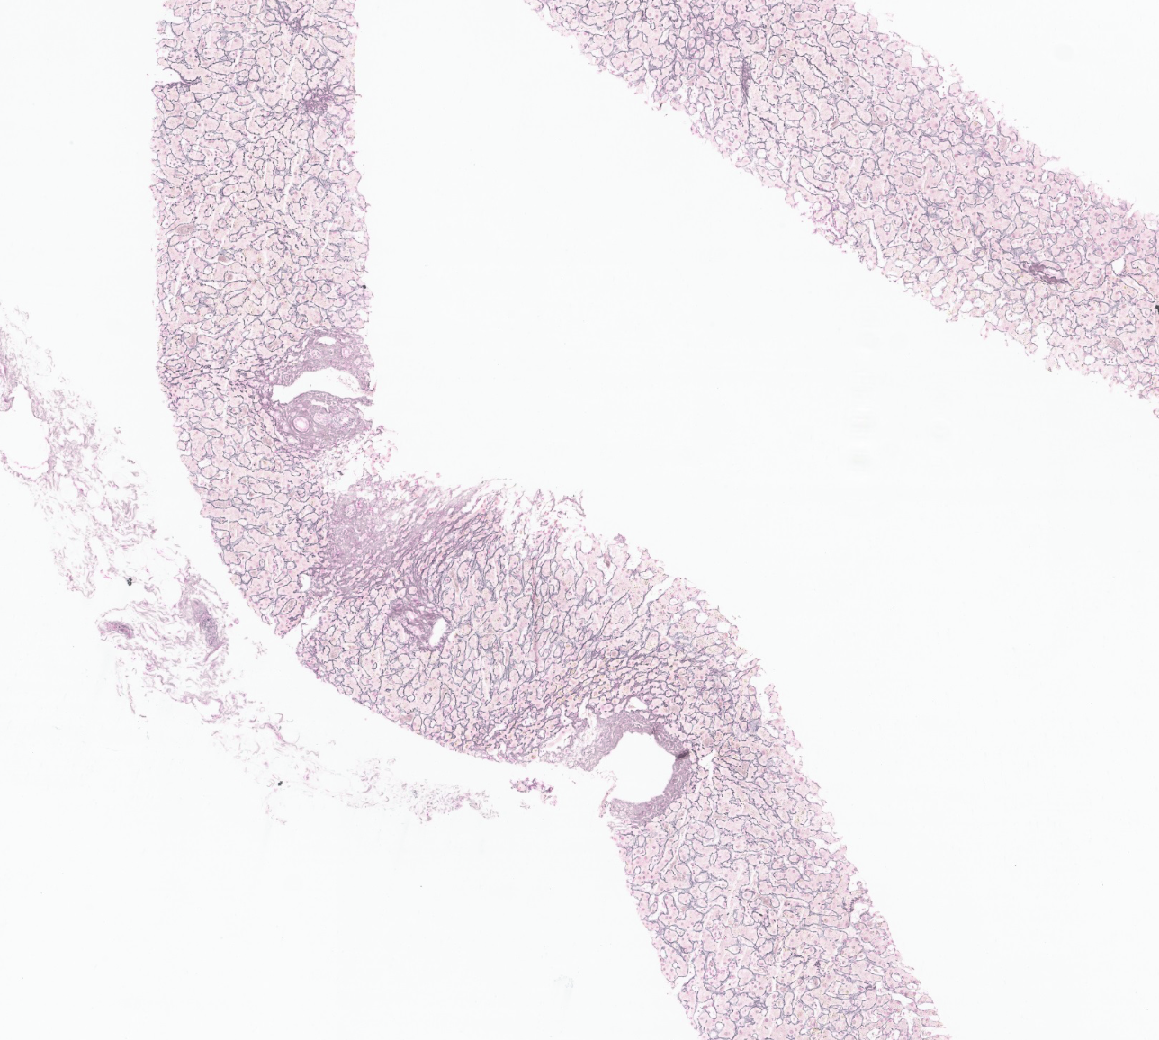
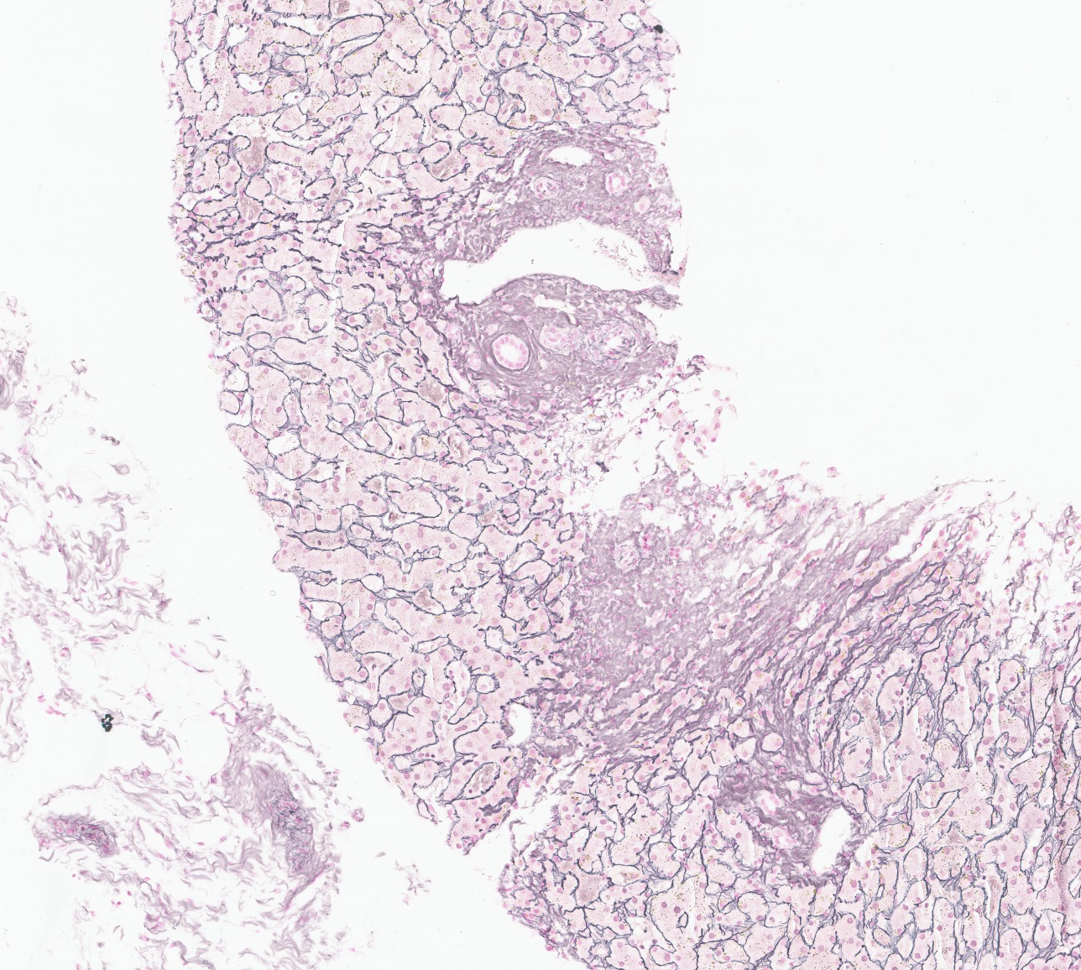
Reticulin
4x
10x
Special stains:
Reticulin network remains intact, reflecting preserved tissue architecture

Slide 9
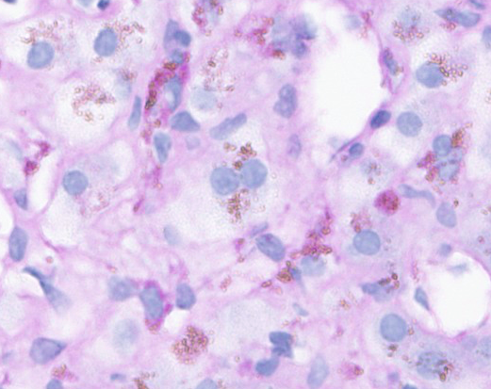
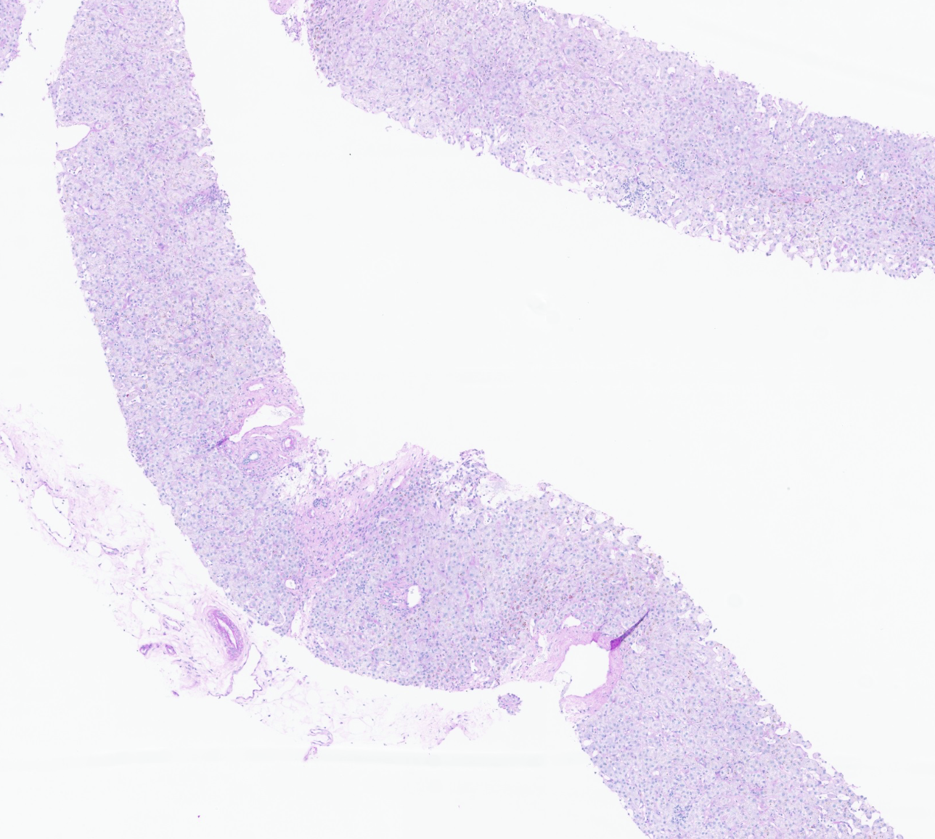
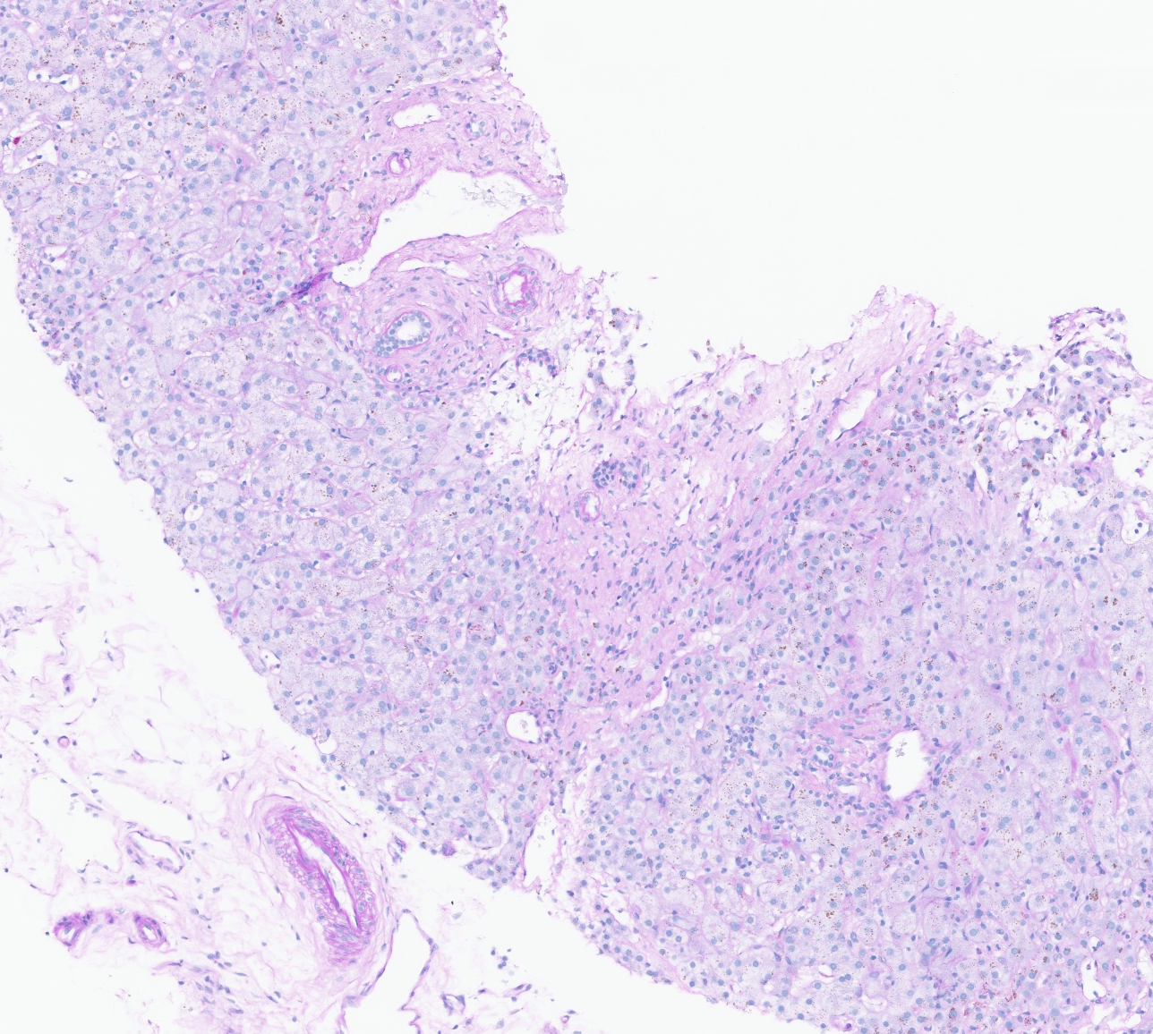
PAS-D
40x
4x
10x
Special stains:
PAS-D: highlights ceroid-laden macrophages

Slide 10
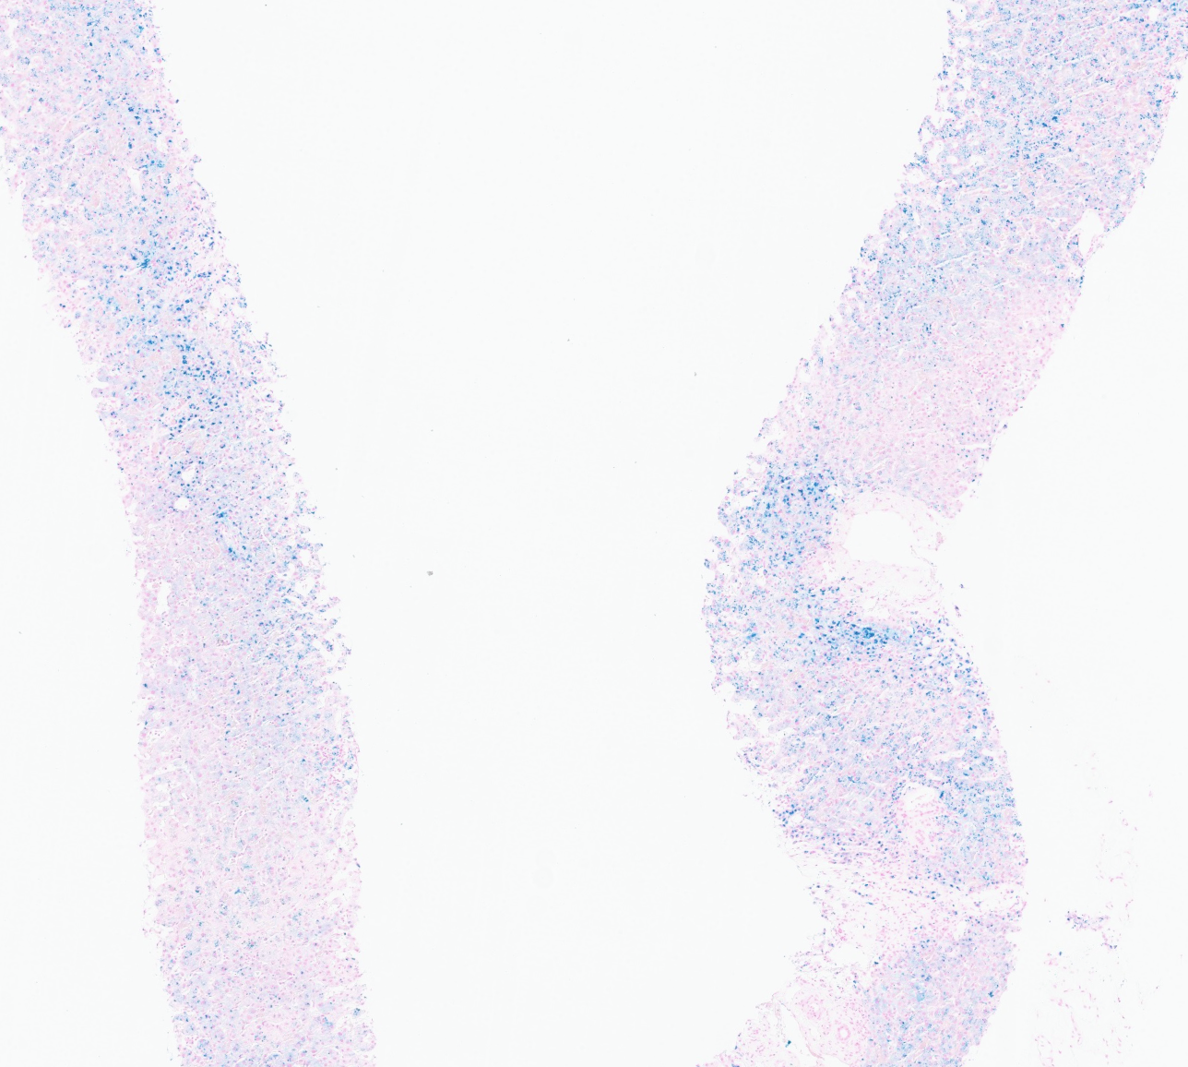
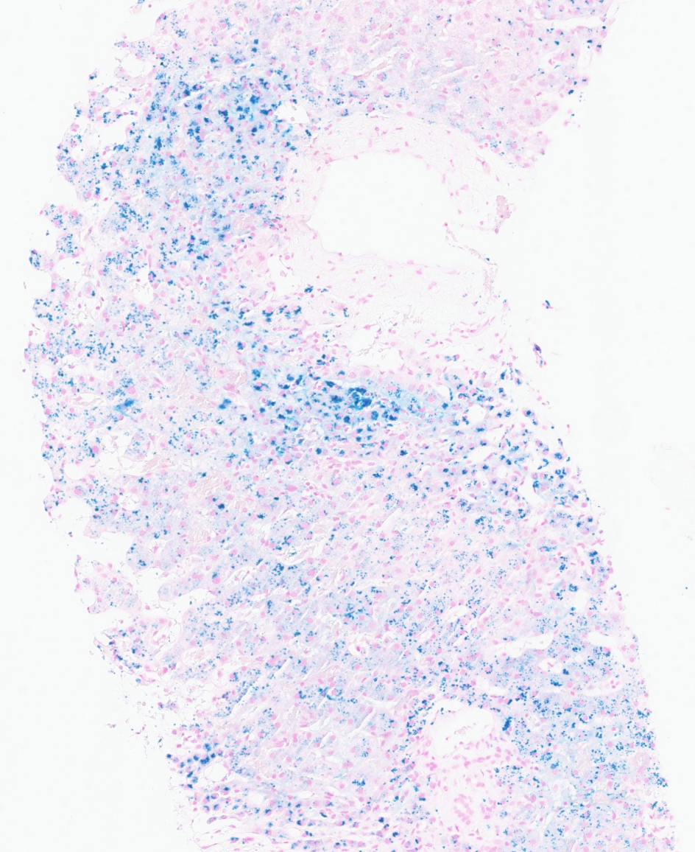
Iron
4x
10x
Special stains:
Marked hepatocellular and reticuloendothelial iron deposition (3+)

Slide 11
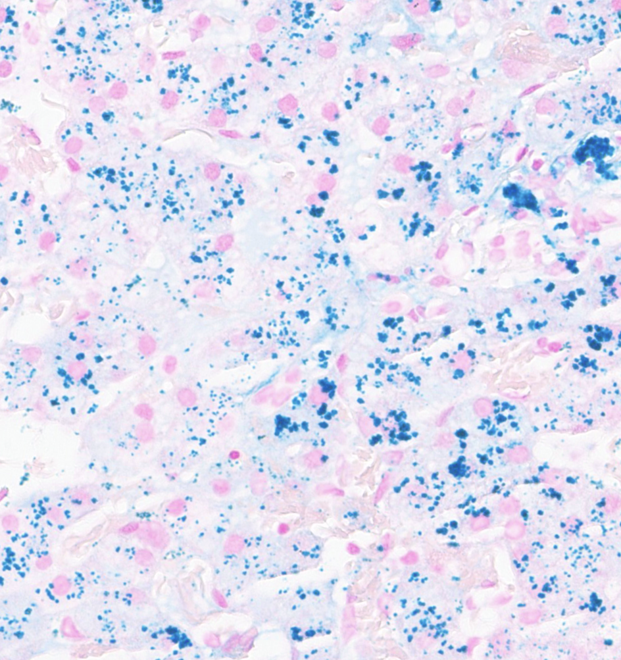
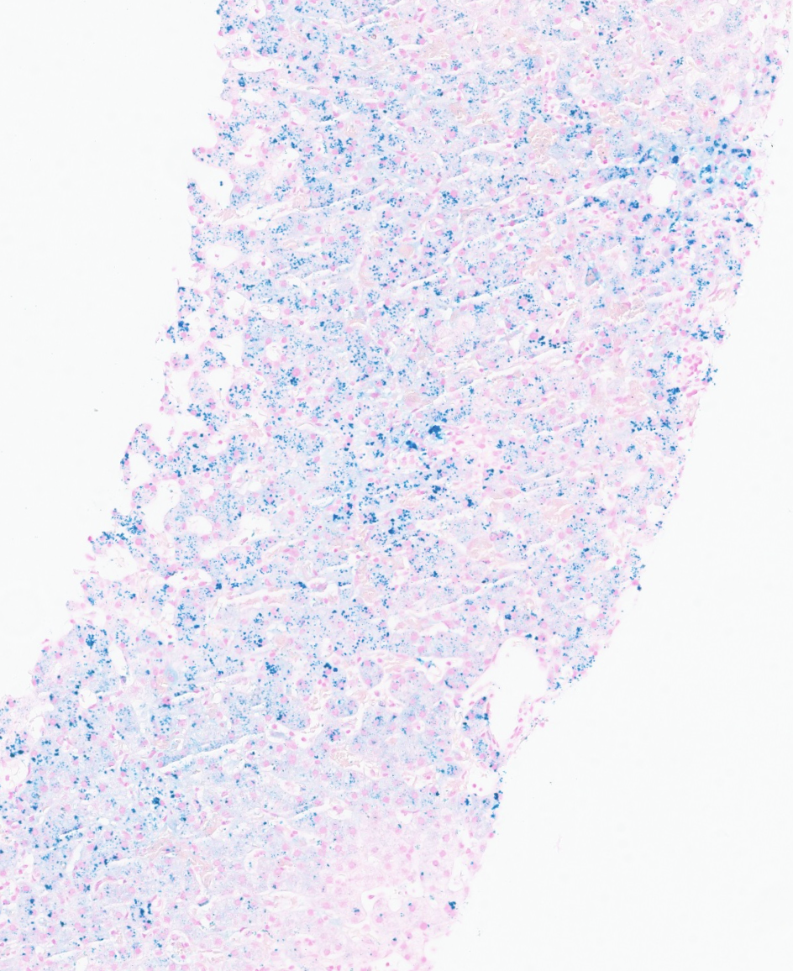
Iron
4x
40x
Special stains:
Marked hepatocellular and reticuloendothelial iron deposition (3+)

