Slide 1
GI Case of the Month
December 2025
Dr. Celia Marginean, MD (Professor, Director of GI/Liver fellowship)
Dorsay Sadeghian, MD (Resident, PGY3)

Slide 2
Clinical History:
The patient is a 59 y.o. female with history of Metabolic Associated Liver Disease (MALD), progressed to liver cirrhosis, who underwent orthotopic liver transplant in May 2025.
Four months after the transplantation, she presented with fatigue, weakness and altered mental status.
Lab work up showed elevated AST: 650 U/L and ALT: 594 U/L, as well as leukopenia. ALP and bilirubin levels were unremarkable.
Liver ultrasound revealed intrahepatic bile ducts and common bile duct dilatation.
Chest CT scan revealed right pleural effusion with adjacent consolidation. Several nodules measuring up to 8 mm were noted in the right lung.
Broad spectrum antibiotics was started for her, and she underwent liver percutaneous biopsy for further investigation.

Slide 3
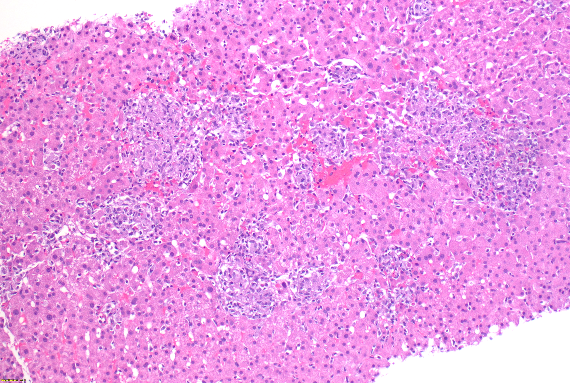
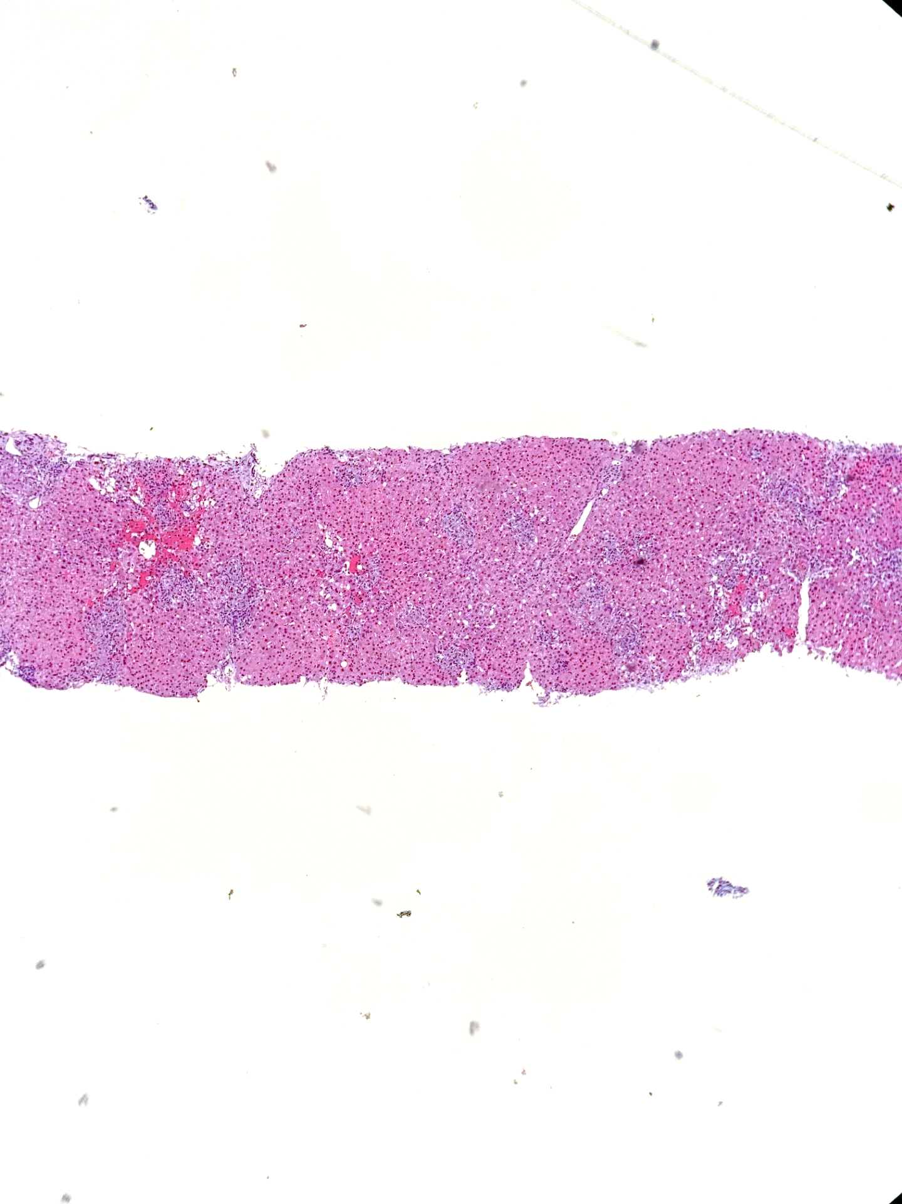
The liver biopsy shows numerous non-necrotizing lobular and portal granulomas in various sizes.

Slide 4
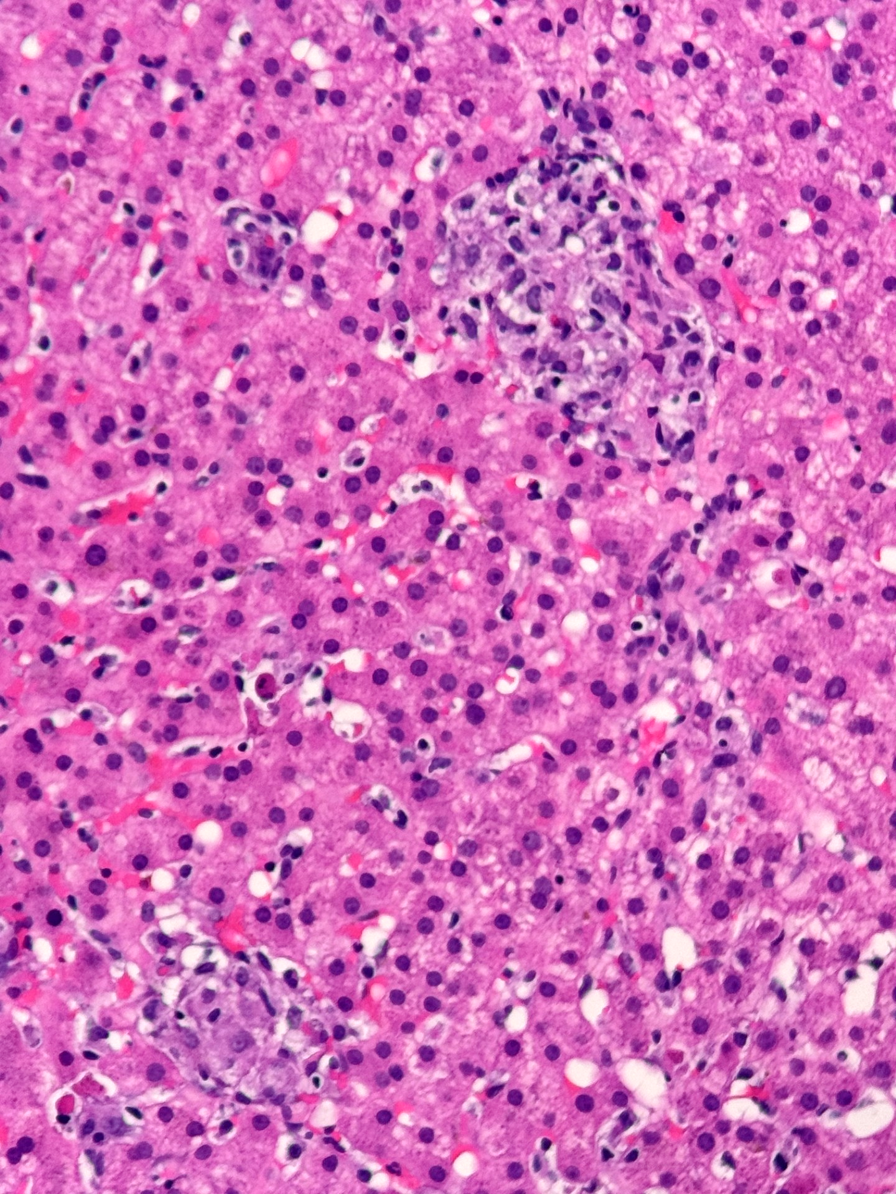
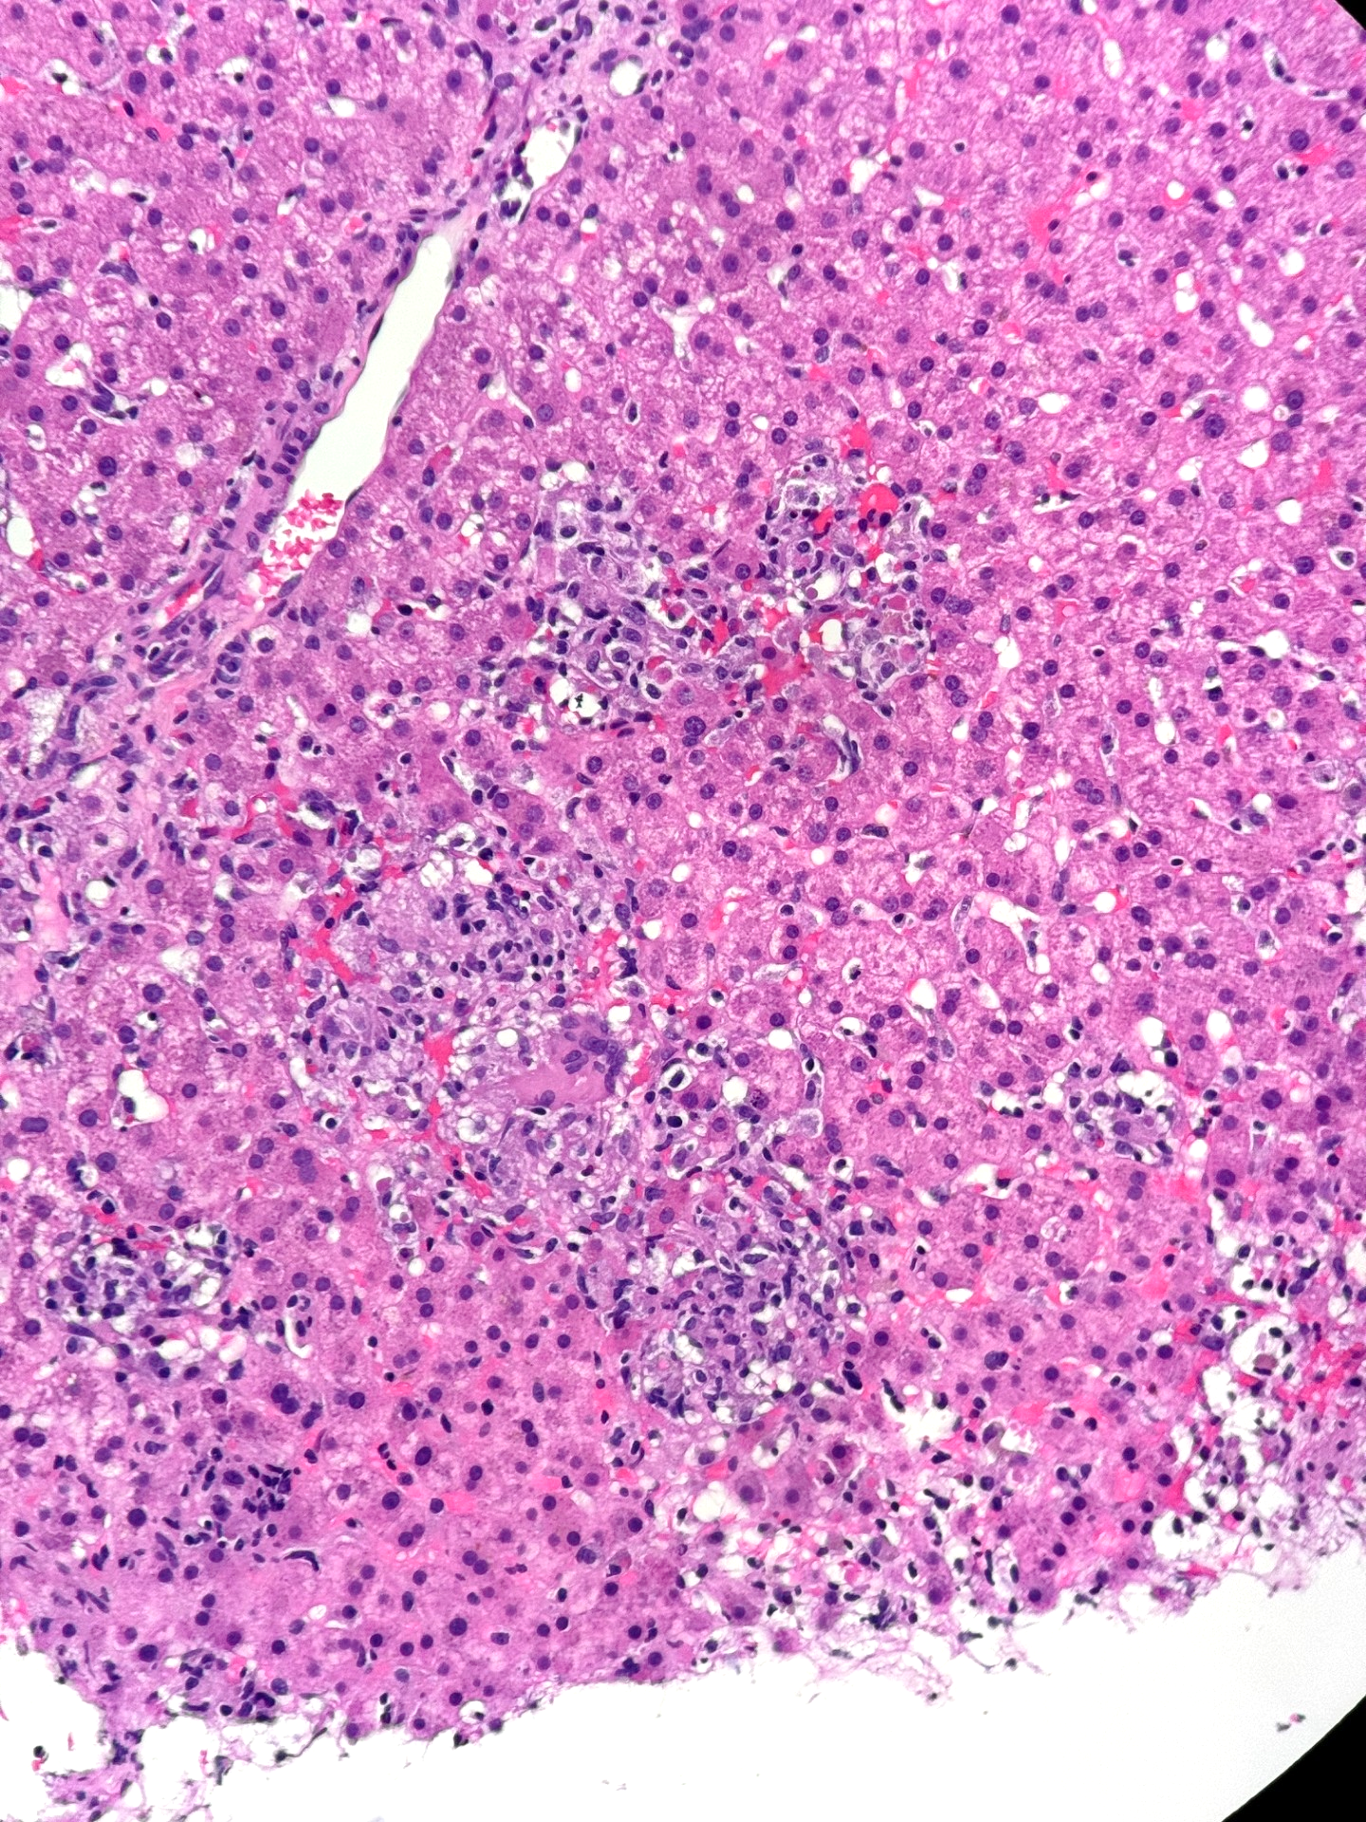
Acidophil Body
High power view shows variable size non-necrotizing granulomas, some coalescing, and a few are centered by multinucleated giant cells (arrow). Mild to moderate lobular inflammation, as well as acidophil bodies (necrotic hepatocytes) are present .

Slide 5
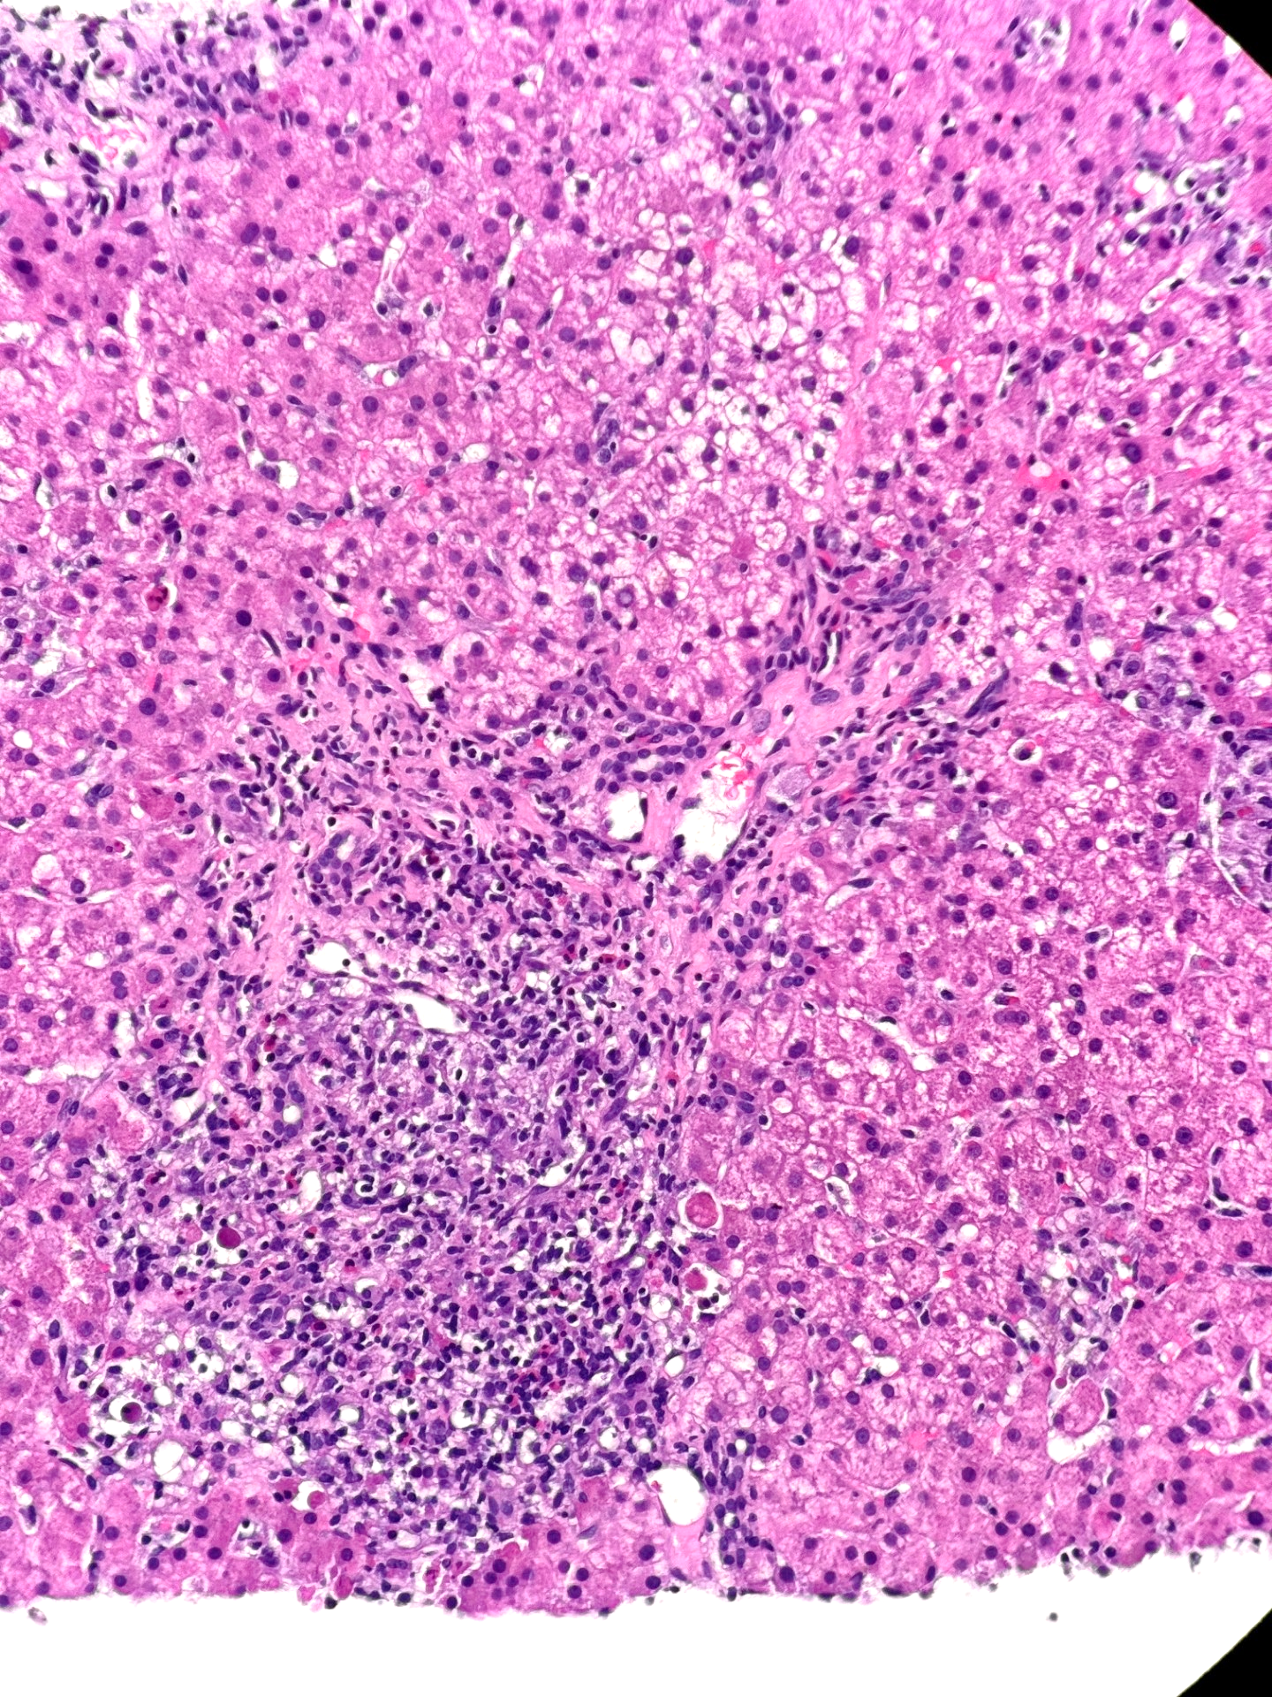
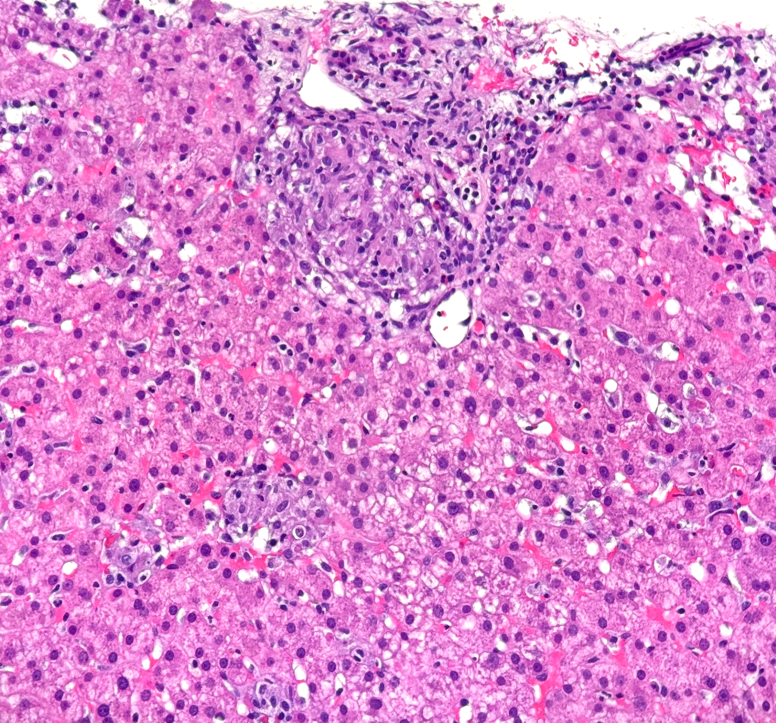
Two out of the 10 portal tracts show expansion by a mixed inflammatory infiltrate, composed of lymphocytes, numerous eosinophils and very scant plasma cells; one of them also includes a portal granuloma (arrow). The bile ducts in these 2 portal tracts show epithelial injury, with lymphocytic infiltration and cytoplasmic vacuolization.

Slide 6
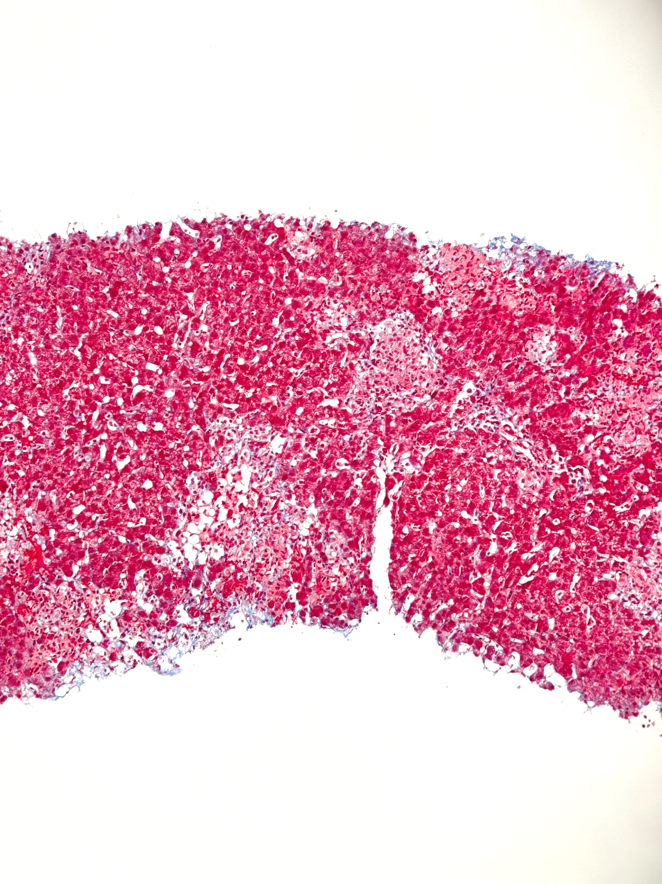
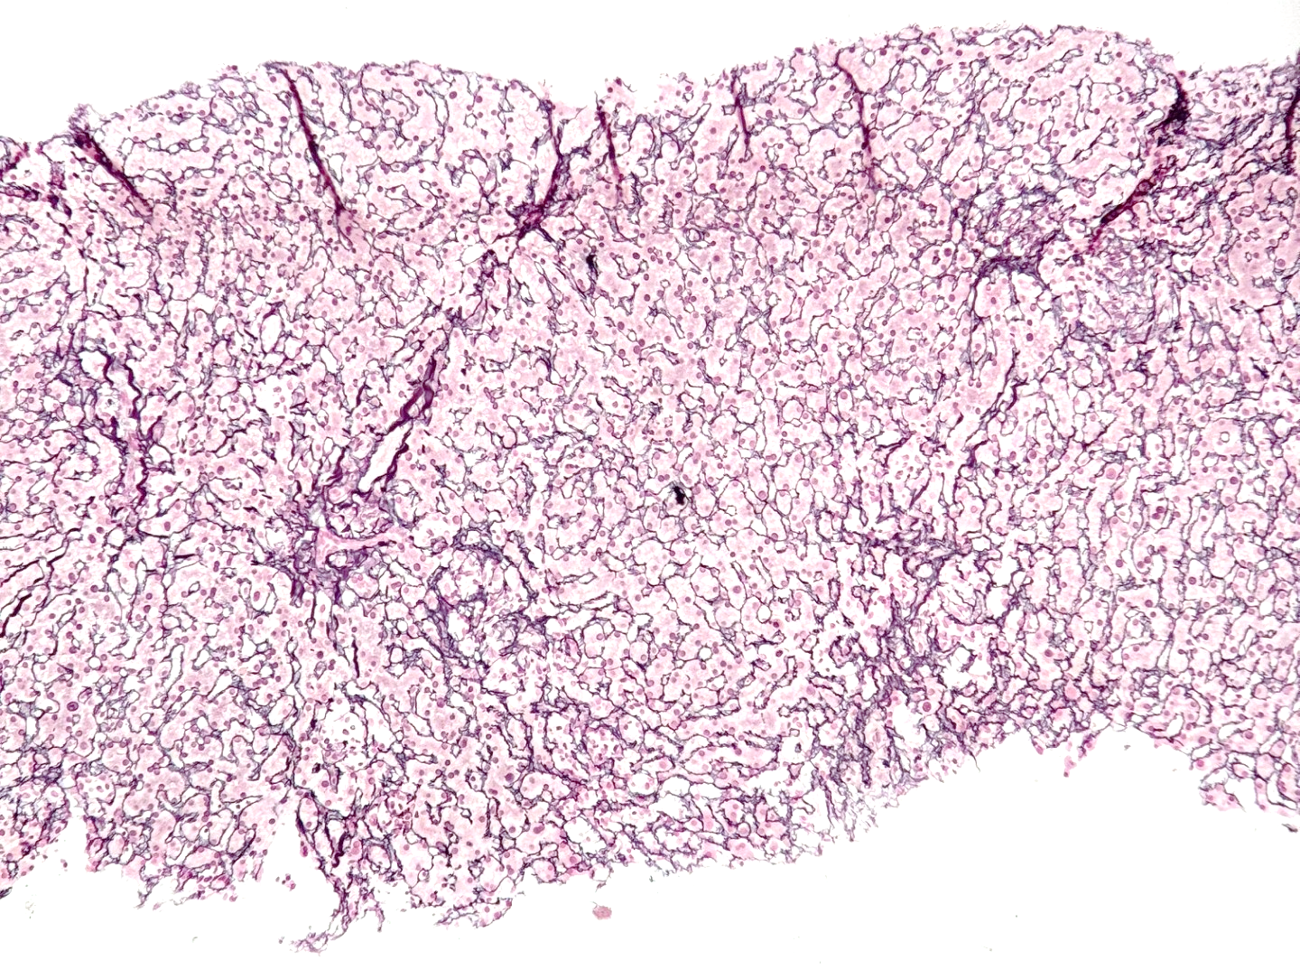
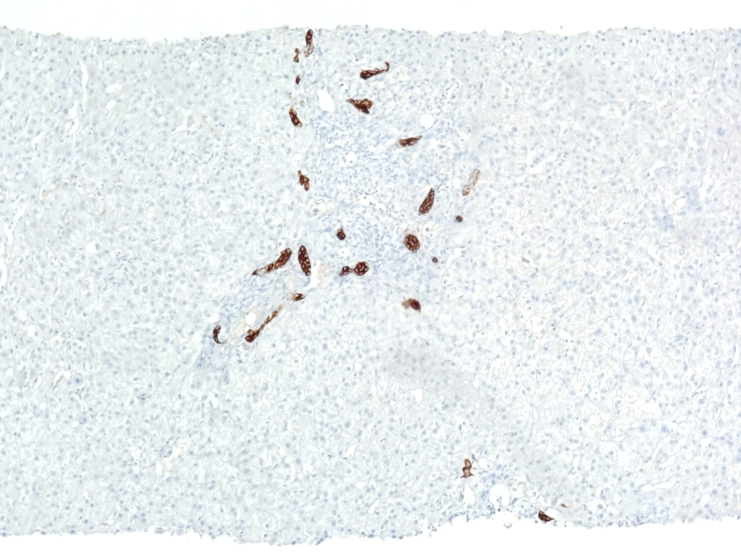
Trichrome
Reticulin
Cytokeratin 7
Trichrome and reticulin stains show preserved lobular architecture, with no evidence of fibrosis.
CK7 also highlights bile ductular proliferation in most of the portal tracts.

Slide 7
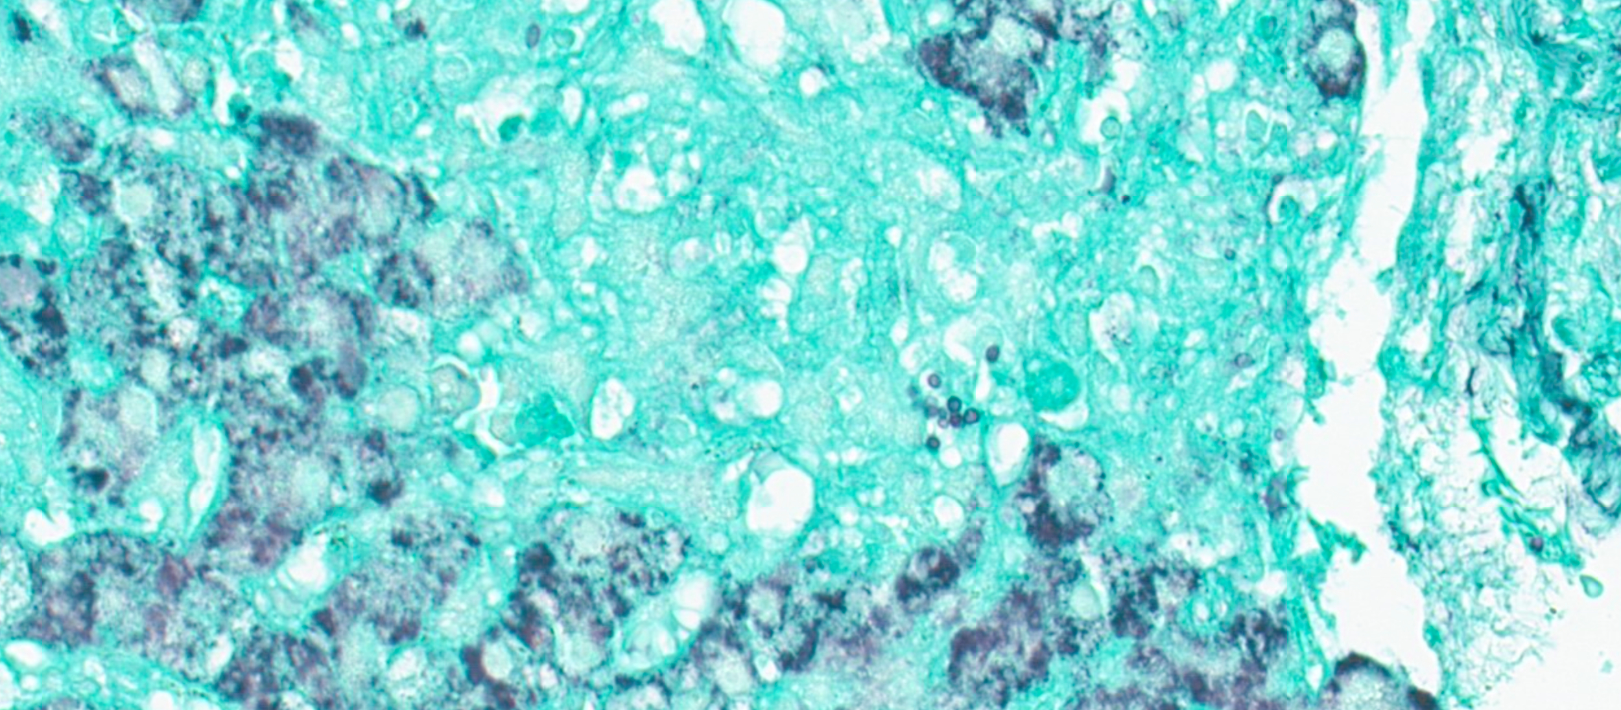
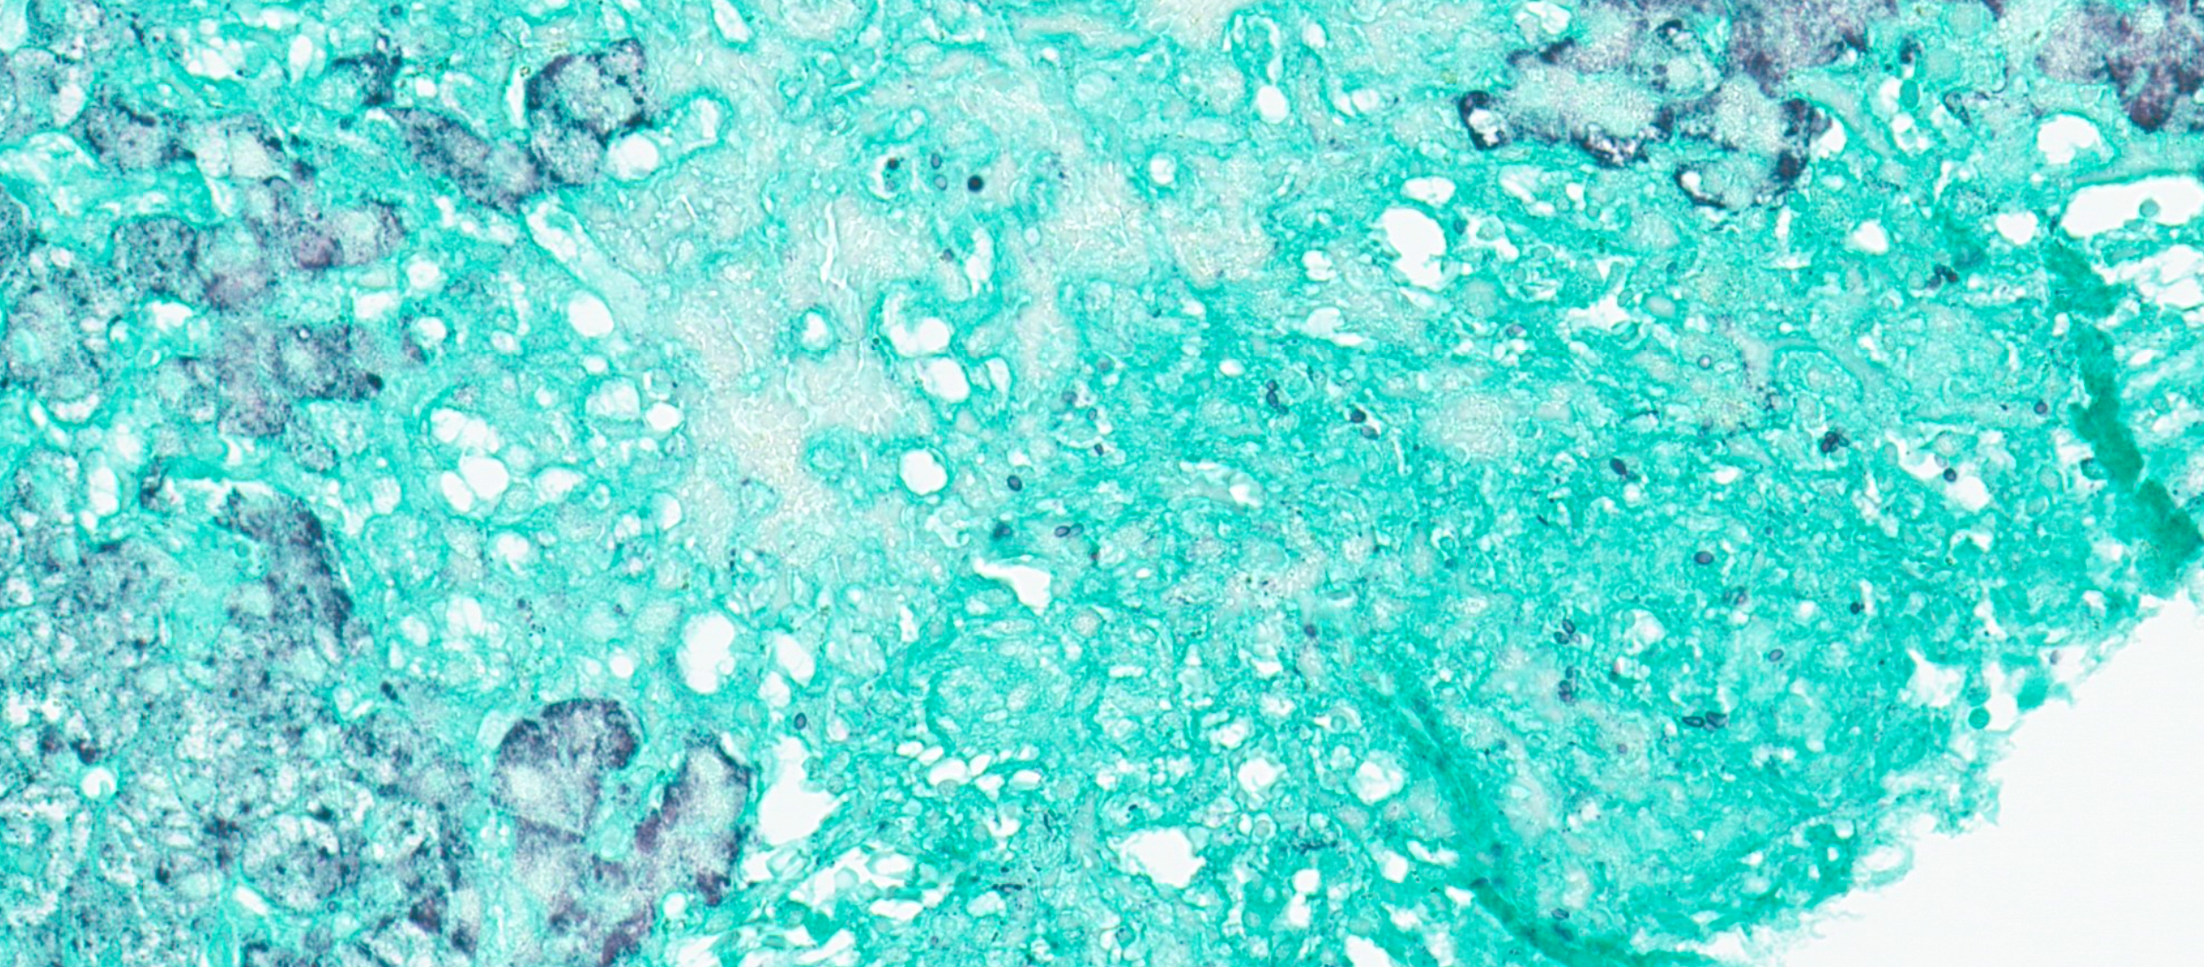
GMS special stains shows numerous fungal spores within the granulomata, some with narrow budding, consistent with histoplasmosis. AFB special stain shows no acid-fast bacteria.

Slide 9
Final Diagnosis:
Liver, post-transplant biopsy:
- Liver with granulomatous hepatitis
- GMS special stain highlights numerous fungal organisms, consistent with histoplasma species

