Slide 1
Case of the month January 2026
Sonal Italiya, MD (Pathology Resident, PGY-3)
Shaimaa Elzamly, MD, PhD (Assistant Professor)

Slide 2
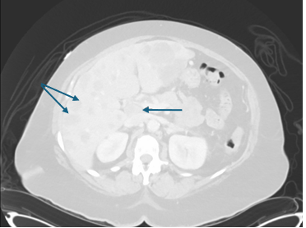
Clinical Presentation
An 80-year-old woman presented with persistent upper abdominal pain for two months, accompanied by early satiety, unintentional weight loss (10–12 lbs), occasional bloody stool, and severe weakness, without jaundice.
An imaging revealed a large, heterogeneous mass centered in the pancreatic body, measuring approximately 6.7 × 4.0 cm, with pancreatic duct dilation.
Additionally, splenic vein occlusion, portocaval lymphadenopathy, multiple liver metastases, and incidental pulmonary emboli were also identified. Serum CA 19-9 was markedly elevated (676,843 U/mL).
Endoscopic ultrasound demonstrated an irregular hypoechoic mass in the body and tail of the pancreas, and a fine needle biopsy (FNB) of the pancreatic mass and liver mass was performed.

Slide 3
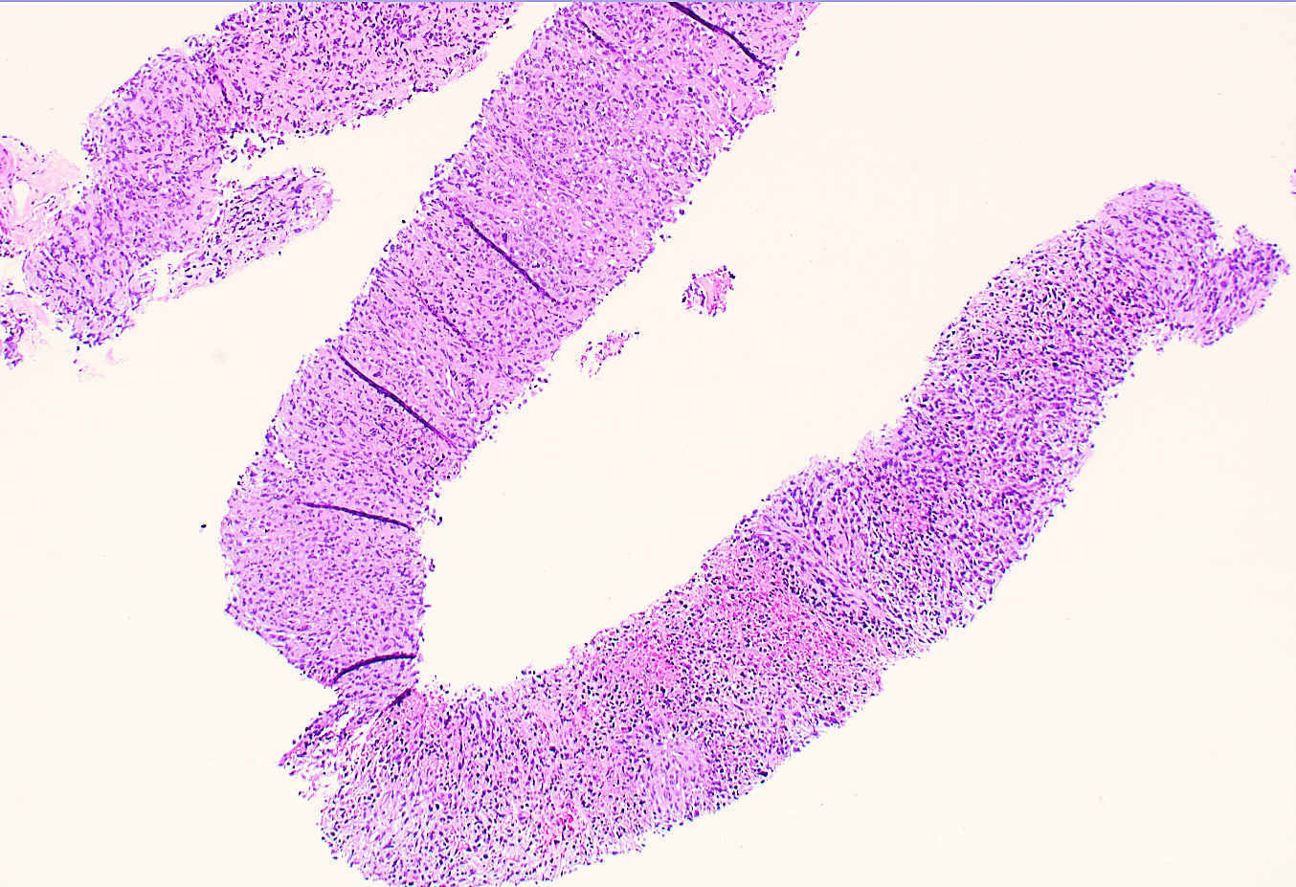
The pancreas mass biopsy (H&E,4x) shows :
Hypercellular tumor with a small amount of stroma
Predominantly sarcomatoid pattern with pleomorphic undifferentiated tumor cells
Areas with focal rhabdoid features and absence of osteoclastic giant cells

Slide 4
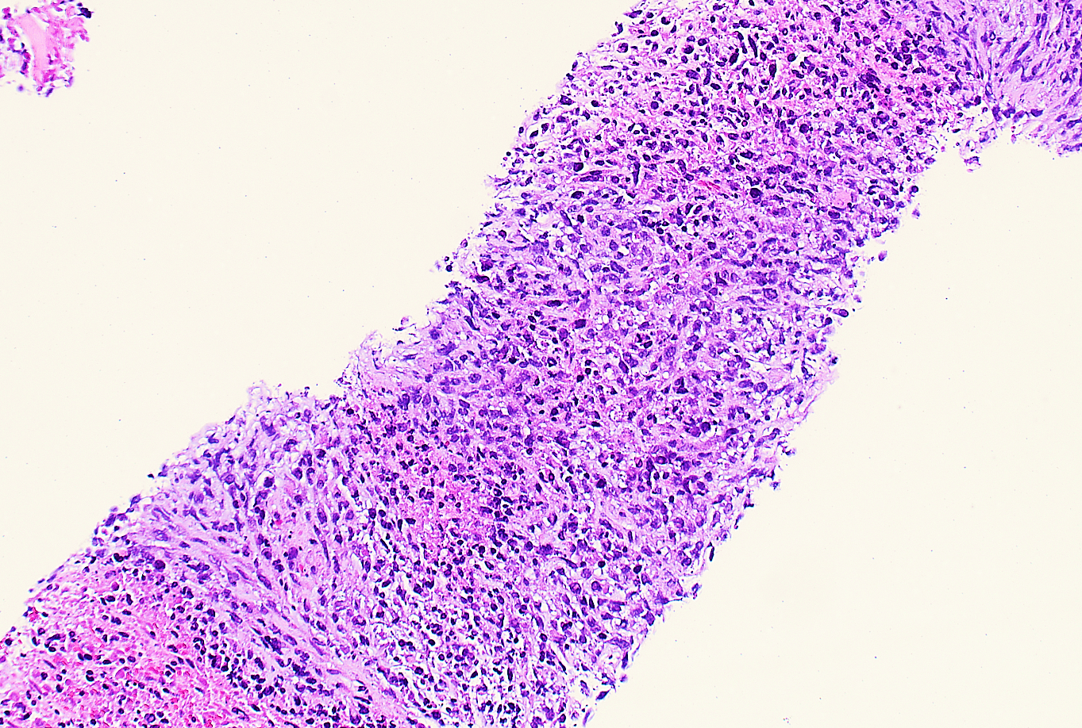
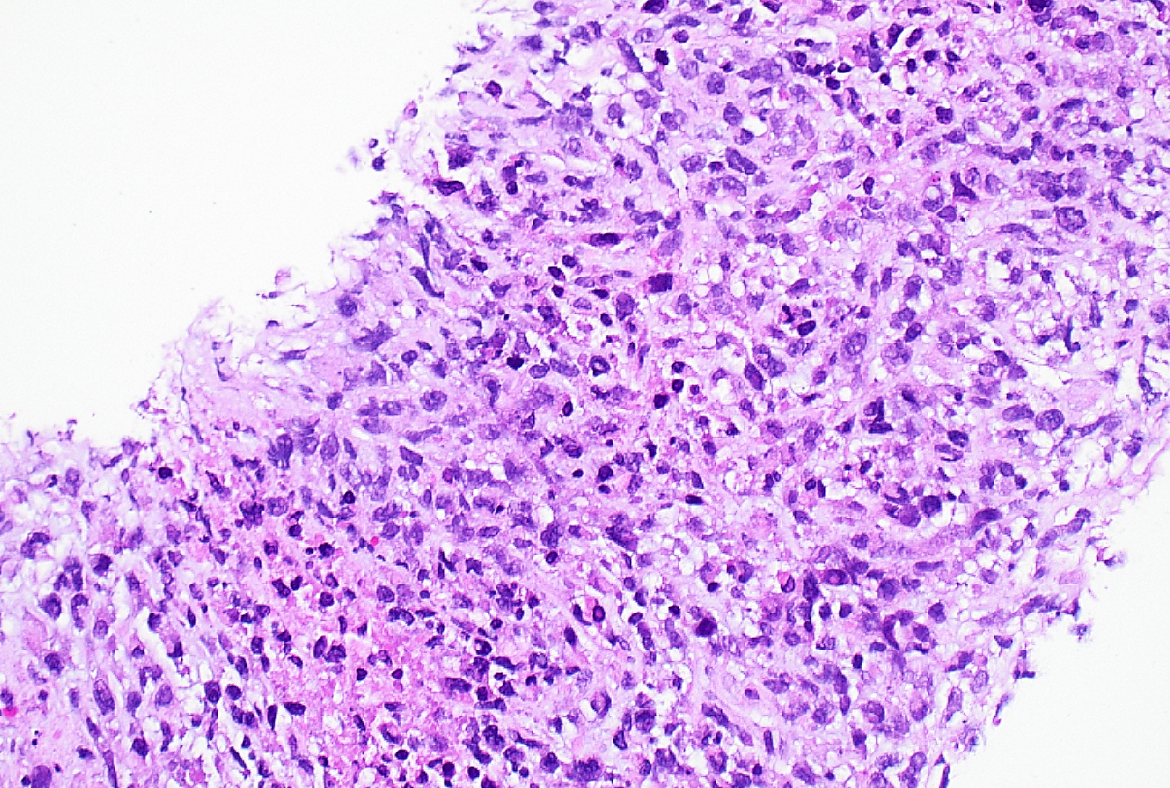
The pancreas mass biopsy (H&E,10x & 20x) shows an undifferentiated tumor with extensive necrosis and high mitotic activity

Slide 5
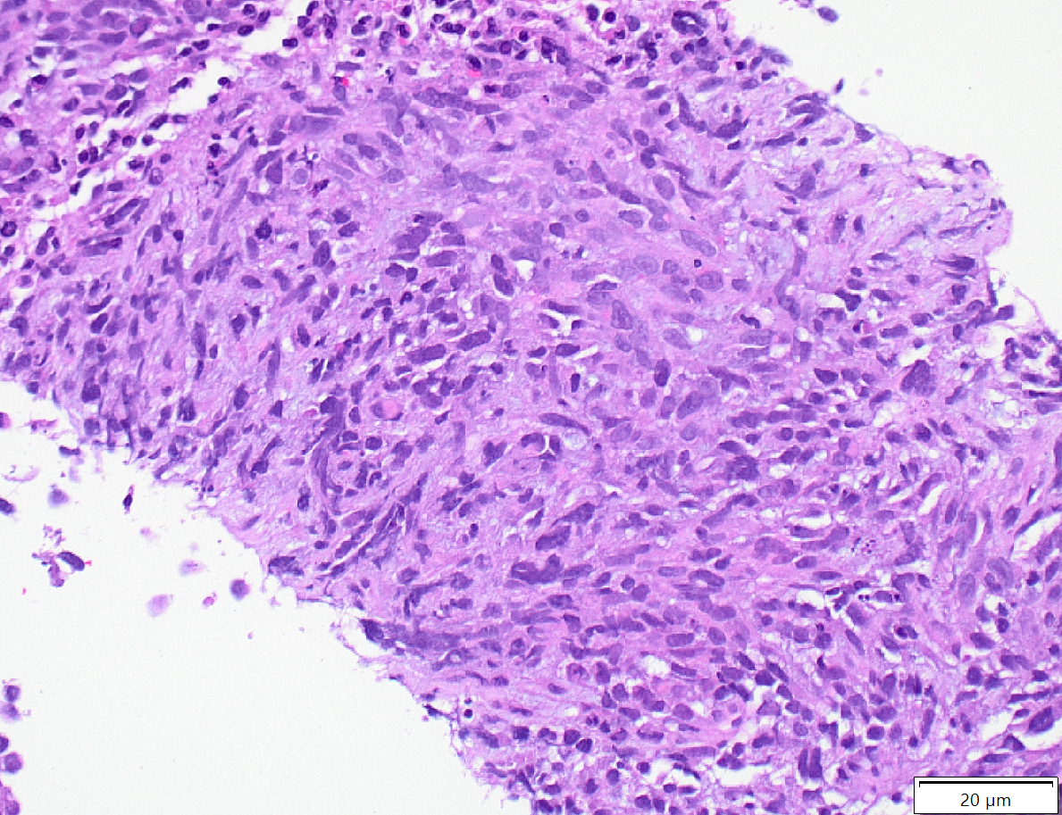
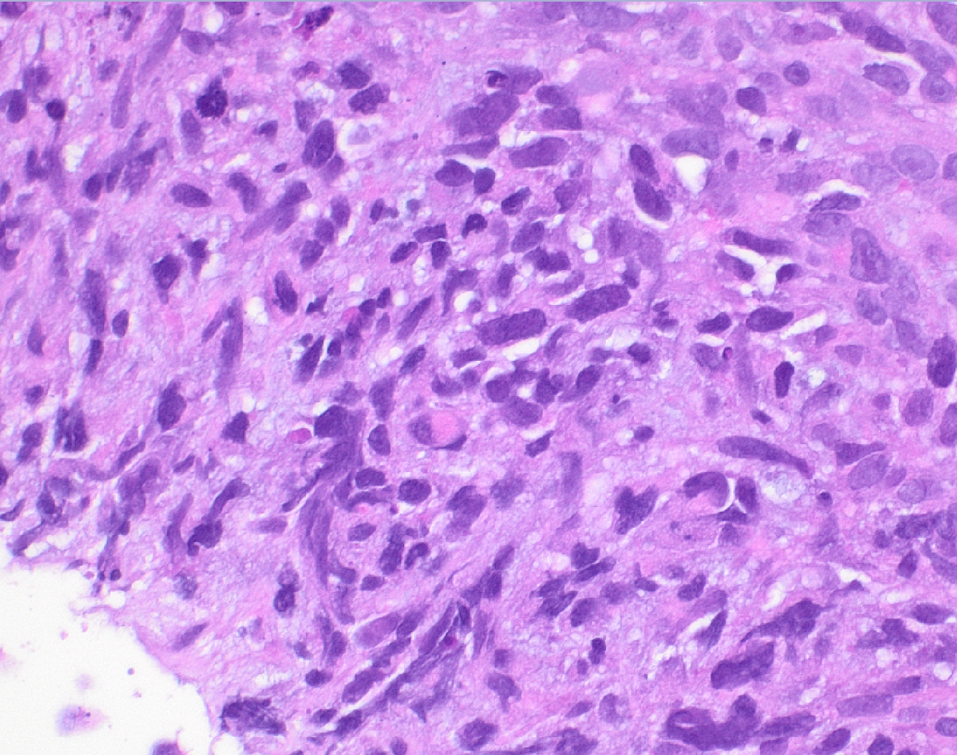
The pancreas mass biopsy (H&E,20x & 40x) shows tumor cells with focal
rhabdoid morphology (arrow)

Slide 6
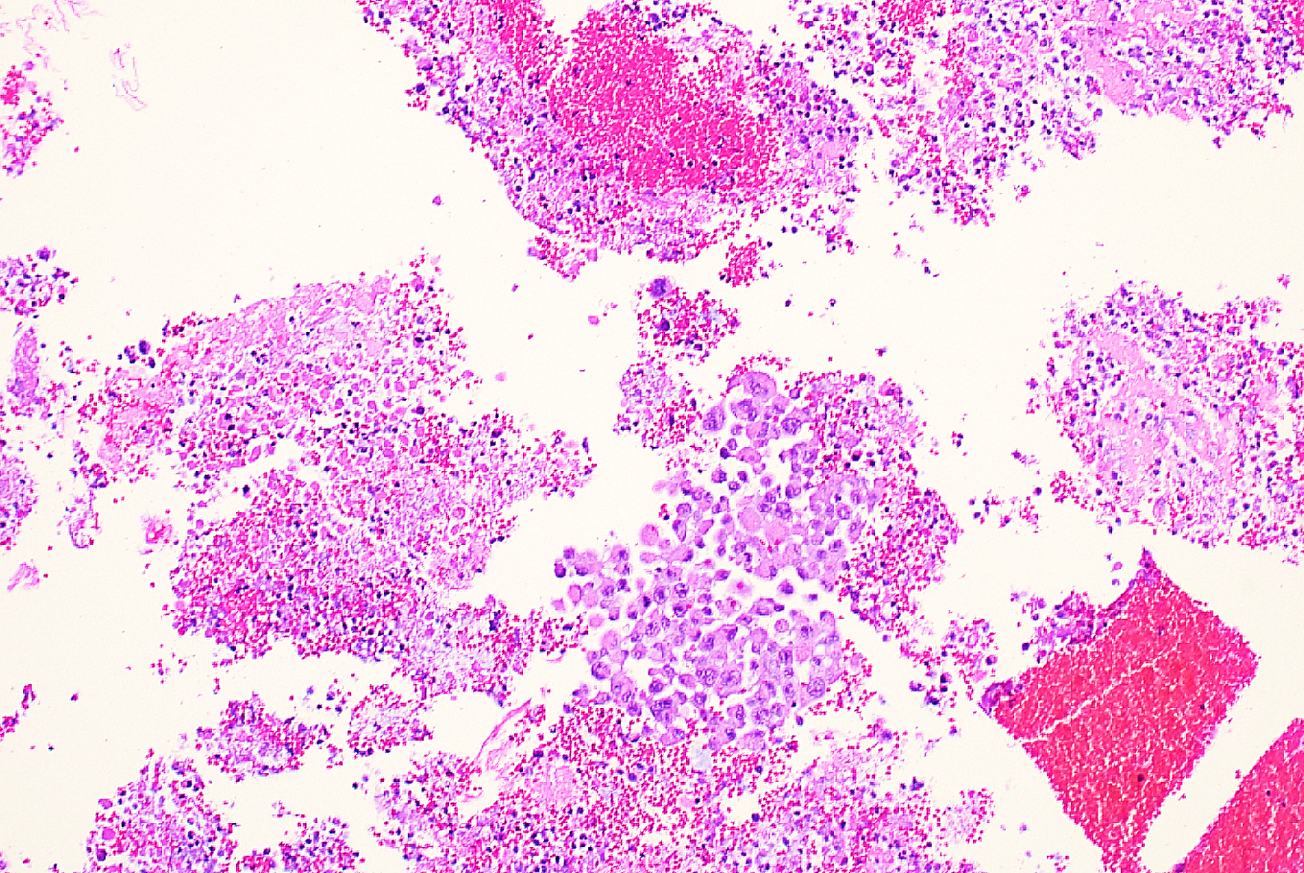
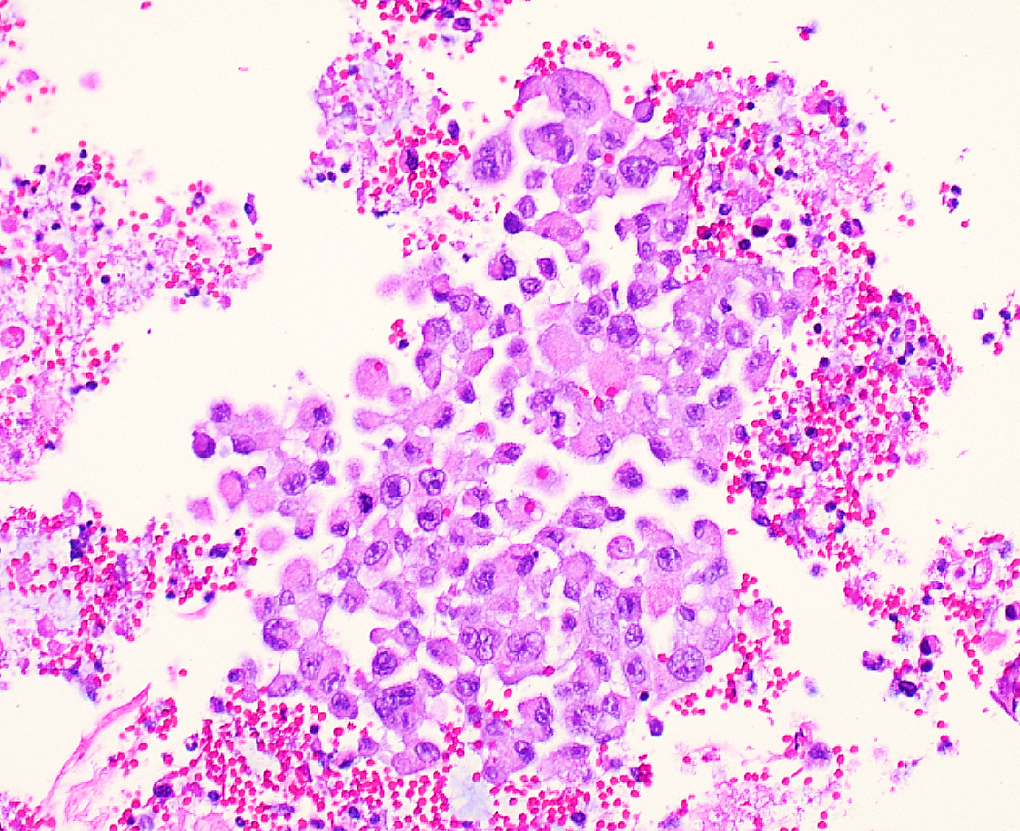
The liver mass biopsy (H&E,20x & 40x) shows tumor cells with rhabdoid features

Slide 7
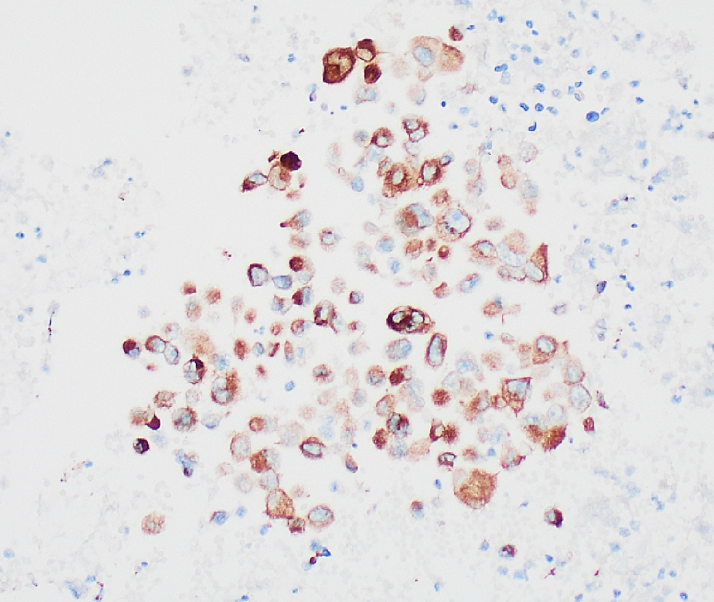
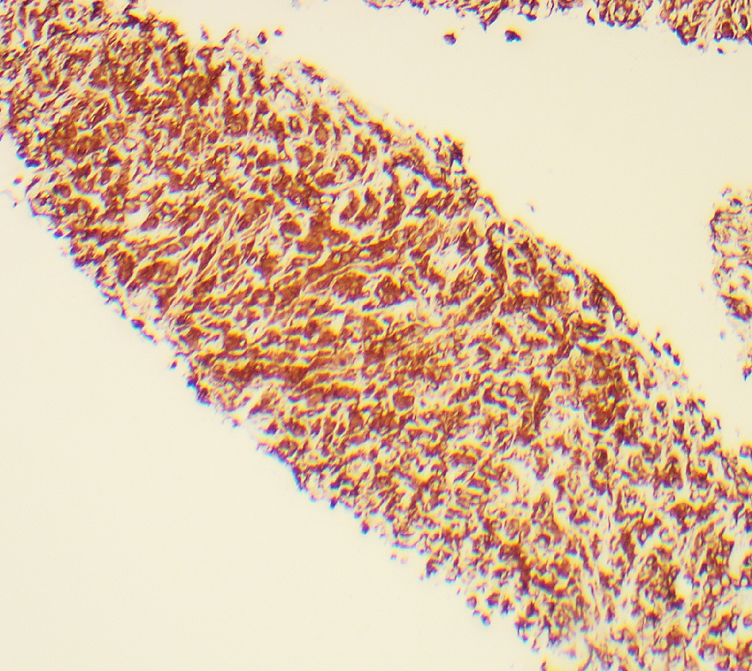
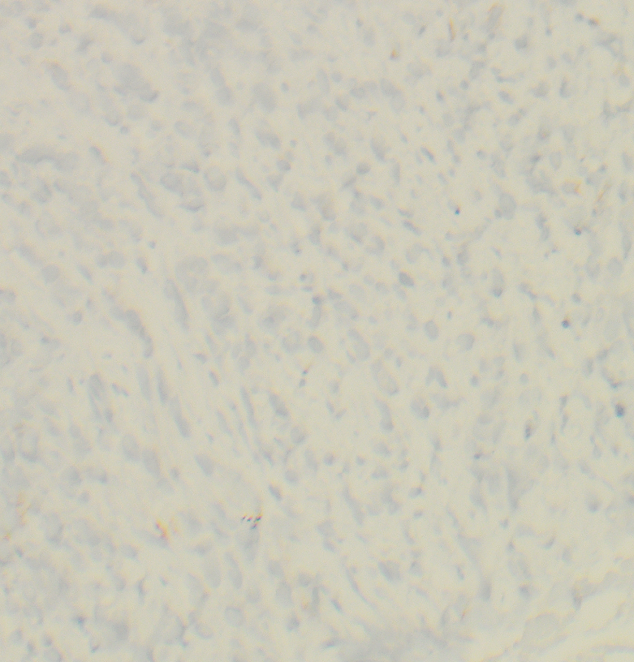
Cam 5.2,20x
Vimentin,10x
E-cadherin,20x
Pancreas mass biopsy shows tumor cells are diffusely positive for CAM5.2 and vimentin.
E-cadherin is lost.

Slide 8
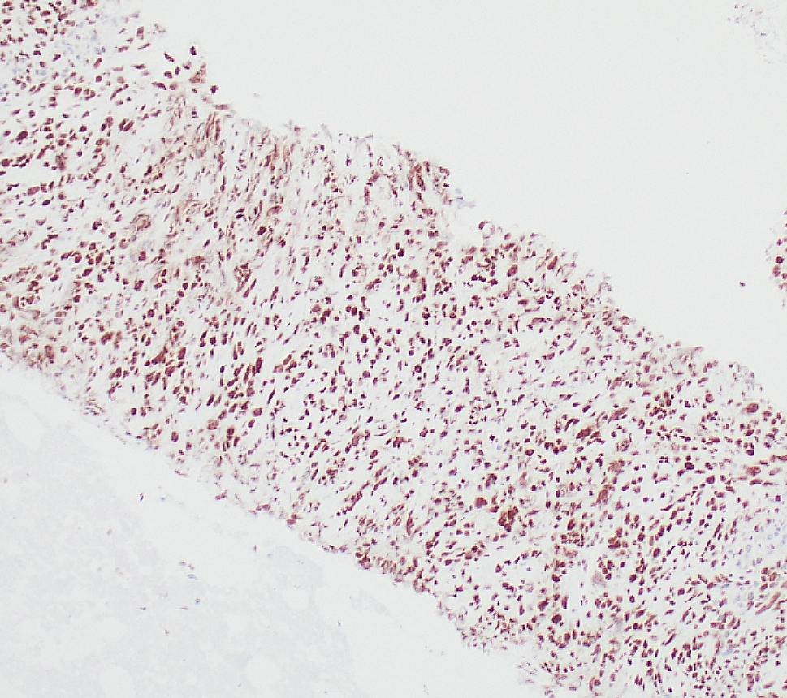
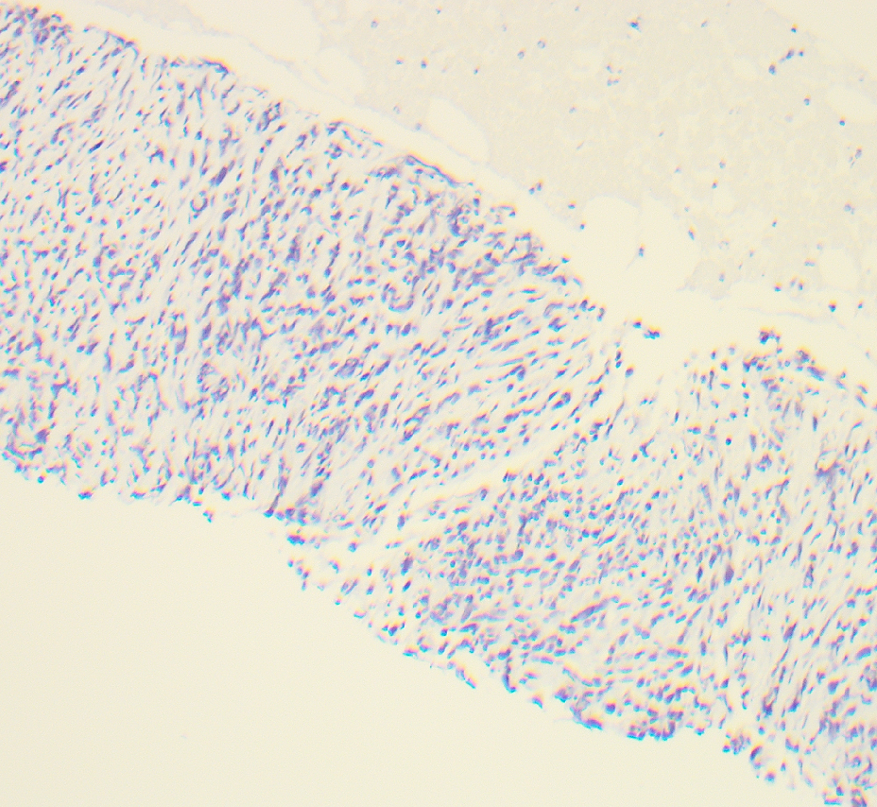
INI1, 10x
BRG-1, 10x
Pancreas mass biopsy shows tumor cells with retained INI1 and loss of BRG-1 expression

