Slide 1
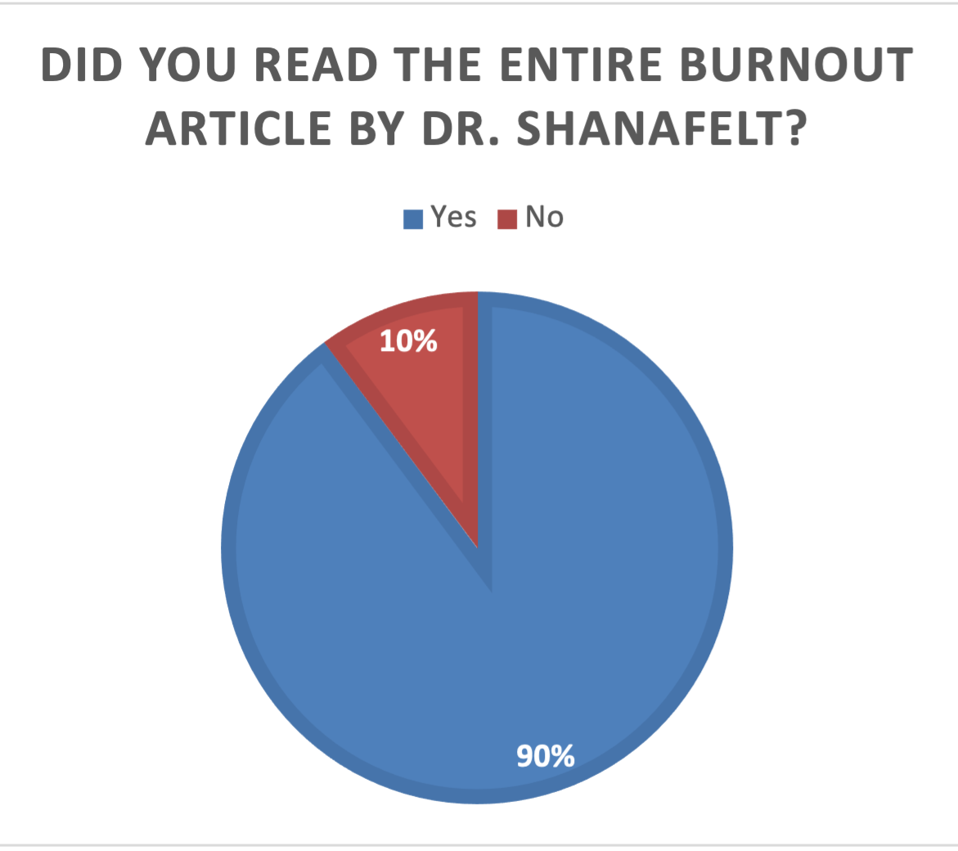
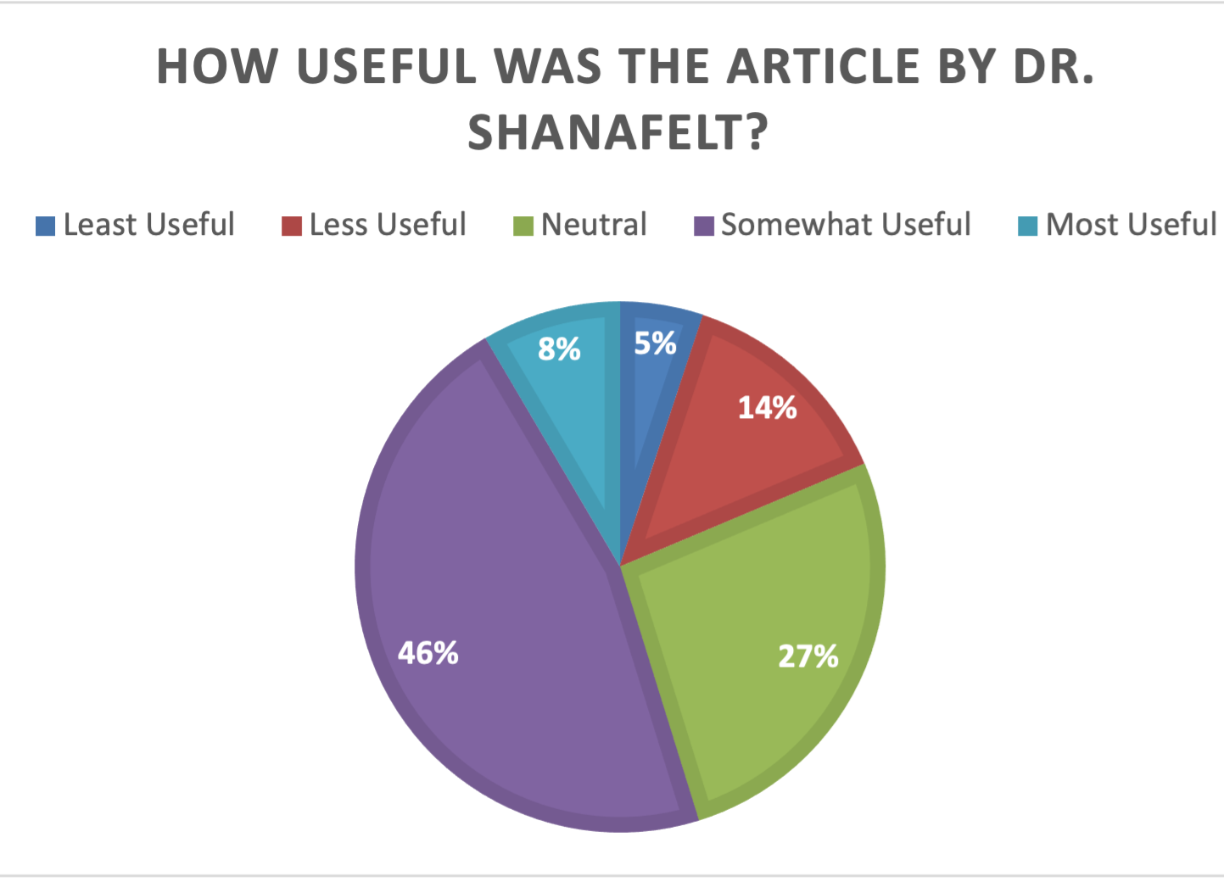
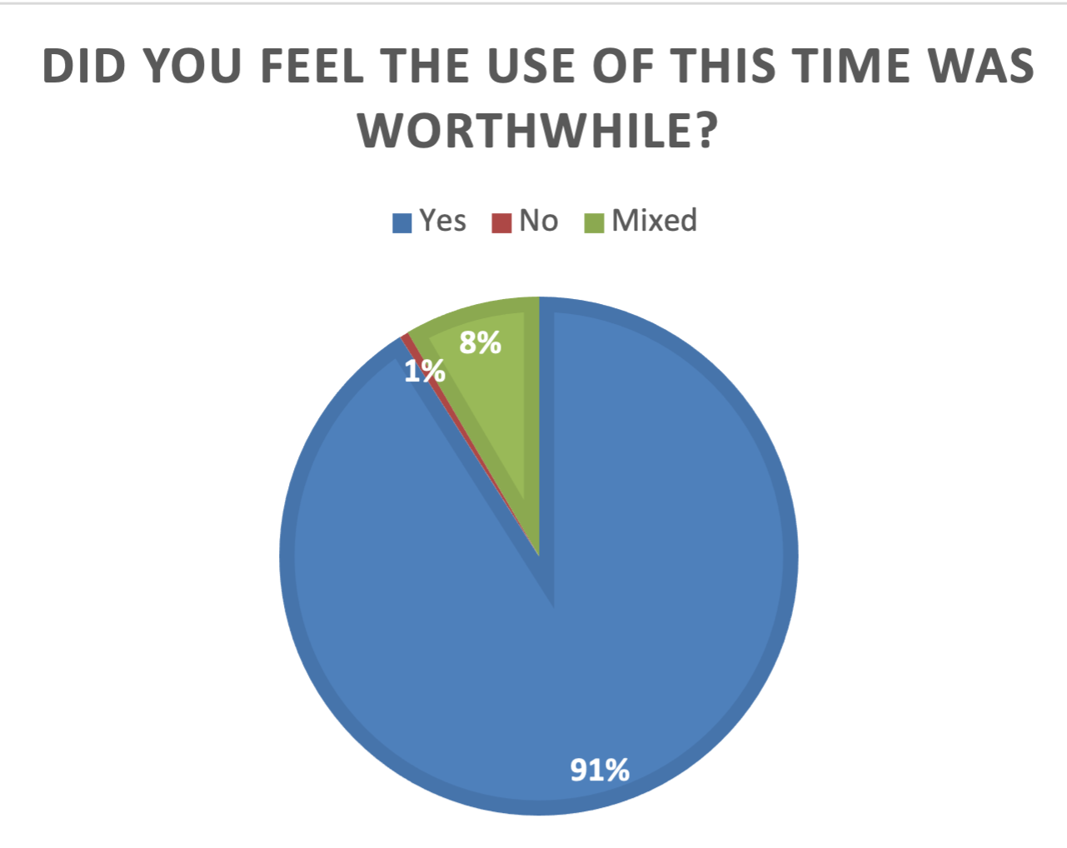
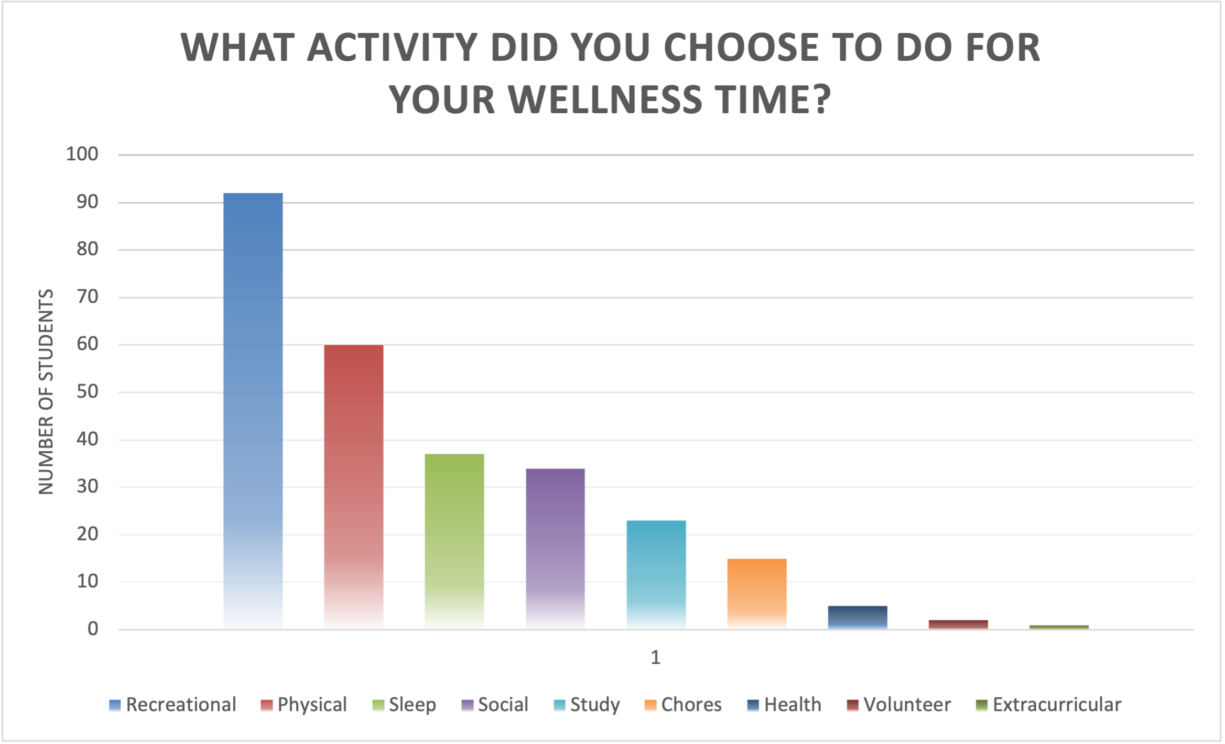
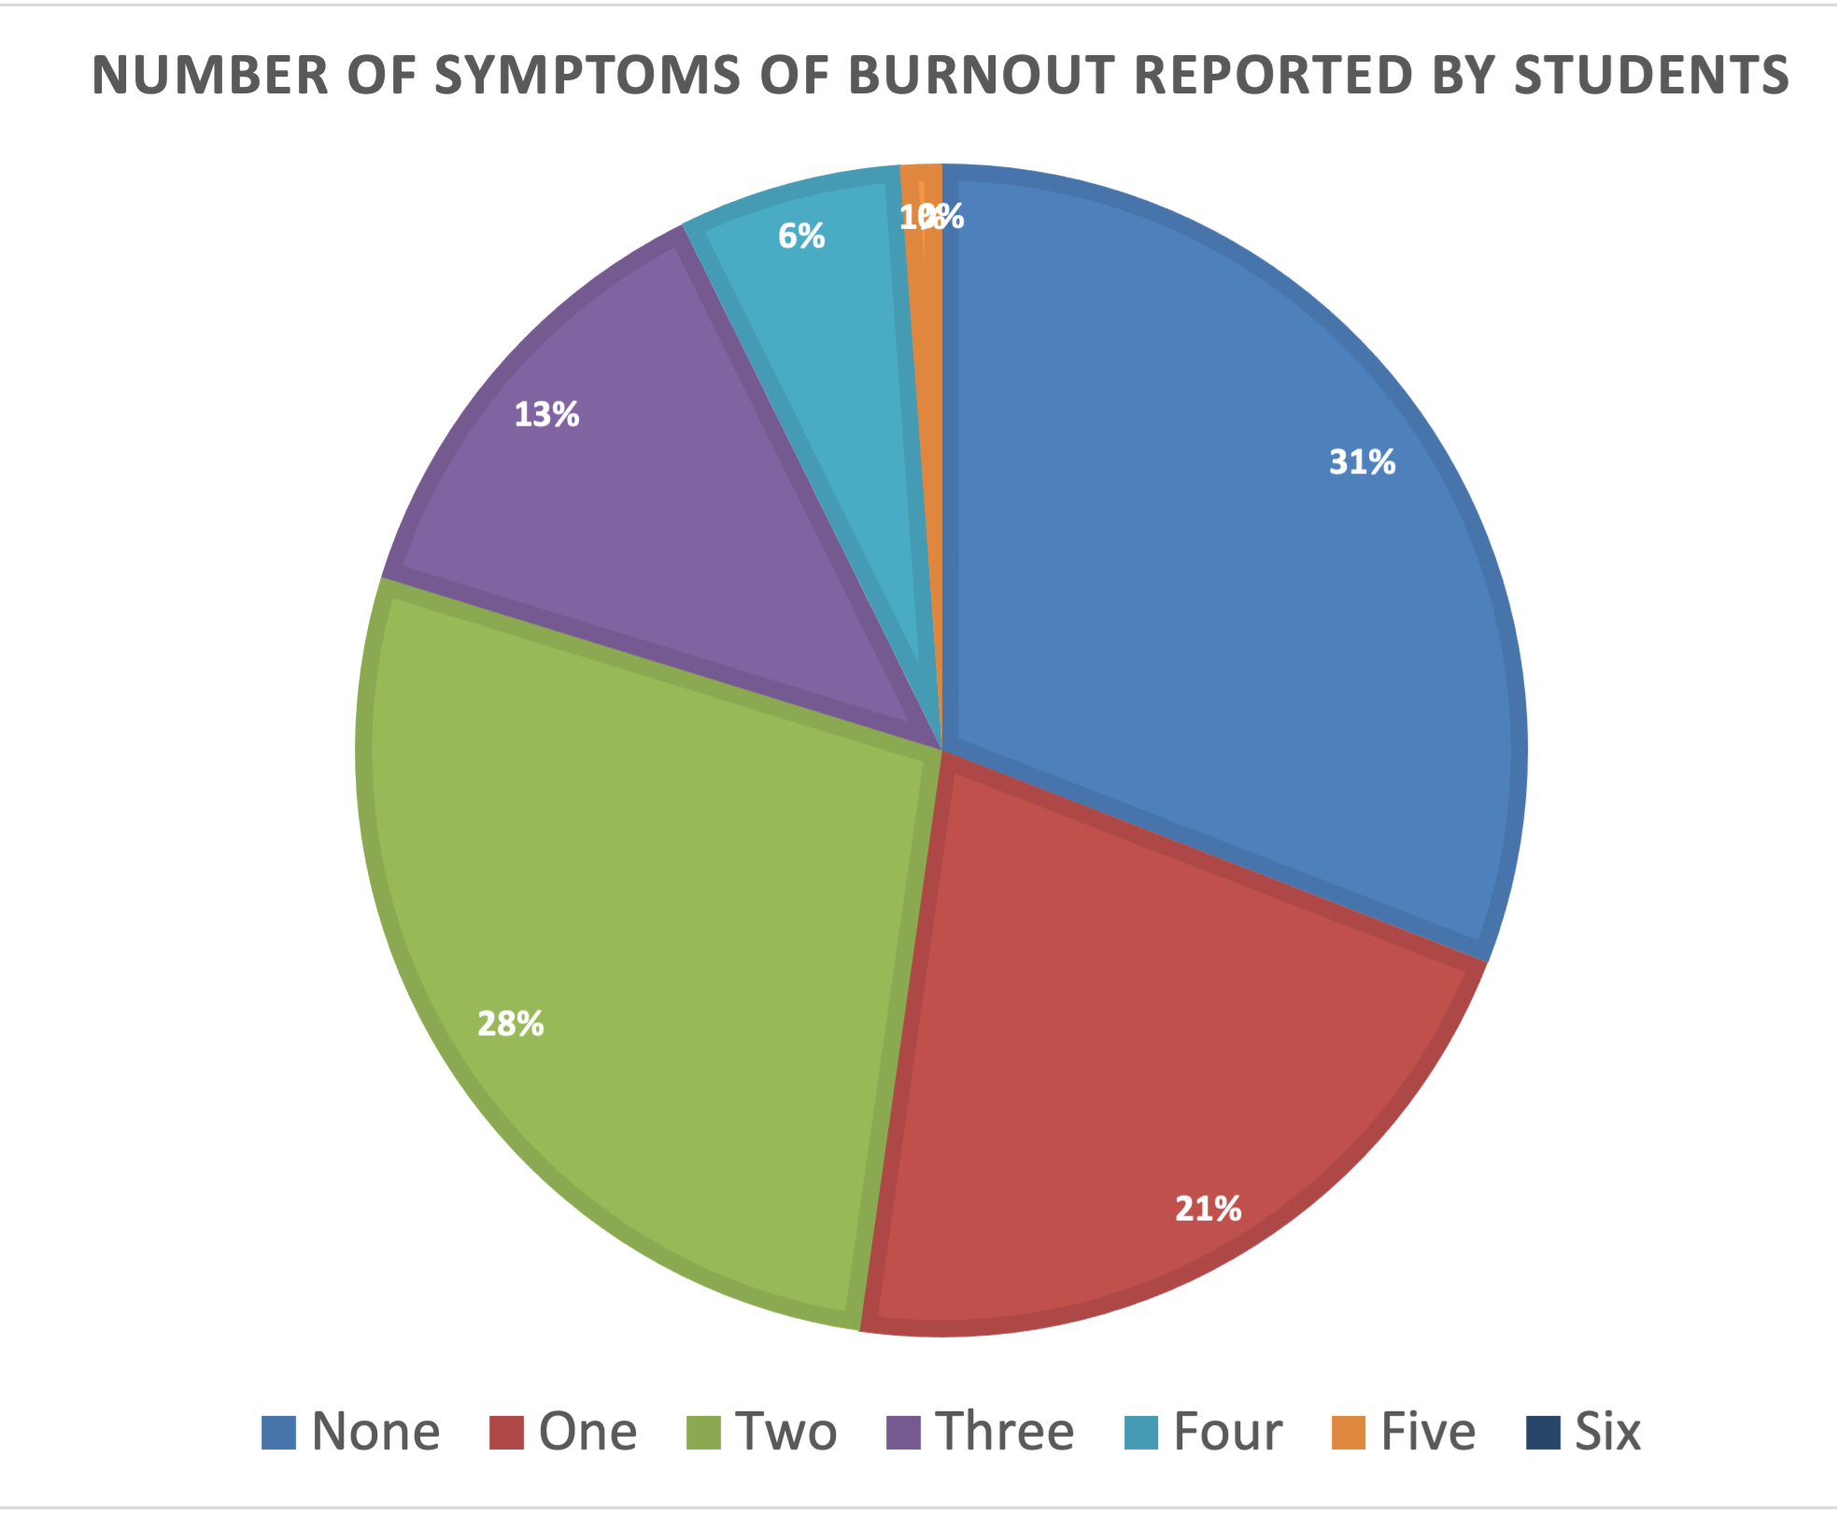
Pilot Study of a Wellness Initiative in the
Internal Medicine Core Clerkship
Alyssa Kahl MD, Lindsey Gay MD, Andrew Caruso MD
Baylor College of Medicine, Department of Internal Medicine
Background
Results
Medical students consistently show higher prevalence of depression than their non-medical student peers and a higher prevalence of suicidal ideation
Medical schools have responded largely by improving access to mental health resources, decreasing stigma, and implementing wellness programs typically under the umbrella of student affairs
Still, we found little evidence of structural changes to the high stress clinical core rotations and believe that change may be needed to improve some of the systematic problems causing medical student stress
Figure 1. Students were asked if they completed the assigned reading on burnout, 90% reported completing it.
Figure 2. Students were asked how useful the reading was, 54% felt it was useful.
Figure 3. Students were asked if they felt the time given for their free half-day was worthwhile.
Objectives
We sought to assess burnout and promote wellness awareness in medical students in their internal medicine core clerkship
Methods
Medical students completed a questionnaire after a wellness exercise during the second week of their internal medicine core clerkship
The exercise included a reading on burnout and a dedicated free half-day they could spend however they chose
The anonymous questionnaire was piloted with 178 core clerkship students during 2021 and included open-ended response and a modified wellness inventory
Figure 4. Students were asked how they spent their dedicated free time. Top responses included recreational activities (such as reading, painting, or cooking), followed by physical activity, sleep, and spending time with family or friends.
Figure 5. Students were asked a modified wellness inventory of 6 items, 69% of students reported at least one symptom of burnout.
Conclusions and Future Directions
Symptoms of burnout are common amongst medical students at Baylor and there may be some benefit to instituting structural changes within course curriculum to limit the systematic problems that lead to burnout
We are currently undergoing a second iteration of the structured wellness initiative that includes biweekly activities and questionnaires to longitudinally follow students during their rotation for improved assessment of our curriculum
References:
Rotenstein, Lisa S., et al. "Prevalence of depression, depressive symptoms, and suicidal ideation among medical students: a systematic review and meta-analysis." Jama 316.21 (2016): 2214-2236.
Dyrbye, Liselotte N., Matthew R. Thomas, and Tait D. Shanafelt. "Systematic review of depression, anxiety, and other indicators of psychological distress among US and Canadian medical students." Academic medicine 81.4 (2006): 354-373.
Shanafelt, Tait D. "Physician well-being 2.0: where are we and where are we going?." Mayo Clinic Proceedings. Vol. 96. No. 10. Elsevier, 2021.
Slavin, Stuart J., Debra L. Schindler, and John T. Chibnall. "Medical student mental health 3.0: improving student wellness through curricular changes." Academic Medicine 89.4 (2014): 573.

