Slide 1
Work With Purpose Understanding Physician Contracts: Is Every Word Important? Nancy Poblenz, DDS, JD Senior Counsel CommonSpirit Health November 16, 2022

Slide 2
Objectives
Understand Letter of Intent
Identify Key Provisions of Employment Contract
Learn When and What to Negotiate
Recognize Risks and Subjective Language
Understand Components of Total Compensation
Identify Different Benefits and Compensation Structures
Understand Termination and Term of Agreement

Slide 3
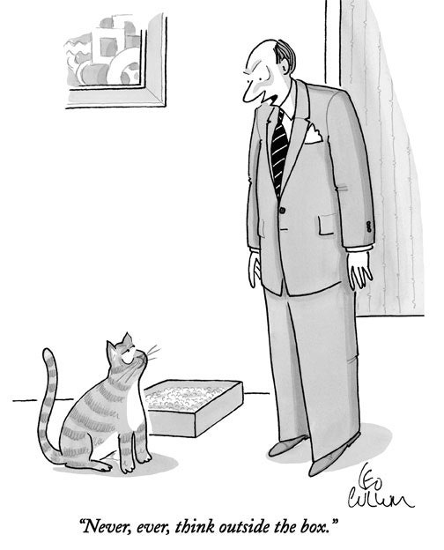

Slide 4
Interviews
Schedule multiple interviews to have options
Bring significant other to site visits
Review online information on interview skills
Consider your answers to typical questions
Bring list of questions for interviewer
Consider impact of divulging too much personal information
Child care, family planning and parenting
Family living in area

Slide 5
Difficult Interview Questions
Faced with inappropriate questions you can:
End interview
Answer – going with transparency to gauge employer’s response
Sidestep
State not comfortable answering and quickly
Redirect by asking about underlying intent such as scheduling conflicts
The following questions may appear casual but are technically unlawful for employer to ask you:
Do you have children? How many? What are their ages?
What are your childcare arrangements?
Are you single, engaged, married or divorced?
Do you have plans to start a family or add to your family?
What does your spouse/significant other do for a living?

Slide 6
Initial Discussion Points
Ask for specifics of what is expected in the professional relationship, which include salary and benefits information plus other points including:
Type of medicine being practiced, where and proposed start date.
Hours expected to work / what constitutes full time employment / schedule flexibility.
Expected availability and on call hours.
Practice membership status / partnership options.
Administrative duties required.
Which hospitals is practice affiliated with?
Does practice have business/strategic plan?
Total value of benefits package.
Term and termination.
Non solicitation/non compete/restrictive covenants.
Compensation amount and structure.
Advertising and marketing of practice.

Slide 7
The Details An Overview
Define expectations for work hours and duties:
Services, procedures, administrative duties.
What is FTE? Number of hours in patient facing capacity.
How are patients assigned/how many expected to be seen each day?
Vacation and paid time off for CME.
In high demand specialties, amount of vacation important negotiating point.
Know requirements for on call responsibilities:
Additional compensation?
Watch for subjective terms like “call arranged on fair basis” or “appropriate basis”. Must be equal!
Maximum hours each month required.
Outside activities:
Allowed to work outside the practice, including such non-patient care activities as research, publishing articles, teaching, consulting, and directorships?
Retain income from outside activities?
Indemnification terms must be reciprocal.
Intellectual property ownership:
Includes social media following.

Slide 8
Caution:
Practice always reserves the right to assign patients to its employed physicians.
Can have a significant impact on your ability to grow practice if the physicians with longer tenure are given the first opportunity to take on new patients.
Document in agreement how new patients to the practice are assigned.
Important provisions:
Employer entitled to expect adherence to various policies and procedures; be sure to specify policies and procedures must be in writing.
Common to contain fairly one-sided vague statements such as: that you will “work diligently” and use your “best efforts” in performing your duties. AVOID THESE TERMS
Review carefully any provision that employer may reserve the right to dictate to you how to perform your duties.
All statements should be tempered with the expectation of your exercise of independent medical judgment.

Slide 9
Can I Negotiate the Contract Terms?
Not everything can be negotiated but it never hurts to ask
Generally, larger corporate employers are less willing to negotiate
Never sign letter of intent prior to completing negotiations
Agree to all terms before you receive written offer
Step out of your comfort zone!
There is no “standard” physician contract; all are unique
Corporate employers generally have contract template used for physicians
Template can be changed prior to signatures
Be well informed about industry standards
Take time to consider the offer; beware of offer which has very limited response time
Define your priorities and determine deal breaker points
Money
Work life balance
Career Advancement
More one on one patient time

Slide 10
Compensation Methodologies What is best for you?
Many different models.
Consists of many factors including; salary, percentage of collections, wRVUs, bonuses, and stipends:
Fixed – set salary - usually for new physicians.
Variable – based only on physician’s performance, no set base salary.
Combination of base salary plus production, usually when exceed certain wRVUs.
Production bonus based on billings or collections.
Profit share from practice.
Stipend for APC supervision.
Additional bonus compensation for things other than patient care, such as positive outcomes, scores on patient satisfaction surveys, quality goals or participation in group governance.
Variety of surveys available to help determine if compensation competitive; evaluate industry norms.
Understand precise method for calculation of any incentive compensation.
May include repayment obligations.
Always ask questions – beware of vague answers!

Slide 11
Base Salary
Fixed amount.
Not determined by hours worked or number of patients seen.
Caution: If you are accepting a salaried job and you are expected to work 60 hours a week that could be a problem.
Make sure the compensation package matches your expectation of number of hours that are generally required each week for work.
Always:
Negotiate for salary increases annually.

Slide 12
Salary Plus
Paid set amount, lower than fixed salary.
Additional compensation for wRVUs in excess of certain threshold or certain net collection amounts.
Understand how net collections is calculated.
Beware: salary caps, discounts and adjustments.
Understand what is considered ancillary services - are these included in total?
Caution: Understand how new patients are assigned - you cannot exceed the threshold if you are not provided patients or are only assigned patients with lower capitation rates.

Slide 13
Other Salary Structures
Net Collections
Billing
Production - wRVUs only
Not recommended
for first 1-3 years of practice.

Slide 14
Summary of Salary Considerations
Evaluate Salary offer in context of:
Expected Hours, including call
Travel
Advancement
Flexibility
Culture
Restrictions (restrictive covenants
and outside work)

Slide 15
Annual Bonus Payments
Eligibility language must be objective and measureable.
Beware vague language: “Opportunities for bonuses, which shall be provided at the sole discretion of the Members of the Practice, are available twice yearly, and will be evaluated, among other factors deemed pertinent by the Members of the Practice,….” or “will be determined by the practice at its discretion”.
Always negotiate for a bonus at least annually.
Written benchmarks/targets.
Amounts:
Usually % of salary.
May be based on other factors

Slide 16
Benefits
More than just medical insurance.
Beware of vague language such as “we provide all the usual benefits”.

Slide 17
What are Benefits?
Medical Insurance
Dental Insurance
Life Insurance
Vision Insurance
Disability: Long and Short Term
Retirement: Pension and or 401k
Professional Liability Coverage
Vacation
Paid Sick Leave
Paid Family Coverage options

Slide 18
Total Compensation Includes Benefits Package and Other Payments
Funding and paid time off to complete Continuing Medical Education requirements. (generally 1 week).
Paid Time off usually 3-4 weeks annually. Are sick days counted as PTO?
Liability insurance – know limits!
Sign on bonus; retention bonus; relocation reimbursement/temporary housing; quality bonus.
Understand repayment obligation if agreement terminated.
Know what is required to qualify for the bonus (patient satisfaction? EMR completion?)
Health/dental /vision insurance / disability insurance / retirement plan. Know carrier; value/cost to practice of physician premium; cost of family premium; deductibles and co-pays. Practice pays for physician coverage. What about family?
Short and long term disabiltity; know amounts (% of salary) and when it is effective. Paid by practice
Don’t forget Savings, 401k and pension/retirement plans. Know vesting and practice contribution amounts annually.
Stipends as reimbursement for travel expenses, fuel, cellular telephone (understand the tax implications).
Life Insurance At least one full year of salary in coverage; ask for two. Paid by practice.
Payment of your licensing fees and dues to professional societies.

Slide 19
Vacation/Paid Time Off
How much paid vacation time annually?
(15-20 working days is the norm).
When do days vest?
Paid if leave practice?
Do all unused vacation days roll over to the
next year?
How many sick days paid per year?
(5 days is the norm).
What are the paid holidays?
Do I receive additional paid days for CME?
(5 days is the norm).

Slide 20
Benefits: Other Considerations
Evaluate benefits in addition to salary, because a good package can make up for a lesser salary if you're saving substantial money on health care and have a large amount of vacation time or a flexible schedule.
On the flip side, consider how much a poor benefits package can cost you; paying a lot out-of-pocket for high premiums, deductibles, co-pays and family premiums can take a big chunk out of your salary.

Slide 21
One Time Costs Can Be Significant Negotiate for Reimbursement
Special instruments or supplies
Initial marketing
Website
Signage
Printing (such as business cards
and brochures)
Medical Staff privilege fees
Office computer equipment
EMR license fees

Slide 22
Perks are Negotiable
Lab coats plus cleaning costs
Scrubs
Personal Laptop/Tablet
Cellular telephone and plan costs
Mileage reimbursement
Stipend for personal vehicle use
CME costs plus expenses for travel and hotel
(beware of limits)
Licensure, professional dues, memberships
Corporate account for meeting clients/marketing

