Slide 1
Total Compensation Includes Benefits Package and Other Payments
Funding and paid time off to complete Continuing Medical Education requirements. (generally 1 week).
Paid Time off usually 3-4 weeks annually. Are sick days counted as PTO?
Liability insurance – know limits!
Sign on bonus; retention bonus; relocation reimbursement/temporary housing; quality bonus.
Understand repayment obligation if agreement terminated.
Know what is required to qualify for the bonus (patient satisfaction? EMR completion?)
Health/dental /vision insurance / disability insurance / retirement plan. Know carrier; value/cost to practice of physician premium; cost of family premium; deductibles and co-pays. Practice pays for physician coverage. What about family?
Short and long term disabiltity; know amounts (% of salary) and when it is effective. Paid by practice
Don’t forget Savings, 401k and pension/retirement plans. Know vesting and practice contribution amounts annually.
Stipends as reimbursement for travel expenses, fuel, cellular telephone (understand the tax implications).
Life Insurance At least one full year of salary in coverage; ask for two. Paid by practice.
Payment of your licensing fees and dues to professional societies.

Slide 2
Vacation/Paid Time Off
How much paid vacation time annually?
(15-20 working days is the norm).
When do days vest?
Paid if leave practice?
Do all unused vacation days roll over to the
next year?
How many sick days paid per year?
(5 days is the norm).
What are the paid holidays?
Do I receive additional paid days for CME?
(5 days is the norm).

Slide 3
Benefits: Other Considerations
Evaluate benefits in addition to salary, because a good package can make up for a lesser salary if you're saving substantial money on health care and have a large amount of vacation time or a flexible schedule.
On the flip side, consider how much a poor benefits package can cost you; paying a lot out-of-pocket for high premiums, deductibles, co-pays and family premiums can take a big chunk out of your salary.

Slide 4
One Time Costs Can Be Significant Negotiate for Reimbursement
Special instruments or supplies
Initial marketing
Website
Signage
Printing (such as business cards
and brochures)
Medical Staff privilege fees
Office computer equipment
EMR license fees

Slide 5
Other Costs and Expenses are Negotiable
Lab coats plus cleaning costs
Scrubs
Personal Laptop/Tablet
Cellular telephone and plan costs
Mileage reimbursement to clinic sites
Stipend for personal vehicle use
CME costs plus expenses for travel and hotel
(beware of limits)
Licensure, professional dues, memberships
Corporate account for meeting clients/marketing

Slide 6
Other compensation
Student loan payments (may be seen in recruitment agreements)
Signing Bonus
Moving Expenses
Temporary Housing
Paid medical coverage for dependents
Matching 401k contributions

Slide 7
Negotiate to Retain Income from Other Sources
Call coverage
Hospital medical director duties
AP supervision
Hospital committee membership
Beware of language such as: “All fees received for professional services including, without limitation, honorarium, consultant fees, research studies and patient care rendered by Physician, whether billed by the Physician or by the Practice and whether received by Physician or by the Practice, shall be owned by the Practice”.

Slide 8
Income Guarantee or Recruitment Agreement:
Paid by Hospital as loan to physician or private practice group and physician
Contract between hospital, practice and physician
Inducement to attract physician to community
Signed after employment agreement with physician practice
Terms generally 1/3: a 1 year loan requires an additional 3 years in community for forgiveness
If leave area before loan forgiven, must pay the loan back to the Hospital
You will be sued by Hospital if you default
Never sign without healthcare attorney review and consultation

Slide 9
Path to Ownership / “Partnership”
Key negotiating point.
High demand specialties usually quicker path.
May be automatic after certain number of years.
Watch for subjective terms like “meeting expectations of group”.
Actual terms of the ownership buy-in will be stipulated in separate “buy-sell” and/or “partnership” agreements, usually not signed until ownership takes place in subsequent years.
BE SURE any implied ownership options or assurances discussed during the original employment negotiations are clearly spelled out in the written employment contract.

Slide 10
Non Compete/Restrictive Covenants
To prevent physicians from taking patients with them to a new practice.
Cannot go to work for competitors during a specific period of time or cannot.
practice within a 10-, 20- or 30- mile radius of the employer for a certain number of years.
Impairs freedom to change jobs!
Not legal in 6 states (CA, MN, NE, NY, ND, OK) In other states, are only legal so long as is deemed to be ”reasonable”.
Details will differ based on specialty; for example, a neurosurgeon will be subject to a much wider geographic restriction than will a family practitioner because neurosurgery is a more specialized practice.
Cannot have non compete in employment agreement if there is recruitment agreement with hospital.
A “non-solicitation” clause prohibits the departing physician from actively seeking to attract patients, employees, and health plan contracts away from the former practice.
If you have non compete, negotiate to limit scope and duration.
Some states (Texas) require buyout provision.
Understand the buyout provision.
Usually total gross compensation for last 12 months.

Slide 11
Repayment Obligations
Carefully review narrative in Compensation section.
Watch for language such as:
“You agree….may deduct from any compensation due to you, including from your final paycheck any amounts you owe including….for repayment obligations under loans, sign on or retention bonus, cost of lost or damaged equipment or materials, ….or any other lawful purpose permitted by law”.

Slide 12
In Summary: Understand Restrictions
Fees
Practice owns all fees generated.
Agreement only allows work for employer.
Practice retains payments for related medical service such as speaking honoraria, medical director fees.
Must refer inpatient and outpatient healthcare per employer policy.
Assignment to employer of all rights to bill and receive payments for services.
Payment Retention
Referrals
Payments

Slide 13
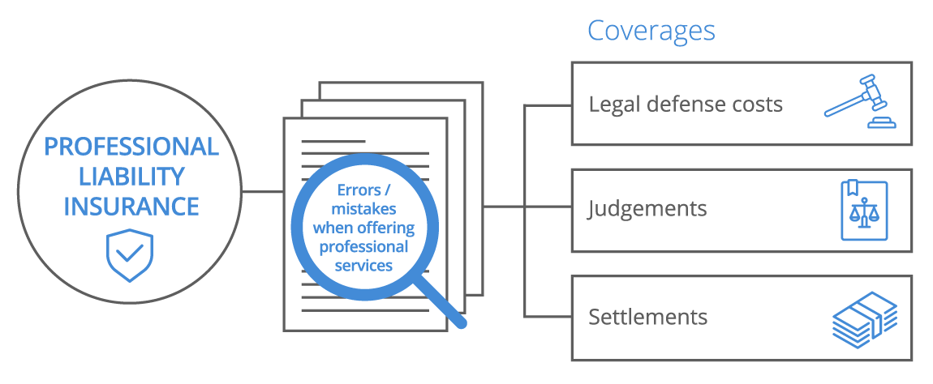
Professional Liability Insurance
Understand type of coverage:
Occurrence or claims made
Occurrence means claims arising from patient care on behalf of employer during policy are covered no matter when reported
Is paid tail coverage provided for claims made policies after termination?
What are the limits of coverage?
Know annual and aggregate limits
Recommend minimum $1 million/$3 million coverage
Watch for Vague Language: “The Practice shall maintain professional malpractice liability insurance from a commercial carrier covering the Physician and the Practice against claims arising out of the performance of this Agreement’s professional medical services in the minimum amounts required by law…”,

Slide 14
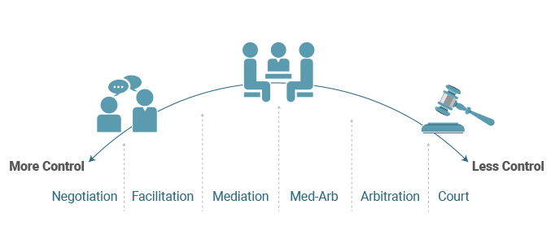
Conflict Resolution
Understand mandatory mediation and/or arbitration provisions:
Arbitration lacks formal evidence process.
“All conflicts must be resolved through arbitration”
Decision of an arbitrator and is binding – no appeal!
Arbitrator may be biased or not understand healthcare issues.
Mandatory provision is generally enforceable
Often more favorable to employer/practice
Determine if you want to waive right to a jury trial.
Be aware: Binding Arbitration is not always the simplest, quickest or least costly solution – may be MORE costly than litigation!

Slide 15
Term and Termination
Term of employment is usually one year, with renewal provisions.
Contract should make absolutely clear under what circumstances you may be terminated.
Generally, two types of provisions relating to termination: with cause and without cause.
With cause termination:
The employer has to provide clear reasons for ending employment; typically includes loss of hospital or prescribing privileges and inappropriate conduct.
Terms need to be specific! “Inability to meet patient needs," is a subjective phrase that can be open to wide variety of different interpretations.
In Employer’s “reasonable judgment” is also subjective, require more specificity.
Usually immediate.
Should include opportunity to cure (notice of violation and time to remedy).
Without cause provision:
Allows the employer to terminate you for no stated reason whatsoever.
Should include severance provision.
Without cause should be reciprocal to also let the physician terminate with no stated reason, as long as written notice given.
Notice of termination given in writing from 30 to 180 days in advance.
A longer notice period is preferable from the physician's perspective, to allow a proper amount of time to find other opportunities.
What payments are due to you after termination?
Unused vacation?
Compensation based on collections?

Slide 16
And What About Taxes?
Tax planning helps hard-working physicians take advantage of all the tax deductions, tax credits and tax exemptions that Congress and the Internal Revenue Service will allow.
Understand all the tax consequences of your
compensation arrangement.
Recommendation: Do not Delay!
Hire a CPA / Tax Professional now.

Slide 17
Other thoughts…..
Everyone has a different set of personal circumstances.
What might be the perfect job for you could be an awful job for someone else.
Take the time to review the pros and cons. Making a list is always helpful.
Listen to your gut; if your inner voice is telling you not to take the job, there
just might be something there.
Keep in mind that if this isn't the right job for you, it's not the end of the world. The next offer might just be that perfect match.
It's much easier to turn down an offer than it is to leave a job that you have already started.
Ask yourself if this job excites you, if you think you'll excel at it, and whether it will advance you on your career path.

Slide 18
What is a Healthcare Attorney?
Has expertise in: Stark, Anti-Kickback, Federal False Claims, Healthcare Regulatory/Compliance, EMTALA, Physician Compensation Agreements, Physician Professional License Defense, Hospitals, ASCs, Health Systems, IRBs, Credentialing, Peer Review (review website carefully and ask questions).
It is not an attorney who represents injured patients or hospitals in medical malpractice actions.
It is not a general practice attorney who advertises handling business contracts, family law, criminal law and probate.

Slide 19
The Offer: Beware of Vague, Confusing and Ambiguous Words/Terms
Reasonable/Reasonably
Substantial/Substantially
Satisfactory
Prompt
Undue/Undue Delay
Properly
Good Faith
Material
Persistent
Recurrent
All Appropriate Measures
Fair
Closely

Slide 20
Sections from actual physician employment agreements
“Employer is entitled to adjust such salary as a result of Employee’s failure to timely and accurately complete medical records and other records with respect to services and treatment rendered to any patient seen by Employee pursuant to Section 1.10 or other failure by Employee to complete clinical notes in a timely manner that results in Employer’s inability to file an insurance claim with a patient’s insurance company or denial of an insurance claim by a patient’s insurance company”.

Slide 21
More….
“Employer shall provide medical health insurance benefits for Employee”.
“……nothing contained in this Agreement shall be construed as requiring Employer to provide Employee with a minimum patient flow, with minimum patient revenue or restrict Employer from discounting Employee's fees, charges or disproportionately allocating Employee patients with lower capitation rates”.

Slide 22
And finally….
“During the term of Physician's employment by the MEDICAL GROUP, and for a period of one (1) year thereafter, Physician shall not…….. (i) engage directly or indirectly in the practice of MEDICAL SPECIALTY or in any other business which competes or would compete with the MEDICAL GROUP in the geographic area specified as 7.5 mile radius of the MEDICAL GROUP'S primary location or become an agent, partner, member, officer, director, employee, participant, or five percent (5%) shareholder in any practice or business so competing….”
“If the relationship between the parties to this Agreement proves satisfactory, at or before the one (1) year anniversary of the agreement both parties (as determined in the sole discretion of each party to this Agreement), the MEDICAL GROUP may offer Physician an opportunity to become a shareholder-employee of the MEDICAL GROUP…..”

Slide 23
“You can only become truly accomplished at something you love. Don’t make money your goal. Instead, pursue the things you love doing, and then do them so well that people can’t take their eyes off you.”
Maya Angelou

Slide 24
Nancy.Poblenz@commonspirit.org

